Slide 1
Magnetic Materials
Reading: Chapter 14 in Kong & Shen
Outline
- Magnetization and Magnetic Susceptibility
- Ferromagnetism, Paramagnetism, Diamagnetism
- ‘Magnetic Charges’

Slide 2
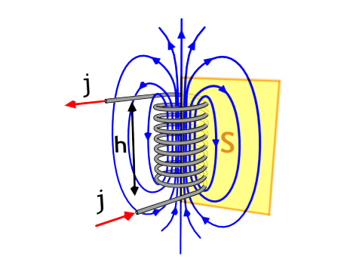

True or False?
1. For a solenoid, if we increase the number of loops N by 5% and increase the height h by 5%, then the H-field inside will not change.
NI
h
2. For a toroid, if we increase the number of loops N, but do not increase the radius, then the H-field inside stays the same.
NI
2πr
3. Lenz’s Rule states that the induced E-field drives the current in the direction to try to keep the magnetic flux constant.

Slide 3




Maxwell’s Equations
Electric Fields
Magnetic Fields
EQS
MQS

Slide 4
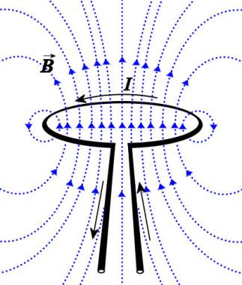
Magnetic Fields
Magnetic
Moment
magnetic monopoles do not exist
m = i a

Slide 5
Microscopic Magnets
Magnetic moment of an atom due to electron orbit…
Magnetic moment of an atom due to electron/nuclear spin…
The magnetization or net magnetic dipole moment per unit volume is given by
average magnetic dipole moment [A m²]
[A/m]
Number of dipoles per unit volume [m⁻³]

Slide 6
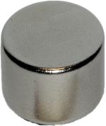
Generating Strong Magnetic Fields
Superposition with current loops…
Image in the
Public Domain

Slide 7
0.5 T Electromagnets
0.5 Tesla with current loop…
0.5 Tesla with 100 turn solenoid…
...but the wires are microscopic !

Slide 8
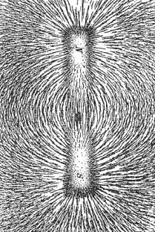
Generating Strong Magnetic Fields
Will it be “easier” to generate a 0.5-T magnetic flux density with a permanent magnet or an electromagnet ?
Image in the Public Domain
and
and

Slide 9
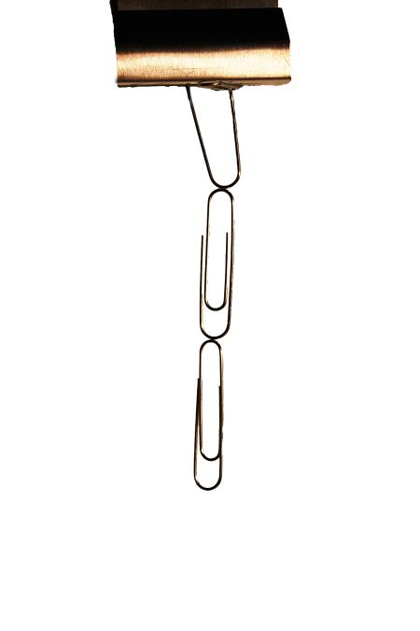
Induced Magnetization
For some materials, the net magnetic dipole moment per unit volume is proportional to the H field
units of
both M and H
are A/m.
MAGNETIC
SUSCEPTIBILITY
(dimensionless)
The effect of an applied magnetic field on a magnetic material
is to create a net magnetic dipole moment per unit volume M

Slide 10
Type of Magnetism | Susceptibility | Atomic / Magnetic Behaviour |  | Example / Susceptibility
Diamagnetism | Small negative | Atoms have no magnetic moment |  | Au Cu | -2.74x10⁻⁶ -0.77x10⁻⁶
Paramagnetism | Small positive | Randomly oriented magnetic moments |  | β-Sn Pt Mn | 0.19x10⁻⁶ 21.04x10⁻⁶ 66.10x10⁻⁶
Ferromagnetism | Large positive | Parallel aligned magnetic moments |  | Fe | ~100,000
Antiferromagnet | Small positive | Parallel and anti-parallel aligned magnetic moments |  | Cr | 3.6x10⁻⁶

Slide 11
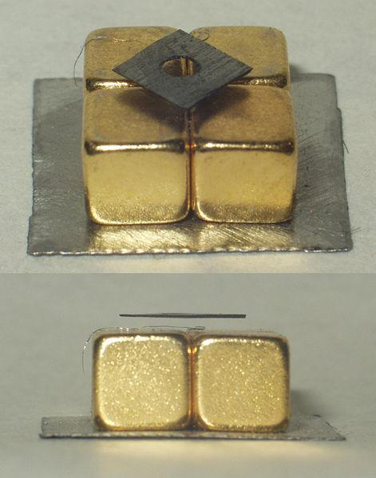
Diamagnetic Materials
Diamagnetism is the property of an object which causes it to create a magnetic field in opposition of an externally applied magnetic field, thus causing a repulsive effect. It is a form of magnetism that is only exhibited by a substance in the presence of an externally applied magnetic field. Diamagnetism is generally a quite weak effect in most materials, although superconductors exhibit a strong effect.
On Right: A small (~6mm) piece of pyrolytic graphite levitating over a permanent neodymium magnet array (5mm cubes on a piece of steel). Note that the poles of the magnets are aligned vertically and alternate (two with north facing up, and two with south facing up, diagonally)
from Wikipedia
Image in the Public Domain

Slide 12
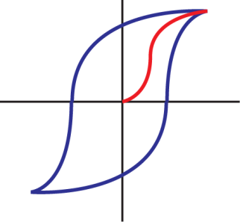
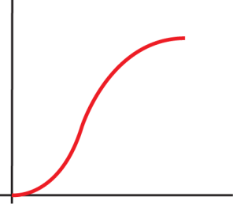






Ferromagnetic Materials
Impact that the imposition of a magnetic field H on a ferromagnetic material has on the resulting magnetic flux density B. The field causes the magnetic moments in each of the domains to begin to align. When the magnetizing force H is eliminated, the domains relax, but don’t return to their original random orientation, leaving a remanent flux B_{r} ; that is, the material becomes a “permanent magnet.” One way to demagnetize the material is to heat it to a high enough temperature (called the Curie temperature) that the domains once again take on their random orientation. For iron, the Curie temperature is 770ºC.
B,J
Initial
Magnetization
Curve
H
0
hysteresis
H
0
Slope =
BEHAVIOR OF AN INITIALLY UNMAGNETIZED MATERIAL
Domain configuration during
several stages of magnetization
Why is there a B even when H is zero ??
Why doesn’t the magnetization change sign until H_{C} ??
Notes:
Book calls it retentivity

Slide 13
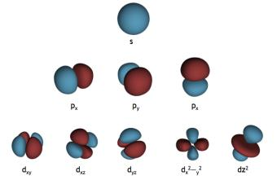
Magnetic Materials
Which has lower energy ?
Orbital 1
Orbital 2
Orbital 1
Orbital 2
Atomic Number
Element
Electronic Structure of 3d
Moment (μ_{B})
21
22
23
24
25
26
27
28
29
Sc
Ti
V
Cr
Mn
Fe
Co
Ni
Cu
1
2
3
5
5
4
3
2
0
= electron spin orientation

Slide 14
Magnetic Materials
magnetic susceptibility
1 | 2 | 3 | 4 | 5 | 6 | 7 | 8 | 9 | 10 | 11 | 12 | 13 | 14 | 15 | 16 | 17 | 18
H (-2,5) |  |  |  |  |  |  |  |  |  |  |  |  |  |  |  |  | He (-1,1)
Li 24 | Be -23 |  |  |  |  |  |  |  |  |  |  | B -19 | C -22 | N (-6,3) | O 7,9 | F | Ne (-4,0)
Na 8,1 | Mg 5,7 |  |  |  |  |  |  |  |  |  |  | Al 21 | Si -3,4 | P -23 | S -12 | Cl (-22) | Ar (-11)
K 5,7 | Ca 21 | Sc 264 | Ti 181 | V 383 | Cr 267 | Mn 828 | Fe 2,16 | Co 1,76 | Ni 0,61 | Cu -9,7 | Zn -12 | Ga -23 | Ge -7,3 | As -5,4 | Se -18 | Br -16 | Kr (-16)
Rb 4,4 | Sr 36 | Y 121 | Zr 109 | Nb 236 | Mo 119 | Tc 373 | Ru 66 | Rh 170 | Pd 783 | Ag -25 | Cd -19 | In -8,2 | Sn 2,4 | Sb -67 | Te -24 | I -22 | Xe (-24)
Cs 5,3 | Ba 6,7 | La 63 | Hf 71 | Ta 175 | W 78 | Re 96 | Os 15 | Ir 37 | Pt 264 | Au -34 | Hg -28 | Tl -36 | Pb -16 | Bi -153 | Po | At | Rn
 |  | Diamagnetic
 |  | Paramagnetic
 |  | Ferromagnetic
All values given for a temperature of 300 K
In case of ferromagnetic materials: saturation
polarization
numbers without ():
numbers with():

Slide 15
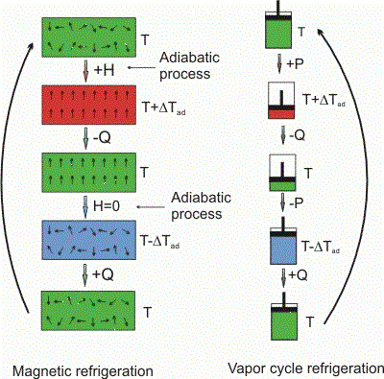
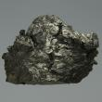
Magnetic refrigeration
N
Heat Irradiation
Magnetic Field
S
Image in the Public Domain
One of the most notable examples of the magnetocaloric effect is in the chemical element gadolinium and some of its alloys. Gadolinium's temperature is observed to increase when it enters certain magnetic fields. When it leaves the magnetic field, the temperature drops. Praseodymium alloyed with nickel (PrNi5) has such a strong magnetocaloric effect that it has allowed scientists to approach within one thousandth of a degree of absolute zero.
Gadolinium
Gd
3 to 4 K per Tesla
Image by Jurii http://commons.wikimedia.org/
wiki/File:Gadolinium-2.jpg on Wikimedia Commons
Source: Wikipedia

Slide 16

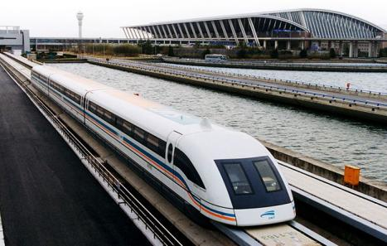
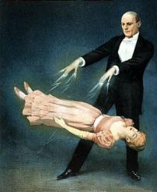
Today’s Culture Moment
Magnetic Levitation
Image in the Public Domain
Image in the Public Domain
Shanghai Maglev Train goes up to 431 km/h
S
N
S
N
S
N
N
S
S
N
N
S
N
S
N
S
Maglev Propulsion

Slide 17
Magnetic Materials
weak magnetism
strong magnetism
diamagnetism
ferromagnetism
Induced magnetic dipoles directed reverse
to the external magnetic field.
Spontaneous alignment of all permanent
magnetic dipoles within a domain in the crystal
lattice (only metals)
What kind of Magnetism is present in these materials ?
=
Ferromagnetism
=
Diamagnetism

Slide 18
Maxwell’s Equations for Magnetic Materials
Magnetic Fields
Image in the Public Domain
How do we incorporate magnetic materials in Maxwell’s Equation ?

Slide 19
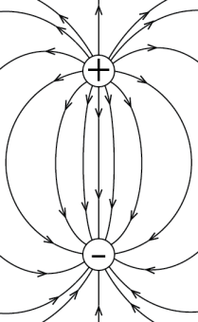
Analogy Between Magnetic and Electric Dipoles
Magnetic Fields
Electric Field
Image in the Public Domain
Magnetic
Moment
Electric Dipole
Moment
m = i a
m = q d
The H-field lines for a magnet looks
like the E-field lines for a electric dipole!

Slide 20
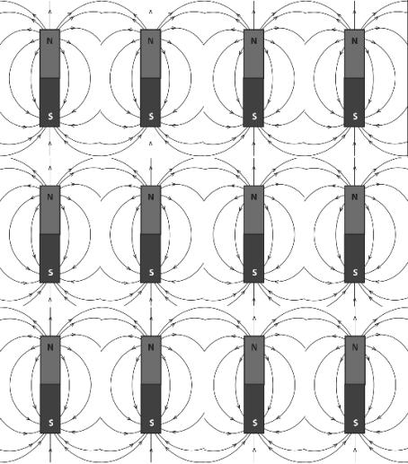
Superposition of Magnetic Moments
N
S
The field outside looks the same as a ‘magnetic charge’ dipole

Slide 21
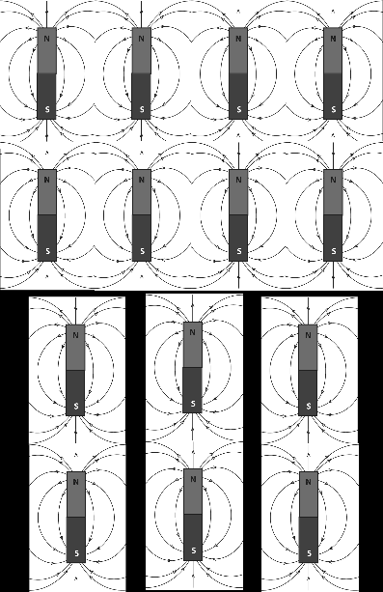
Equivalent Magnetic Charges
Going from region of high magnetization to low magnetization it appears as if there are ‘magnetic charges (monopoles)’ within the material !!
S(-)
S(-)
These ‘magnetic charges’ obey a Gauss Law…
Notes:
Use the board for this part

Slide 22
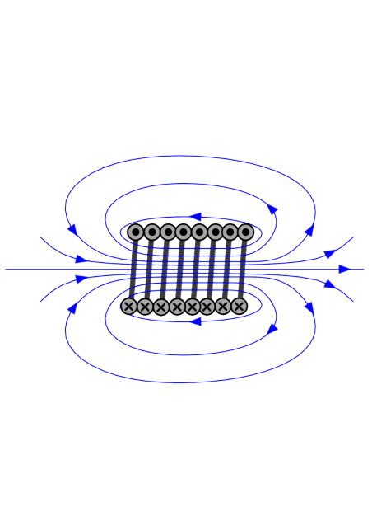
Magnetic Flux Φ [Wb] (Webers)
Magnetic Flux Density B [Wb/m²] = T (Teslas)
Magnetic Field Intensity H [Amp-turn/m]
due to macroscopic
& microscopic
due to macroscopic
currents
Magnetization M
is due to material’s
microscopic response
to magnetic field H

Slide 23
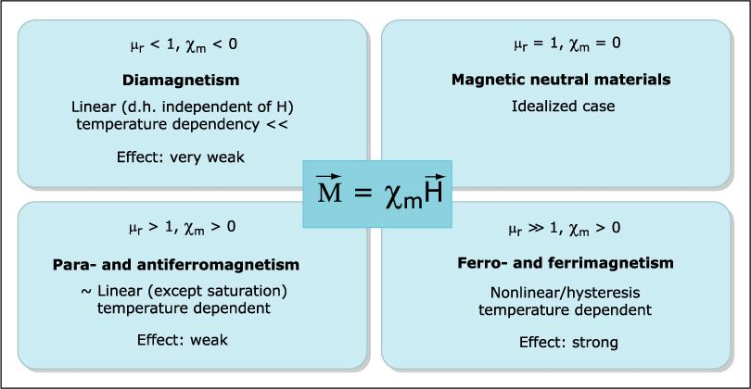
Magnetic Susceptibility and Permeability
Image by MIT OpenCourseWare.
μ_{r} = 1+χ_{m} is the relative permeability of the material
μ = μ_{ο}μ_{r} is the permeability of the material

Slide 24

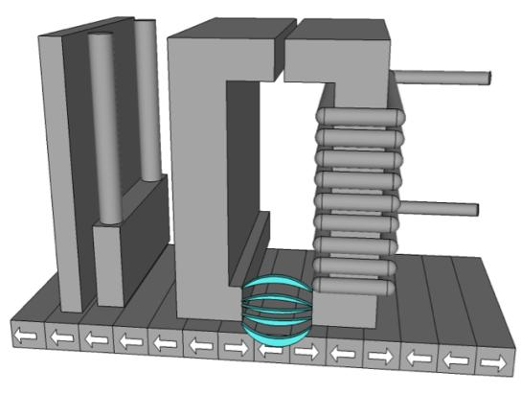
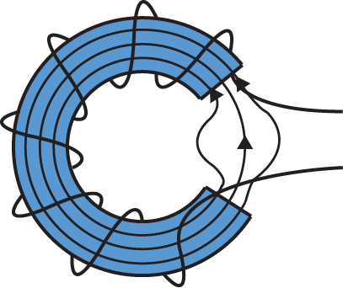
Magnetic Storage
Ring Inductive
Write Head
Shield
GMR
Read
Head
Magnetic
flux
Recording Medium
Horizontal
Magnetized Bits
Electric
current

Slide 25

Ferromagnetic Materials
B,J
Initial
Magnetization
Curve
H
0
hysteresis
H
0
Slope =
Behavior of an initially unmagnetized
material.
Domain configuration during several stages
of magnetization.
C
i
H : coercive magnetic field strength
B : remanence flux density
B : saturation flux density
r
S

Slide 26
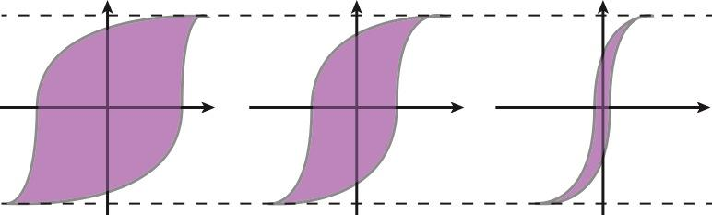
Choosing Magnetic Storage
Which material is most attractive for the storage media ?
Retains a large
fraction of the
saturation field
when driving
field removed.
Saturation
Magnetization
M
M
M
H
H
H
B_{o}
B_{o}
B_{o}
Narrow hysteresis loop implies
A small amount of dissipated
Energy in repeatedly reversing
The magnetization.

Slide 27
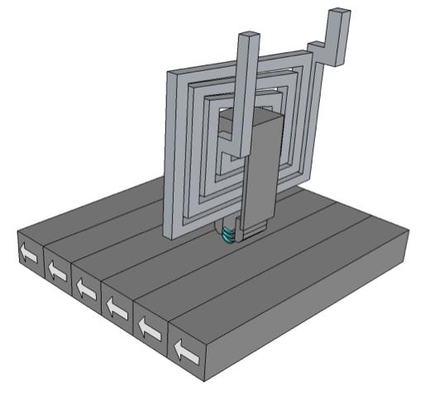
Thin Film Write Head
Recording Current
Magnetic Head Coil
Magnetic Head Core
Recording Magnetic
Field
Close-up of a hard disk head resting on a disk platter. A reflection of the head and its suspension is visible on the mirror-like disk.

Slide 28

Practical Issues with Scaling
As the magnetic domain size shrinks, the read/write head must move closer to the hard drive surface…
read/
write
head
human hair
Image in the Public Domain
smoke
particle
dust
particle
fingerprint
aluminum platter
Altitude: 1.5 mm
Lubricant: 0.15 mm
magnetic oxide
coating
Carbon overcoat: 0.5 mm
Scaled up disk
structure

Slide 29
Summary
Magnetic
Moment
m = i a
H
0

Slide 30
MIT OpenCourseWare
http://ocw.mit.edu
6.007 Electromagnetic Energy: From Motors to Lasers
Spring 2011
For information about citing these materials or our Terms of Use, visit: http://ocw.mit.edu/terms.

