Slide 1
Magnetic Circuits
Outline
Ampere’s Law Revisited
Review of Last Time: Magnetic Materials
Magnetic Circuits
Examples

Slide 2
Electric Fields
Magnetic Fields
GAUSS
GAUSS
FARADAY
AMPERE

Slide 3
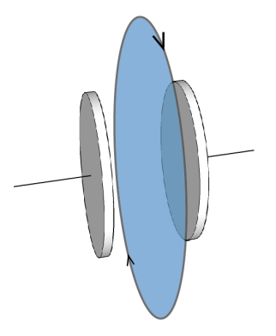
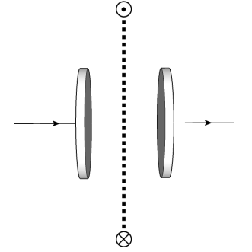
Ampere’s Law Revisited
In the case of the magnetic field we can see that ‘our old’ Ampere’s law can not be the whole story. Here is an example in which current does not gives rise to the magnetic field:
Side
View
Consider the case of charging up a capacitor C which is connected to very long wires.
The charging current is I. From the symmetry it is easy to see that an application of Ampere’s law will produce B fields which go in circles around the wire and whose magnitude is B(r) = μ_{o}I/(2πr). But there is no charge flow in the gap across the capacitor plates and according to Ampere’s law the B field in the plane parallel to the capacitor plates and going through the capacitor gap should be zero!
This seems unphysical.

Slide 4
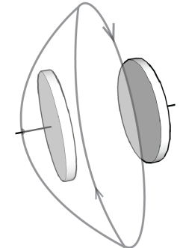
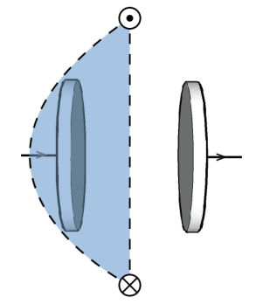
Ampere’s Law Revisited (cont.)
If instead we drew the Amperian surface as sketched below,
we would have concluded that B in non-zero !
Side
View
Maxwell resolved this problem by adding a term to the Ampere’s Law.
In equivalence to Faraday’s Law,
the changing electric field can generate the magnetic field:
COMPLETE
AMPERE’S LAW

Slide 5
Faraday’s Law and Motional emf
What is the emf over the resistor ?
In a short time Δt the bar moves a distance Δx = v*Δt, and the flux increases by ΔФ_{mag} = B (L v*Δt)
There is an increase in flux through the circuit as the bar of length L moves to the right (orthogonal to magnetic field H) at velocity, v.
from Chabay and Sherwood, Ch 22

Slide 6
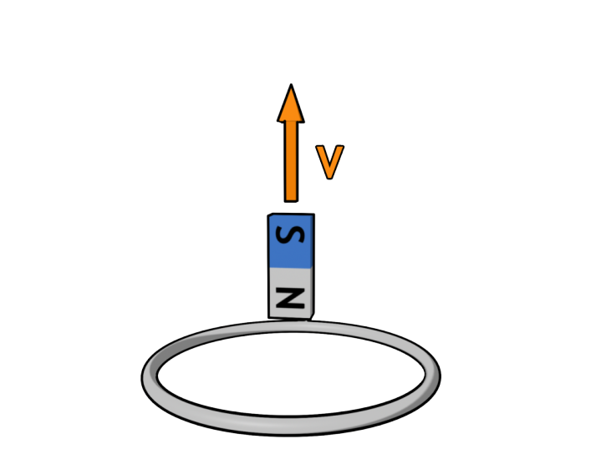
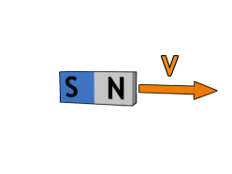
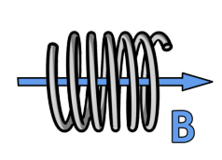
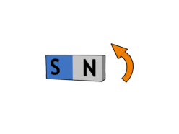
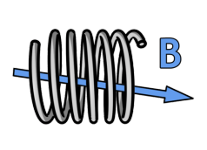
from Chabay and Sherwood, Ch 22
Faraday’s Law for a Coil
The induced emf in a coil of N turns is equal to
N times the rate of change of the magnetic flux on one loop of the coil.
Moving a magnet towards a coil produces a time-varying magnetic field inside the coil
Rotating a bar of magnet (or the coil) produces a time-varying magnetic field inside the coil
Will the current run
CLOCKWISE or ANTICLOCKWISE ?

Slide 7
Complex Magnetic Systems
DC Brushless
Stepper Motor
Reluctance Motor
Induction Motor
We need better (more powerful) tools…
Magnetic Circuits: Reduce Maxwell to (scalar) circuit problem
Energy Method: Look at change in stored energy to calculate force

Slide 8
Magnetic Flux Φ [Wb] (Webers)
Magnetic Flux Density B [Wb/m²] = T (Teslas)
Magnetic Field Intensity H [Amp-turn/m]
due to macroscopic
& microscopic
due to macroscopic
currents
Faraday’s Law
and

Slide 9
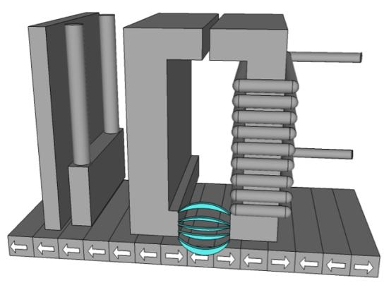

Example: Magnetic Write Head
Ring Inductive
Write Head
Shield
GMR
Read
Head
Recording Medium
Horizontal
Magnetized Bits
Bit density is limited by how well the field can be localized in write head

Slide 10
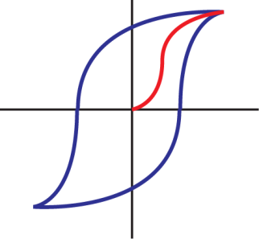
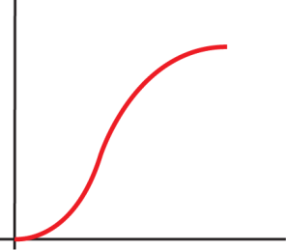








Review: Ferromagnetic Materials
B
B,J
Initial
Magnetization
Curve
H
0
hysteresis
H
0
Slope =
Behavior of an initially unmagnetized
material.
Domain configuration during several stages
of magnetization.
C
i
H : coercive magnetic field strength
B : remanence flux density
B : saturation flux density
r
S

Slide 11
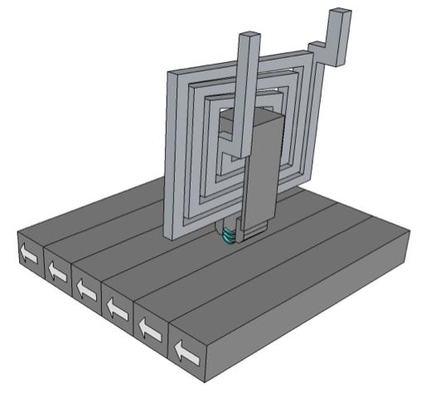
Thin Film Write Head
Recording Current
Magnetic Head Coil
Magnetic Head Core
Recording Magnetic
Field
Recorded Data
How do we apply Ampere’s Law to this geometry (low symmetry) ?

Slide 12
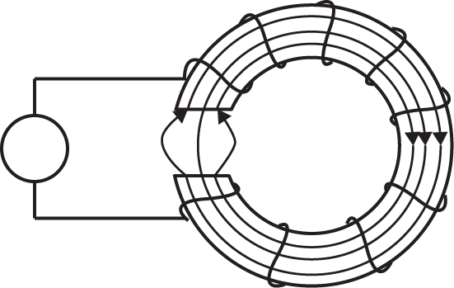
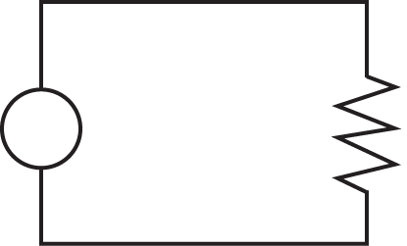
Electrical Circuit Analogy
Charge is conserved…
Flux is ‘conserved’…
+
Ф
EQUIVALENT
CIRCUITS
Electrical
Magnetic

Slide 13
Electrical Circuit Analogy
Electromotive force (charge push)=
Magneto-motive force (flux push)=
+
Ф
EQUIVALENT
CIRCUITS
Electrical
Magnetic

Slide 14
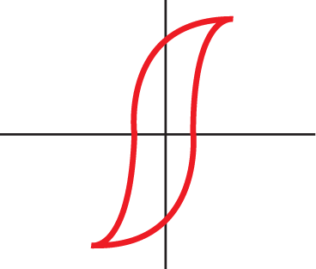
Electrical Circuit Analogy
Material properties and geometry determine flow – push relationship
OHM’s LAW
Recovering macroscopic variables:

Slide 15
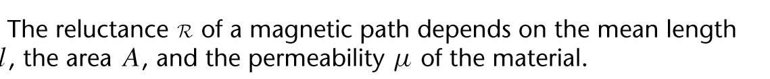
Reluctance of Magnetic Bar
Magnetic “OHM’s LAW”

Slide 16
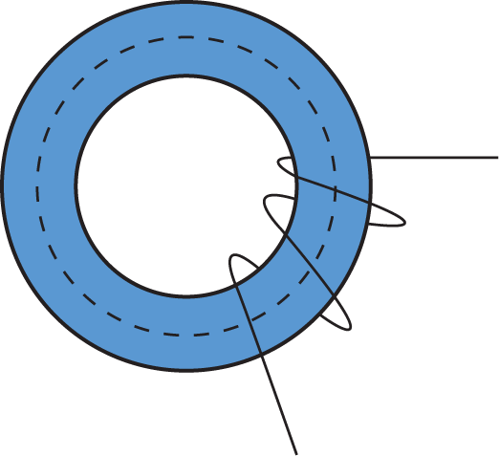
Flux Density in a Toroidal Core
Core centerline
N turn
coil
(of an N-turn coil)
i

Slide 17
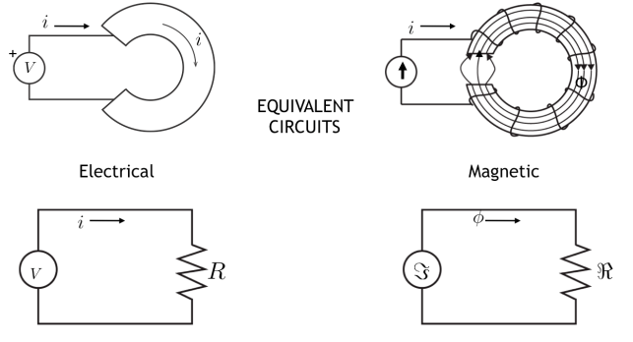
Electrical Circuit Analogy
Electrical | Magnetic
Voltage | Magnetomotive Force
Current | Magnetic Flux
Resistance | Reluctance
Conductivity | Permeability
Current Density | Magnetic Flux Density
Electric Field | Magnetic Field Intensity

Slide 18
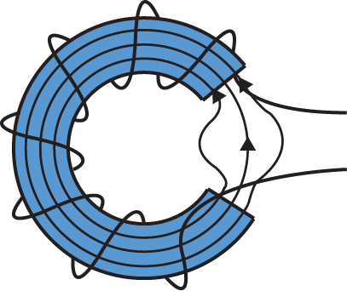
Toroid with Air Gap
Magnetic
flux
Electric
current
A = cross-section area
Why is the flux confined mainly to the core ?
Can the reluctance ever be infinite (magnetic insulator) ?
Why does the flux not leak out further in the gap ?

Slide 19
Fields from a Toroid
Magnetic
flux
Electric
current
A = cross-section area

Slide 20
Scaling Magnetic Flux
Magnetic
flux
&
Electric
current
A = cross-section area
Same answer as Ampere’s Law (slide 9)

Slide 21
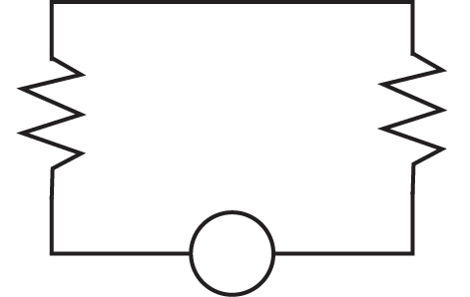
Magnetic Circuit for ‘Write Head’
Core Thickness = 3cm
2cm
8cm
2cm
0.5cm
N=500
i
+ -
A = cross-section area

Slide 22
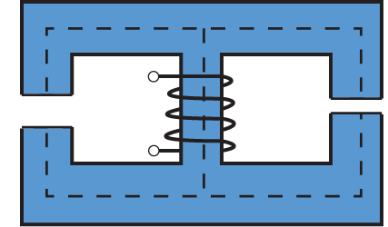
Parallel Magnetic Circuits
10cm
10cm
i
Gap b
0.5cm
1cm
Gap a
A = cross-section area

Slide 23
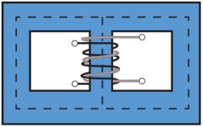
A Magnetic Circuit with Reluctances in Series and Parallel
“Shell Type” Transformer
Magnetic Circuit
+
+
N₁ turns
λ₁
v₁
v₂
N₂ turns
λ₂
+
-
-
-
+
Depth A
-
l₂
l₁
l=l₁+l₂

Slide 24
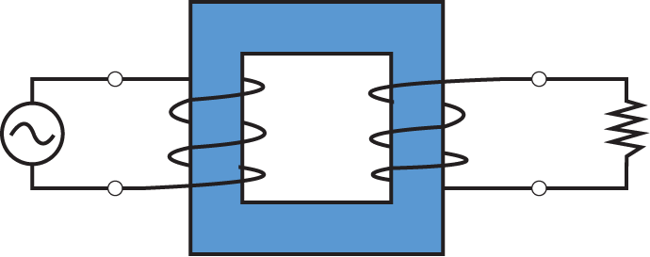
Faraday Law and Magnetic Circuits
Ф
i₁
i₂
+
-
+
v₁
-
+
v₂
-
sinusoidal
N₁
N₂
Load
Primary
Secondary
Laminated Iron Core
A = cross-section area
Flux linkage
Step 1: Estimate voltage v₁ due to time-varying flux…
Step 2: Estimate voltage v₂ due to time-varying flux…

Slide 25
Complex Magnetic Systems
DC Brushless
Stepper Motor
Reluctance Motor
Induction Motor
Powerful tools…
Magnetic Circuits: Reduce Maxwell to (scalar) circuit problem
Makes it easy to calculate B, H, λ
Energy Method: Look at change in stored energy to calculate force

Slide 26
Stored Energy in Inductors
In the absence of mechanical displacement…
For a linear inductor:
Stored energy…

Slide 27
Relating Stored Energy to Force
Lets use chain rule …
This looks familiar …
Comparing similar terms suggests …

Slide 28
Energy Balance
heat
electrical
mechanical
neglect heat
For magnetostatic system, dλ=0 no electrical power flow…

Slide 29
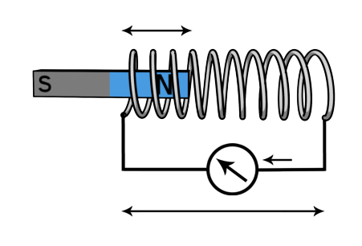
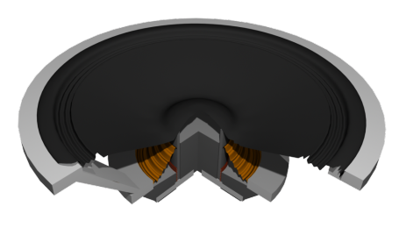
Linear Machines: Solenoid Actuator
Coil attached to cone
If we can find the stored energy, we can immediately compute the force…
…lets take all the things we know to put this together…

Slide 30

KEY TAKEAWAYS
COMPLETE AMPERE’S LAW
Electrical | Magnetic
Voltage | Magnetomotive Force
Current | Magnetic Flux
Resistance | Reluctance
Conductivity | Permeability
Current Density | Magnetic Flux Density
Electric Field | Magnetic Field Intensity
RELUCTANCE

Slide 31
MIT OpenCourseWare
http://ocw.mit.edu
6.007 Electromagnetic Energy: From Motors to Lasers
Spring 2011
For information about citing these materials or our Terms of Use, visit: http://ocw.mit.edu/terms.

