Slide 1
Dielectrics and Dipoles
Reading – Shen and Kong – Ch. 10
Outline
Polarization and Dipole Density
Dielectric Constant
Microphones
More Dielectric Actuators

Slide 2
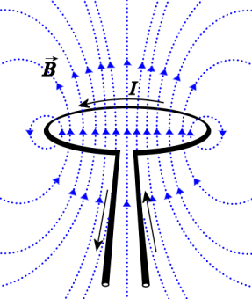
True or False?
1. The magnetic moment is defined as
and has units of Amp-m²
m = i a
2. In a linear magnetic material, the magnetization is given by
where is the magnetic susceptibility with units of m³
NI
2πr
3. The energy stored in the magnetic field is (½ µ_{o}H²)·(Volume) and has units of Joules.

Slide 3
Electric Fields
Magnetic Fields

Slide 4




Air Capacitors
d

Slide 5
… let’s insert a metal sheet between capacitor plates
d
- Capacitance increases
- Since σ remained the same
then decreases

Slide 6
… let’s insert an insulator sheet
between capacitor plates
d
- Capacitance increases
- Since σ remained the same
then decreases

Slide 7
Why is there σ_{dielectric} ?
What is the magnitude of σ_{dielectric} ?
When molecules are in an electric field they get stretched
Electric field polarizes molecules …
… turns them into DIPOLES

Slide 8

What is a Dipole ?
small amount of charge moved by field E
- -
- -
- -
- -
-
- -
- -
- -
- -
- -
+ +
+ +
+ +
+ +
+ +
+ +
NO external E filed
external E filed stretches
the atom/molecule
Dipole Moment =
electric dipole moment, p (or electric dipole for short), is a measure of the polarity of a system of electric charges. Here x is the displacement vector pointing from the negative charge to the positive charge. This implies that the electric dipole moment vector points from the negative charge to the positive charge. Note that the electric field lines run away from the positive charge and toward the negative charge. There is no inconsistency here, because the electric dipole moment has to do with the positions of the charges, not the field lines.

Slide 9
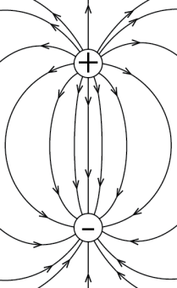
Analogy Between Magnetic and Electric Dipoles
Magnetic Fields
Electric Field
Magnetic
Moment
Electric Dipole
Moment
m = i a
m = q d

Slide 10
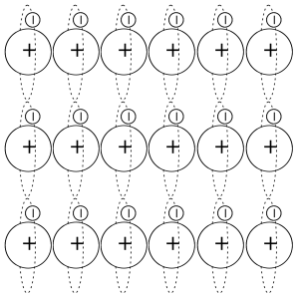
Superposition
The magnetization or net magnetic dipole moment density is given by
The polarization or net electric dipole moment density is given by
[C/m²]
average electric dipole moment [C m]
[A/m]
Number of dipoles per unit volume [m⁻³]
average magnetic dipole moment [A m²]
Number of dipoles per unit volume [m⁻³]

Slide 11
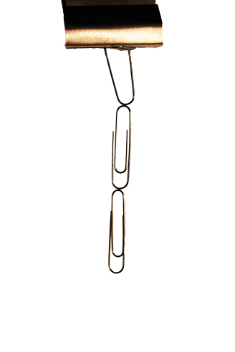

Induced Magnetization
For some materials, the net magnetic dipole moment per unit volume is proportional to the H field
units of
both M and H
are A/m.
MAGNETIC
SUSCEPTIBILITY
(dimensionless)
The effect of an applied magnetic field on a magnetic material
is to create a net magnetic dipole moment per unit volume M

Slide 12
Induced Polarization
Density of dipoles….
Electric field polarizes molecules…
… equivalent to …
polarization density, P (a.k.a electric polarization, or simply polarization) - density of permanent or induced electric dipole moments in a dielectric material.
The SI unit of measure is coulombs per square meter.
electric susceptibility of a dielectric material is a measure of how easily it polarizes in response to an electric field

Slide 13
Polarizability, α, tells us how easy is to disturb charge distribution, like the electron cloud of an atom or molecule, from its normal shape by an external electric field.
Origin of the Dielectric Response
+
Electronic Polarizability (α_{e})
Polarization of localized electrons
Polarizability (α)
increases
-
-
2. Ionic Polarizability (α_{i})
Displacement of ions
Response Time
Increases
(slower
response)
+
+
3. Dipolar Polarizability (α_{d})
Reorientation of polar molecules
-
+
4. Space Charge Polarizability (α_{s})
Long range charge migration
-

Slide 14
Bound Charges and Polarization
- -
- -
- -
- -
- -
+ +
+ +
+ +
low dipole density
high dipole density
negative interface charge

Slide 15
… let’s insert an insulator sheet
between capacitor plates
d
equivalently …

Slide 16
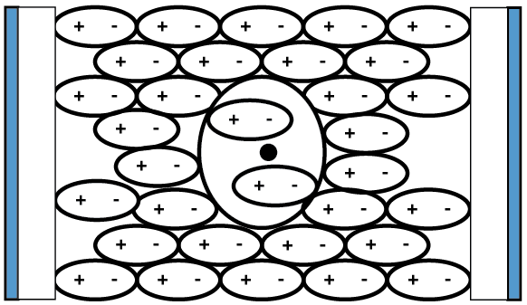
… let’s insert an insulator sheet
between capacitor plates
Electric displacement D
d
equivalently …

Slide 17
Displacement Fields
where we define electric displacement field, D, as
Displacement field D accounts for the effects of
unbound (“free”) charges within materials.
Electric field E accounts for the effects of
total charges (both “bound” and “free”) within materials.

Slide 18
Ferroelectrics
A ferroelectric material develops a spontaneous polarization
(builds up a charge) in response to an external electric field
The polarization does not
go away when the
external field is removed
The direction of the
polarization is reversible
Examples BaTiO₃
PbTiO₃
Applications of Ferroelectric Materials
Non-volatile FRAM (Ferroelectric Random Access Memory)

Slide 19
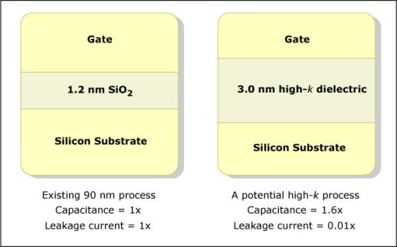
Why Worry About Dielectrics ?
Gate
Terminal
Image by MIT OpenCourseWare.
Drain
Terminal
Source
Terminal
Capacitor in 90, 65nm
Capacitor in 45nm
Metal
P Type
P Type
SiO₂ ε/ε_{o} =3.9
HfO₂ ε/ε_{o} =25
N Type
As transistors scale, insulation within the capacitor has become leaky…

Slide 20
Energy Density of the Electric Field
What is the energy density stored in the capacitor ?
For a capacitor with large, flat plates…
The electric field is not just the origin of electrostatic forces but also tells us about the stored energy !

Slide 21
Linear Dielectric Slab Actuator
Note: We are going to keep Q constant on the plates

Slide 22
Electromagnetic Energy Storage
Remember …
Magnetic
Electric
Magnetic machine
Electric machine

Slide 23
Key Takeaways
Electric displacement
Magnetic
Electric

Slide 24
MIT OpenCourseWare
http://ocw.mit.edu
6.007 Electromagnetic Energy: From Motors to Lasers
Spring 2011
For information about citing these materials or our Terms of Use, visit: http://ocw.mit.edu/terms.

