Slide 1
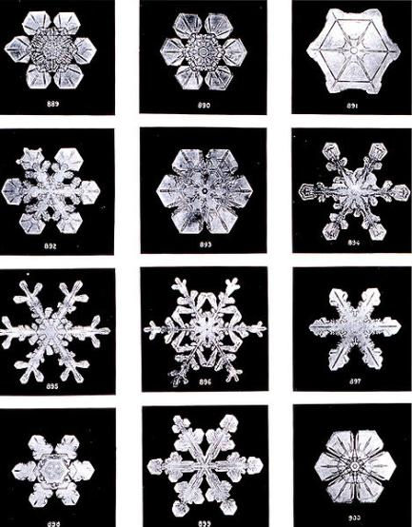
Practical Dielectrics
Reading – Shen and Kong – Ch. 10
Outline
What Holds Liquids Together – electrostatics
How does the Adhesive Tape Work – electrostatics
Electrostatic Breakdown of Dielectrics
Rotary Electrostatic Motor
Images are in the public domain

Slide 2

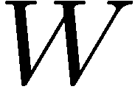
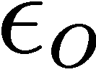
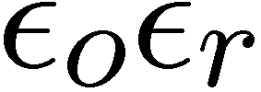


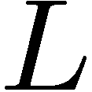





Linear Dielectric Slab Actuator
Note: We are going
to keep Q constant
on the plates

Slide 3



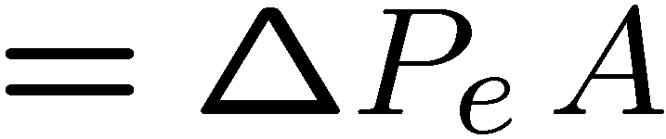
Force and Differential Pressure
differential pressure pushing the dielectric slab into the capacitor in [N/m²] or [J/m³]
(just the difference of electric field densities on each side)

Slide 4
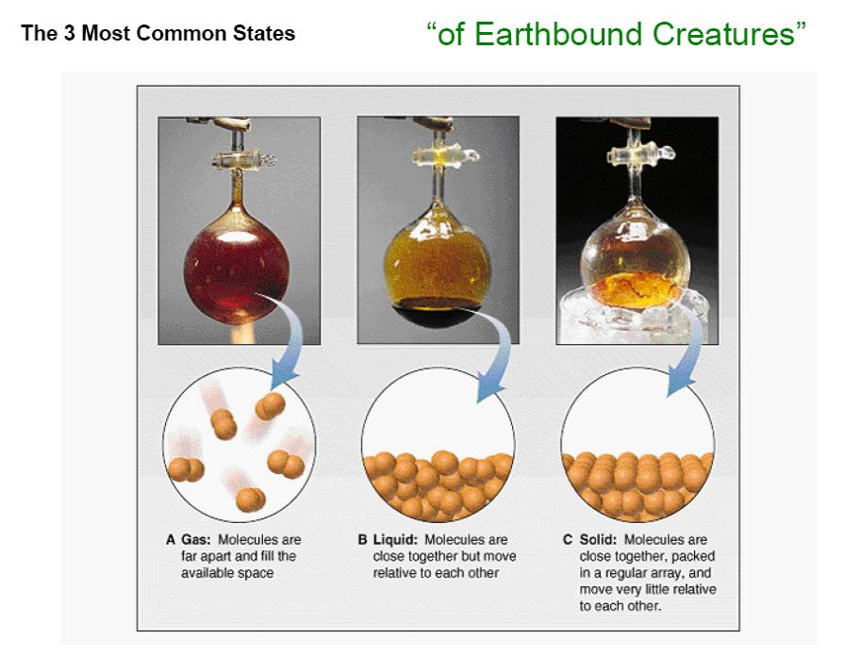
© Source unknown. All rights reserved. This content is excluded from our Creative
Commons license. For more information, see http://ocw.mit.edu/fairuse.
… so what role does electrostatics play in keeping materials together

Slide 5


Induced Dipole Forces between Atoms/Molecules
Electrostatic
attraction
ELECTROSTATIC ATTRACTION
DISTORTS ELECTRON CLOUDS
Helium atom 1
Helium atom 2
Induced Dipole forces are lower between spherical than between sausage-like molecules
(see the boiling points)
Why?
n-Pentane
(bp = 309.4 K)
Image in public domain
Neopentane
(bp = 282.7 K)
Image in public domain

Slide 6

What is a Dipole ?
small amount of charge moved by field E
- -
- -
- -
- -
-
- -
- -
- -
- -
- -
+ +
+ +
+ +
+ +
+ +
+ +
NO external E filed
external E filed stretches
the atom/molecule
Dipole Moment =
electric dipole moment, p (or electric dipole for short), is a measure of the polarity of a system of electric charges. Here x is the displacement vector pointing from the negative charge to the positive charge. This implies that the electric dipole moment vector points from the negative charge to the positive charge. Note that the electric field lines run away from the positive charge and toward the negative charge. There is no inconsistency here, because the electric dipole moment has to do with the positions of the charges, not the field lines.

Slide 7
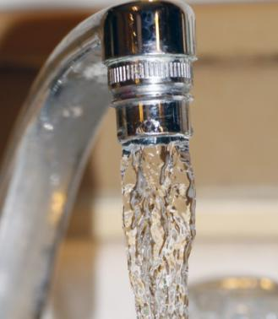
Dielectric Response of Water
O
More precisely
the relative dielectic constant of H₂O is:
87.9 at 0°C, 78.4 at 25°C, 55.6 at 100°C
Ice: 99 at -20°C, 171 at -120°C
Gas: 1.0059 at 100°C, 101.325 kPa
H
H
A stream of distilled water
… is attracted to a charged rod (or comb)
Image by Dottie Mae http://www.flickr.com/photos/dottiemae/5202454566/ on flickr

Slide 8
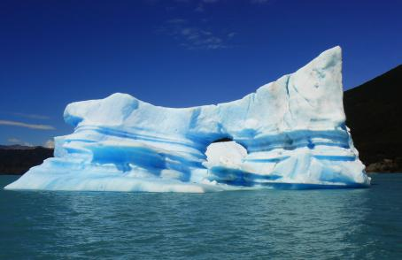
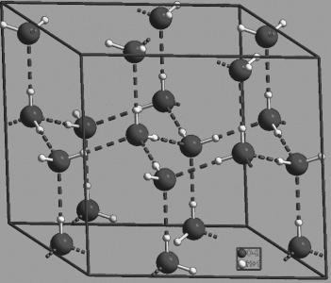
Water in three states:
liquid, solid (ice),
and (invisible) vapor in air.
Clouds are droplets of liquid,
condensed from water vapor.
Crystal structure of ice is hexagonal, resulting in planar, hexagonal snowflakes.
All images are in the public domain
Notes:
Typical snowflake has 180 billion mollecules.

Slide 9
Electrostatic Adhesive Surface
Conducting wires embedded in an insulator produce an electric field in the air just above the surface of the dielectric. If a paper is placed on top of the dielectric, the electrostatic force pulls it closer to the surface.
ELECTROSTATIC FORCE
PAPER
AIR GAP
INSULATOR
CONDUCTING WIRES
(every other conductor is charged to positive voltage)
Typical voltage used to charge the imbedded conductors = 300 Volts
Typical spacing between conductors = 2 mm

Slide 10
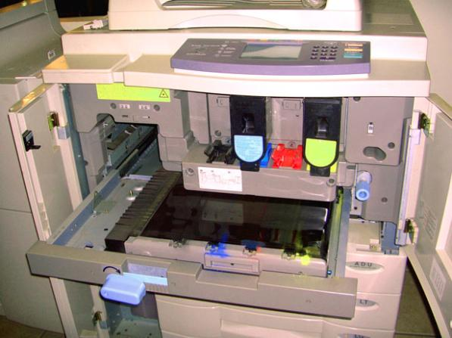
Xerography
15 kV
Cylindrical drum
photoconductor
light
toner
paper
Image is in the public domain
Notes:
Drum is made up of a higher photoconductive material. It is initially charged by a corona wire. Light discharges some of these negative charges. The toner clings only to the areas of the drum that have negative charge. Paper, in turn, electrostatically attracts the toner.

Slide 11

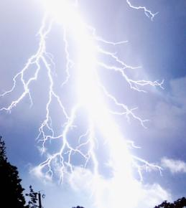



How Strong is this Force ?
The maximum electric field strength is
limited by the electrostatic breakdown
Typically…
Image is in the public domain
For small gaps…
-
-
-
-
Electron
thermalizes
due to collisions
-
-
-
-
-
ionization
-
Notes:
4.4 N/m2 = 6e-4 psi
Small gaps – 4.4e4 N/m^2

Slide 12
Dielectric Breakdown
… is similar to ionization of air.
In the insulating region of a capacitor, there is a small number of free electrons due to impurities and other defects. These electrons are accelerated by the electric field and collide with the lattice structure. If the field strength is high enough, the electron generates more electrons with collision, resulting in a avalanche effect or a large current.
Material | Relative permittivity | Breakdown E field (10⁶V/m)
Air | 1.0 | Approximately 3
Oil | 2.3 | 15
Paper | 1.5-4.0 | 15
Polystyrene | 2.7 | 20
Glass | 6.0 | 30
Mica | 6.0 | 200
Notes:
Ways to increase capacitance: put a material with higher dielectric breakdown.

Slide 13
Electromagnetic Energy Storage
Recall from last week …
Magnetic
Electric
Magnetic machine
Electric machine

Slide 14


Electrostatic vs Magnetostatic Actuators
MAGNETIC
ELECTRIC
 | Max Field
Magnetic |  | 400 kJ/m³
Electric (Macro) |  | 4.4 J/m³
Electric (Micro) |  | 44 kJ/m³
Electric (Bio/Nano) |  | 4.4 MJ/m³
Gasoline |  | 38 GJ/m³
Notes:
Magnetic actuators have higher energy storage per volume but are more difficult to integrate.

Slide 15

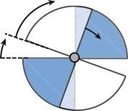

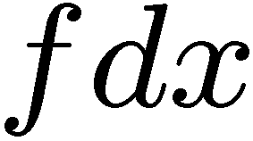

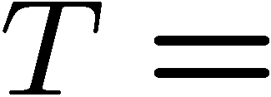

Rotary Electrostatic Motor (No Dielectric)
(with 4 segments)
Plate Overlap Area changes
From to
- Rotating Metal Plates
- Slip contact
If voltage is applied across the plates, torque T is produced
v
stator
rotor
Notes:
How do I keep motor spinning?

Slide 16
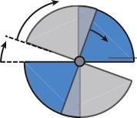
Rotary Electrostatic Motor (With Dielectric)
(with 4 segments)
- Rotating Dielectric Plates
- No contact to the rotor needed
If voltage is applied across the plates, torque is produced
Plate Overlap Area changes
From to
v
pair of +/-
metal plates
as stator
dielectric
rotor
Notes:
Nothing is different in this case except for the permittivity which is epsilon instead of epsilon_naught.

Slide 17





Torsional Electrostatic Actuator
= length
of the paddle
x
origin
CHARGE ON LEFT PADDLE:

Slide 18

Torsional Electrostatic Actuator (cont.)

Slide 19







Example: Torsional Electrostatic Actuator
x
Estimate time required to sweep 24º (+/- 12º)…
Notes:
Typical limiting scanning frequency of MEMs – a few kilohertz.

Slide 20
KEY TAKEAWAYS
Correspondence between linear and angular coordinate systems
- The maximum electric field strength is limited by the electrostatic breakdown.
- The maximum magnetic field strength is limited by the maximum current allowed through the coils of the electromagnet.
- Since there are no magnetic monopoles, there is no “magnetostatic breakdown.”

Slide 21
MIT OpenCourseWare
http://ocw.mit.edu
6.007 Electromagnetic Energy: From Motors to Lasers
Spring 2011
For information about citing these materials or our Terms of Use, visit: http://ocw.mit.edu/terms.

