Slide 1
Complex Numbers and Phasors
Reading - Shen and Kong - Ch. 1
Outline
Linear Systems Theory
Complex Numbers
Polyphase Generators and Motors
Phasor Notation

Slide 2
True / False
1. In Lab 1 you built a motor about 5 cm in diameter. If this motor spins at 30 Hz, it is operating in the quasi-static regime.
2. The wave number k (also called the wave vector) describes the “spatial frequency” of an EM wave.
3. This describes a 1D propagating wave:

Slide 3
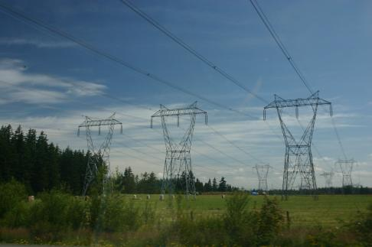
Electric Power System
The electric power grid operates at either 50 Hz or 60 Hz, depending on the region.
Image is in the public domain.

Slide 4
Electric Power System
3 phase transmission line
3 phase generator
3 phase load

Slide 5
The Challenge of Sinusoids
Models of dynamic systems couple time signals to their time derivatives. For example, consider the system
Where is a constant. Suppose that is sinusoidal, then and its time derivative will take the form
Coupling the signal to its time derivative will involve trigonometric identities which are cumbersome! Are there better analytic tools? (Yes, for linear systems.)

Slide 6
Linear Systems
Homogeneity
Superposition
If
If
Linear
System
Linear
System
then
Linear
System
Linear
System
then
Linear
System

Slide 7
Linear Systems
If
Real Linear
System
Real Linear
System
then
Real Linear
System

Slide 8
Linear Systems
If
Linear
System
Linear
System
then
Linear
System

Slide 9
Now Responses to Sinusoids are Easy
… Euler’s relation
Combining signals with their time derivatives, both expressed as complex exponentials, is now much easier.
Analysis no longer requires trigonometric identities. It requires only the manipulation of complex numbers, and complex exponentials!

Slide 10
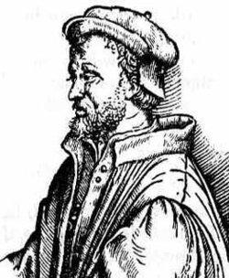
Imaginary numbers
Trained initially in medicine
First to describe typhoid fever
Made contributions to algebra
1545 book Ars Magna gave solutions for cubic and quartic equations (cubic solved by Tartaglia, quartic solved by his student Ferrari)
First Acknowledgement of complex numbers
Image is in the public domain.
Gerolamo Cardano
(1501-1576)

Slide 11
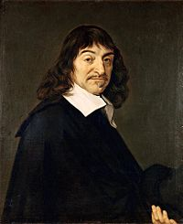
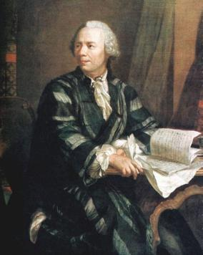
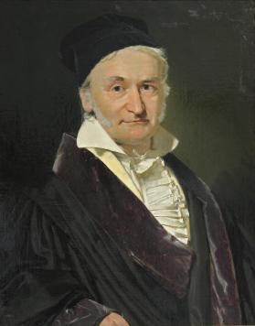
Descartes coined the term “imaginary” numbers in 1637
The work of Euler and Gauss made complex numbers more acceptable to mathematicians
All images are in the public domain.

Slide 12
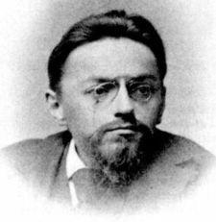
Notation
Image is in the public domain.
Image is in the public domain.
Analysis of alternating current in electrical engineering
Steinmetz, 1893
Complex numbers in mathematics
Euler, 1777

Slide 13
Complex Numbers (Engineering convention)
We define a complex number with the form
Where , are real numbers.
The real part of , written is .
The imaginary part of z, written , is .
Notice that, confusingly, the imaginary part is a real number.
So we may write as

Slide 14
Complex Plane
and

Slide 15
Polar Coordinates
In addition to the Cartesian form, a complex number may also be represented in polar form:
Here, is a real number representing the magnitude of , and represents the angle of in the complex plane.
Multiplication and division of complex numbers is easier in polar form:
Addition and subtraction of complex numbers is easier in Cartesian form.

Slide 16
Converting Between Forms
To convert from the Cartesian form to polar form, note:

Slide 17
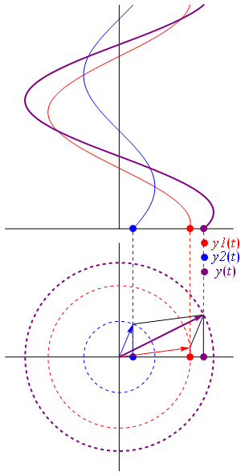
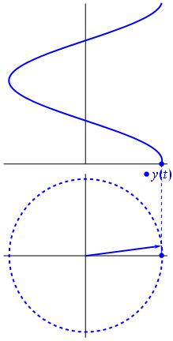
Phasors
A phasor, or phase vector, is a representation of a sinusoidal wave whose amplitude , phase , and frequency are time-invariant.
The phasor spins around the complex plane as a function of time.
Phasors of the same frequency can be added.
This is an animation
But it’s a known fact

Slide 18
Modern Version of Steinmetz’ Analysis
Begin with a time-dependent analysis problem posed in terms of real variables.
Replace the real variables with variables written in terms of complex exponentials; is an eigenfunction of linear time-invariant systems.
Solve the analysis problem in terms of complex exponentials.
Recover the real solution from the results of the complex analysis.

Slide 19
Example: RC Circuit
Assume that the drive is sinusoidal:
+
-
+
-
And solve for the current

Slide 20
Use Steinmetz AC method
Sinusoidal voltage source expressed in terms of complex exponential
Complex version of problem
Recover real solution from complex problem

Slide 21
Natural Response / Homogeneous Solution
Linear constant-coefficient ordinary differential equations of the form
have solutions of the form where
Can we always find the roots of such a (characteristic) polynomial?

Slide 22
Polynomial Roots
Can we always find roots of a polynomial? The equation
has no solution for in the set of real numbers. If we define, and then use, a number that satisfies the equation
that is,
or
then we can always find the n roots of a polynomial of degree n.
Complex roots of a characteristic polynomial are associated with an oscillatory (sinusoidal) natural response.

Slide 23
Single-phase Generator
load
Instantaneous power of phase A

Slide 24
Two-phase Generator
Load on
phase A
Instantaneous power of phase A
Load on phase B
Instantaneous power of phase B
Total Instantaneous power output

Slide 25
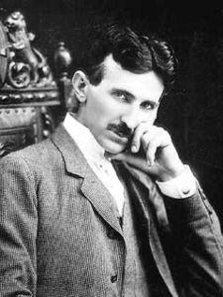
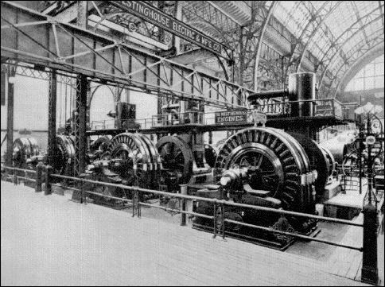
Patented two-phase electric motor
Some people mark the introduction of
Tesla’s two-phase motor as the beginning
of the second industrial revolution (concept 1882, patent, 1888)
Image is in the public domain.
Nikola Tesla circa 1886
Image is in the public domain.
AC generators used to light the Chicago Exposition in 1893

Slide 26


Electric Power System … Revisited
3 phase transmission line
3 phase generator
3 phase load

Slide 27
What about Space?
Maxwell’s equations are partial differential equations, and hence involve “signals” that are functions of space and their spatial derivates. Correspondingly, we will find complex exponential functions of the form
to be very useful in analyzing dynamic systems described with Maxwell’s equations.

Slide 28
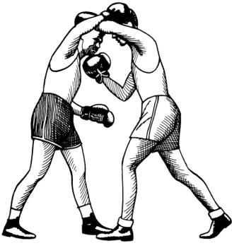

What’s the Difference between i and j ?
Engineering
Physics
Clipart images are in the public domain.
Can go back and forth between physics and engineering literature
If we adopt the convention
We will ultimately use both notations in 6.007

Slide 29
MIT OpenCourseWare
http://ocw.mit.edu
6.007 Electromagnetic Energy: From Motors to Lasers
Spring 2011
For information about citing these materials or our Terms of Use, visit: http://ocw.mit.edu/terms.

