Slide 1
Interaction of Atoms and Electromagnetic Waves
Outline
Review: Polarization and Dipoles
- Lorentz Oscillator Model of an Atom
- Dielectric constant and Refractive index

Slide 2
True or False?
The dipole moment of this atom is , and points in the same direction as the polarizing electric field.
- -
- -
- -
- -
- -
+ +
+ +
+ +
NI
2πr
2. The susceptibility relates the electric field to the polarization in this form:
3. The refractive index can be written

Slide 3
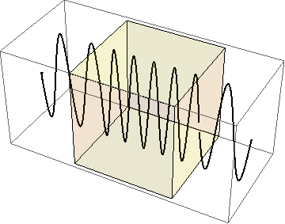


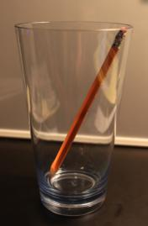
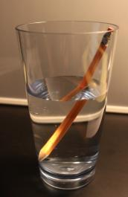
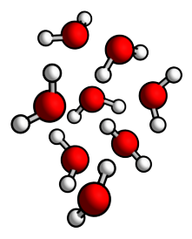
Refractive Index: Waves in Materials
Index of refraction
How do we get from molecules/charges and fields to index of refraction ?

Slide 4
Index of Refraction
Material
Vacuum | 1
Air | 1.000277
Water liquid | 1.3330
Water ice | 1.31
Diamond | 2.419
Silicon | 3.96
frequency
wavelength
When propagating in a material,
at 5 x 10¹⁴ Hz
λ (m)
10²
10⁻¹
10⁻³
10⁻⁴
10⁻⁵
10⁻⁶
10⁻⁷
10⁻⁸
10⁻⁹
10⁻¹⁰
10⁻¹¹
10⁻¹²
10³
10¹
1
10⁻²
Radio waves
IR
UV
“Hard” X-rays
Microwaves
“Soft” X-rays
Gamma rays
Visible

Slide 5

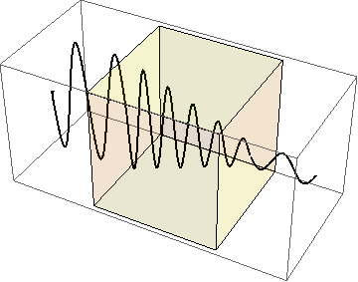
Absorption
Photograph by Hey Paul on Flickr.
Why are these stained glass different colors?
Tomorrow: lump refractive index and absorption into a complex refractive index
Absorption
coefficient
Refractive
index

Slide 6
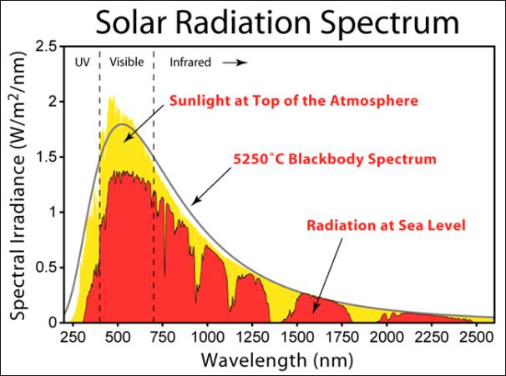
Incident Solar Radiation
How do we introduce propagation through a medium (atmosphere) into Maxwell’s Equations?
Image created by Robert A. Rohde / Global Warming Art. Used with permission.

Slide 7
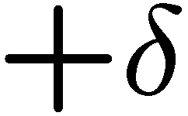
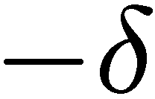
Microscopic Description of Dielectric Constant
small amount of charge moved by field E
- -
- -
- -
- -
- -
+ +
+ +
+ +
+ +
+ +
+ +
NO external field
Nucleus
Electron
“spring”
Density of dipoles…
Electric field polarizes molecules…
… equivalent to …

Slide 8
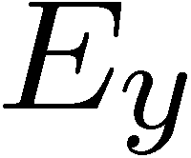
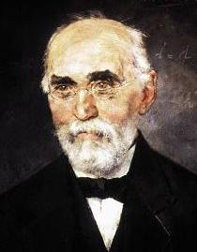

Lorentz Oscillator
Lorentz was a late nineteenth century physicist, and quantum mechanics had not yet been discovered. However, he did understand the results of classical mechanics and electromagnetic theory. Therefore, he described the problem of atom-field interactions in these terms. Lorentz thought of an atom as a mass ( the nucleus ) connected to another smaller mass ( the electron ) by a spring. The spring would be set into motion by an electric field interacting with the charge of the electron. The field would either repel or attract the electron which would result in either compressing or stretching the spring.
Nucleus
Electron
“spring”
Hendrik Lorentz (1853-1928)
Nobel in 1902 for Zeeman Effect
Lorentz was not positing the existence of
a physical spring connecting the electron to an atom; however, he did postulate that the force binding the two could be described by Hooke's Law:
where y is the displacement from equilibrium. If Lorentz's system comes into contact with an electric field, then the electron will simply be displaced from equilibrium. The oscillating electric field of the electromagnetic wave will set the electron into harmonic motion. The effect of the magnetic field can be omitted because it is miniscule compared to the electric field.
Image in public domain

Slide 9

Springs have a resonant frequency
Hooke’s Law
Solution
ω₀
ω₀
So we can write:

Slide 10


Microscopic Description of Dielectric Constant
Nucleus
Electron
“spring”
Damping
Electron mass
Restoring force
(binding electron & nucleus)
field
force

Slide 11
Solution using complex variables
Lets plug-in the expressions for and
into the differential equation from slide 9:
Natural resonance
+ +
+ +
+ +

Slide 12



Oscillator Resonance
Driven harmonic oscillator: Amplitude and Phase depend on frequency
Low frequency
At resonance
High frequency
medium amplitude
Displacement,
in phase with
large amplitude
Displacement,
90º out of phase with
vanishing amplitude
Displacement and in antiphase

Slide 13
Polarization
Since charge displacement, y, is directly related to polarization, P, of our material
we can then rewrite the differential equation:
For linear polarization in direction

Slide 14
Dielectric Constant from the Lorentz Model

Slide 15
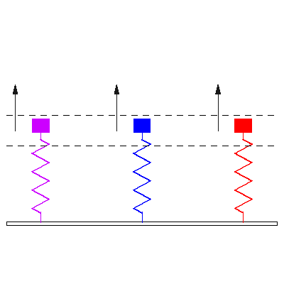
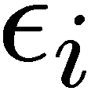
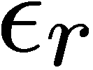

Microscopic Lorentz Oscillator Model

Slide 16
Real and imaginary parts

Slide 17
Dielectric constant of water
80
60
Magnitude
40
20
1
10
Frequency (GHz)
Microwave ovens usually operate at 2.45 GHz

Slide 18


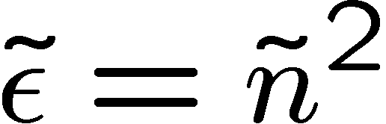




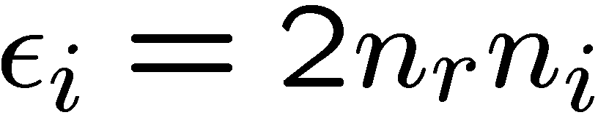
Complex Refractive Index

Slide 19
Absorption Coefficient
Absorption
Refractive
index
[cm⁻¹]

Slide 20
Absorption
Absorption
coefficient
Refractive
index
Beer-Lambert Law or Beer’s Law

Slide 21
Key Takeaways
Nucleus
Lorentz Oscillator Model
Electron
“spring”
Decay
Absorption
coefficient
Refractive
index
Beer’s Law

Slide 22
MIT OpenCourseWare
http://ocw.mit.edu
6.007 Electromagnetic Energy: From Motors to Lasers
Spring 2011
For information about citing these materials or our Terms of Use, visit: http://ocw.mit.edu/terms.

