Slide 1
Electromagnetic Waves in Materials
Outline
Review of the Lorentz Oscillator Model
Complex index of refraction – what does it mean?
TART
Microscopic model for plasmas and metals

Slide 2

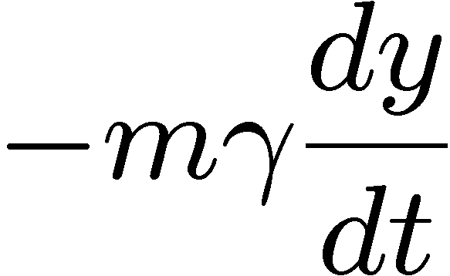

True / False
1. In the Lorentz oscillator model of an atom, the electron is bound to the nucleus by a spring whose spring constant is the same for any atom.
2. The following is the differential equation described by the Lorentz oscillator model:
3. For dielectrics, we can approximate the index of refraction as the square root of the dielectric constant.

Slide 3
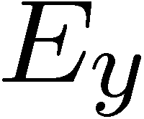
Microscopic Description of Dielectric Constant
Nucleus
Electron
“spring”
Damping
Electron mass
Restoring force
(binding electron & nucleus)
field
force

Slide 4
Solution using complex variables
Lets plug-in the expressions for and
into the differential equation from slide 3:
Natural resonance
+ +
+ +
+ +

Slide 5
Oscillator Resonance
Driven harmonic oscillator: Amplitude and Phase depend on frequency
Low frequency
At resonance
High frequency
medium amplitude
Displacement,
in phase with
large amplitude
Displacement,
90º out of phase with
vanishing amplitude
Displacement and in antiphase

Slide 6
Polarization
Since charge displacement, y, is directly related to polarization, P, of our material
we can then rewrite the differential equation:
For linear polarization in direction

Slide 7
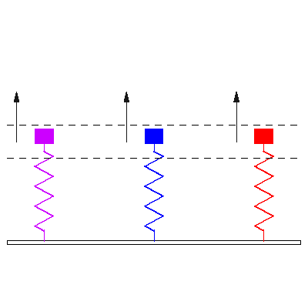
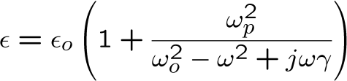

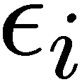

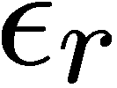

Microscopic Lorentz Oscillator Model

Slide 8
Behavior of a driven (and damped) harmonic oscillator can be summarized as follows
phase
Hi
frequency
limit
Low
frequency
limit
180°
amplitude
Amplitude
Phase Lag
(displacement vs. driving field)
90°
Frequency
This type of response of bound charges is typical for many materials

Slide 9


Complex Refractive Index
(real)
(imaginary)

Slide 10


Absorption Coefficient
Absorption
Refractive
index
[cm⁻¹]

Slide 11
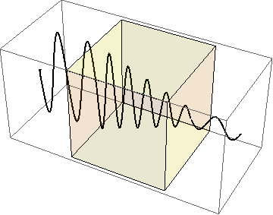
Absorption and Reflection
Absorption
coefficient
Refractive
index
Beer-Lambert Law or Beer’s Law

Slide 12
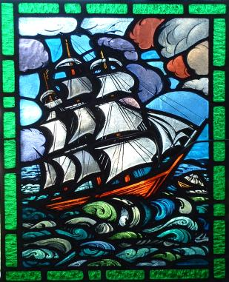
T A R T
Different resonant frequencies
Photograph by Hey Paul on Flickr.
Transmissive
Absorptive
Reflective
Transmissive
Transmissive
Absorp.
Reflective
Transmissive

Slide 13
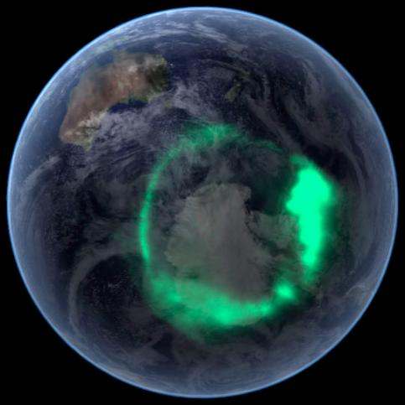
Plasma in Ionosphere
Plasma is an ionized gas consisting of positively charged molecules (ions) and negatively charged electrons that are free to move.
Plasma exists naturally in what we call ionosphere (80 km ~ 120 km above the surface of the Earth). Here the UV light from the Sun ionizes air molecules.
Aurora Australis
Image is in the public domain

Slide 14
Plasmas (which we will assume to be lossless, )
… have no restoring force for electrons,
Reflecting
Transparent
1.0
What happens when the dielectric constant is negative?
0.5
0
-0.5
1
1.5
2
If ε < 0 then n is imaginary

Slide 15
Optical Response of Plasmas
Reflecting
Transparent
1
0.5
for
for
0
-0.2
1.5
0.5
1
2

Slide 16
Plasma Frequency
AM radio is in the range 520-1610 kHz
FM radio in in the range 87.5 to 108 MHz
Reflected
Transmitted

Slide 17
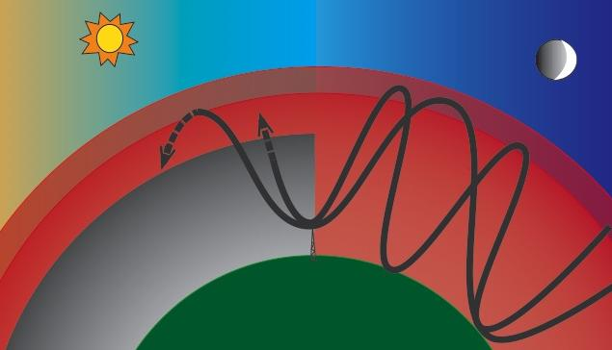
F layer 180 km
E layer 120 km
D layer 60 km
AM radio
transmitter
The Ionosphere and Radio Wave Propagation
The ionosphere is important for radio wave (AM only) propagation....
Ionosphere is composed of the D, E, and F layers.
The D layer is good at absorbing AM radio waves.
D layer disappears at night...the E and F layers bounce the waves back to the Earth.
This explains why radio stations adjust their power output at sunset and sunrise.

Slide 18

Why do metals reflect light?
© Kyle Hounsell. All rights reserved. This content is excluded from our Creative Commons license. For more information, see http://ocw.mit.edu/fairuse.

Slide 19
Metals are Lossy
Why is there a discontinuity here?
or must change for this to be true
Metals have loss
but have no restoring force for electrons
Drude Model for metals
0.5
0.4
0.3
0.2
0.1
-5
-10
-20
-25
-30

Slide 20
Behavior of Metals
6
100
5
80
4
R
T
T
60
R
Reflection(%)
3
40
2
1
20

Slide 21

Image by Kate Hopkins http://www.flickr.com/photos/accidentalhedonist/5200667428/ on flickr
T
A
R
T
Dielectric
Metal
Plasma

Slide 22
Key Takeaways
Nucleus
Electron
Lorentz Oscillator Model
“spring”
Decay
Absorption
coefficient
Refractive
index
Transmissive
Absorptive
Reflective
Transmissive
Beer’s Law

Slide 23
MIT OpenCourseWare
http://ocw.mit.edu
6.007 Electromagnetic Energy: From Motors to Lasers
Spring 2011
For information about citing these materials or our Terms of Use, visit: http://ocw.mit.edu/terms.

