Slide 1
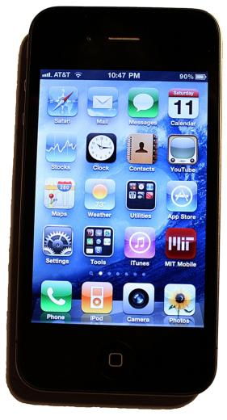
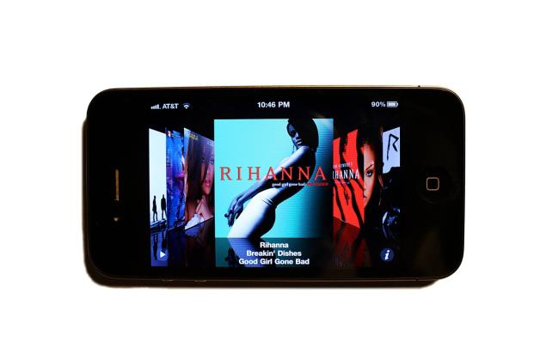
Welcome to
6.007 – Applied Electromagnetics
From Motors to Lasers
What is inside an iPhone ?

Slide 2
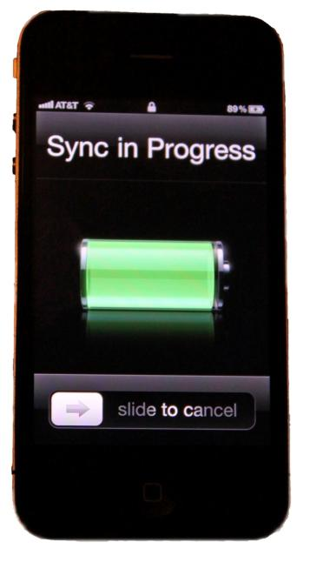
iPhone Technical Specifications
Operating System: OS X
Memory: 4gb or 8gb versions available
Processor: 32-bit, 620 MHz core
Muliti-Touch Display:
3.5 inch 480 x 320-pixel HVGA resolution,160 dpi
Wireless: Quad-band (850,900,1800,1900 MHz), WiFi (802.11b/g), EDGE, Bluetooth 2.0+EDR
Digital Camera:
2.0 mega pixels with 1200x1600 resolution
Battery: 1400 mAh, 3.7 V
Rechargeable lithium-ion,
Talk time: up to 8 hours,
Standby time: up to 250 hours,
Internet use: up to 6 hours,
Video playback: up to 7 hours,
Audio playback: up to 24 hours
Size: 4.5 x 2.4 x 0.46 in (115 x 61 x 11.6 mm)
Weight: 4.8 ounces (135 grams)
For more views of iPhone under the hood see
http://www.eetimes.eu/200001828
http://www.eetimes.eu/200001864

Slide 3
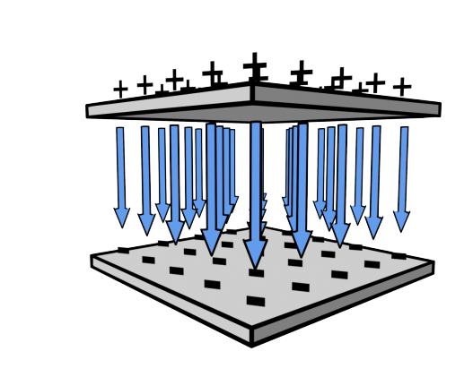










Capacitors
E
Maxwell’s Equations

Slide 4

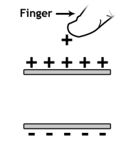

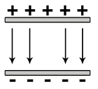


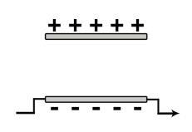
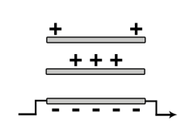
Capacitors in the iPhone
Touchsensor
Accelerometer
LCD Display
CMOS Photodiode Imager
CMOS Transistor
Flash Memory

Slide 5
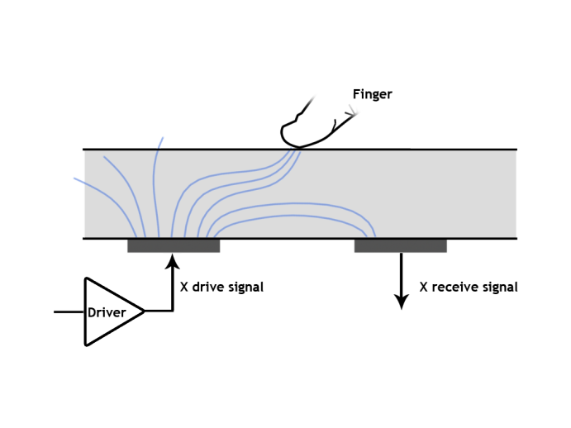
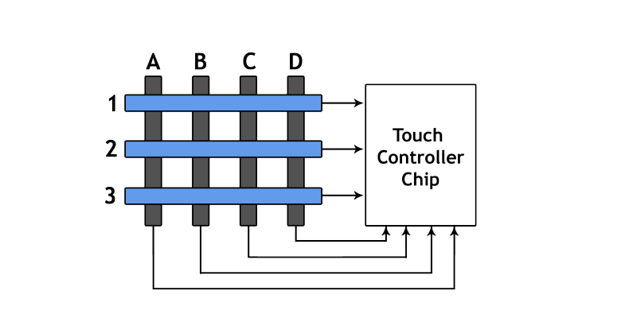
iPhone Capacitive Touch Sensor
Touchsensor
E

Slide 6
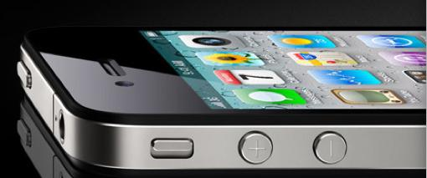
Liquid Crystal Display (LCD) and Touch Panel
Protective cover
Capacitive Touch Sensor
Iphone image by Sean MacEntee http://www.flickr.com/photos/smemon/4679667189/sizes/l/in/photostream/ on flickr

Slide 7
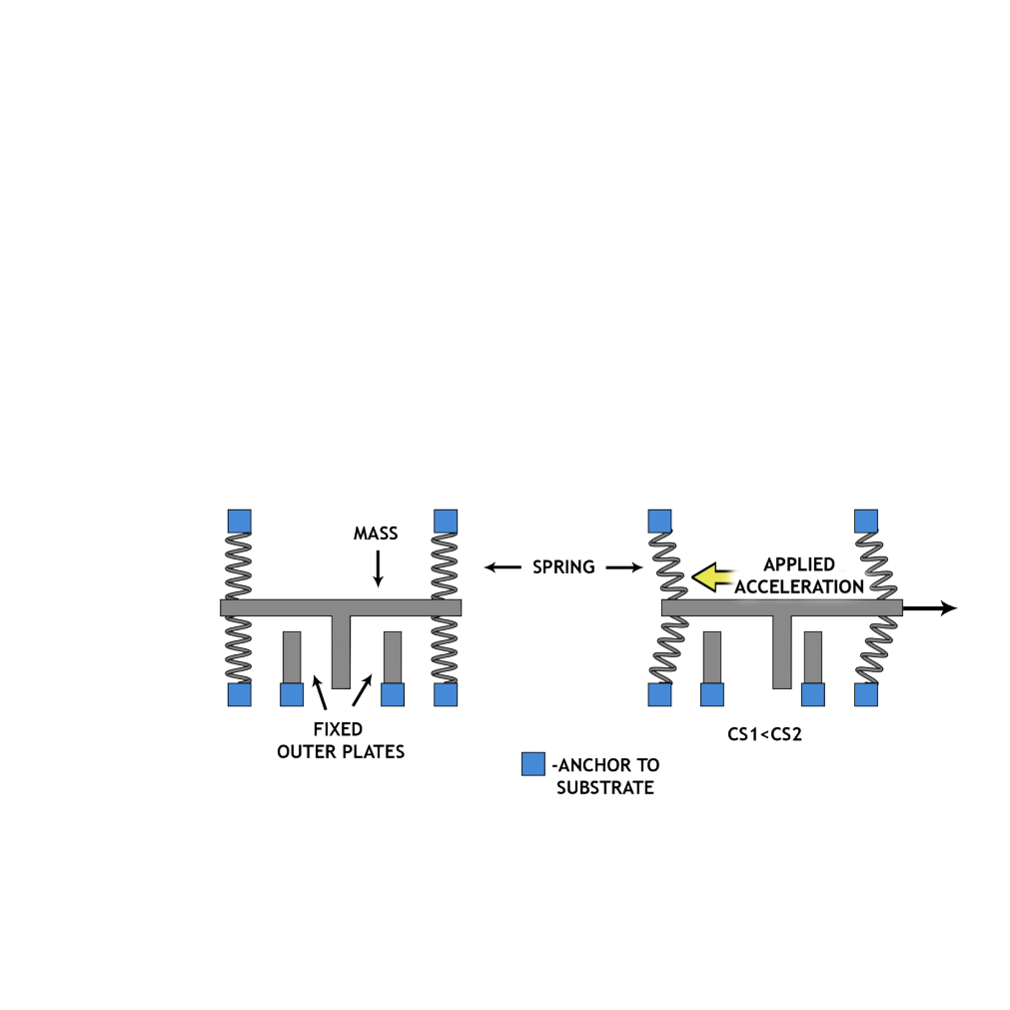
Accelerometers
Accelerometer
SENSOR AT REST
RESPONDING TO AN APPLIED ACCELERATION
(MOVEMENT SHOWN IS GREATLY EXAGGERATED)

Slide 8
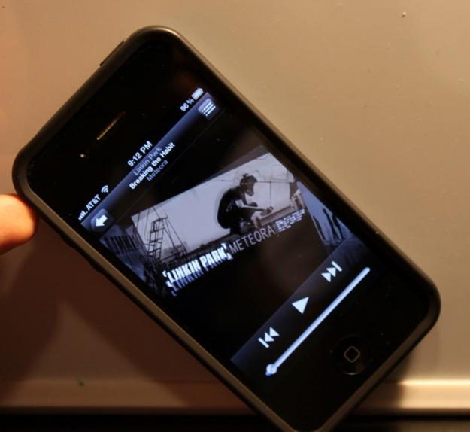
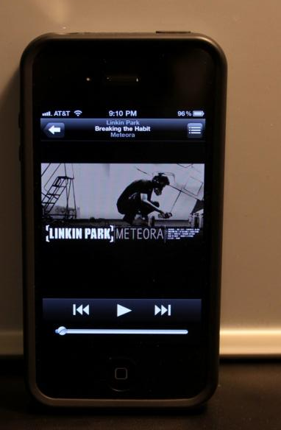
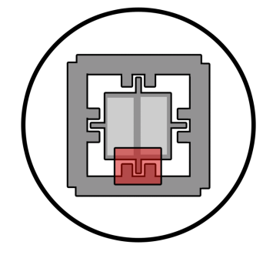

Accelerometer
… detects when you rotate the iPhone from Portrait to Landscape, and automatically rotates the content of the display
SILICON MASS
SILICON
SPRINGS
CAPACITIVE
SENSOR

Slide 9
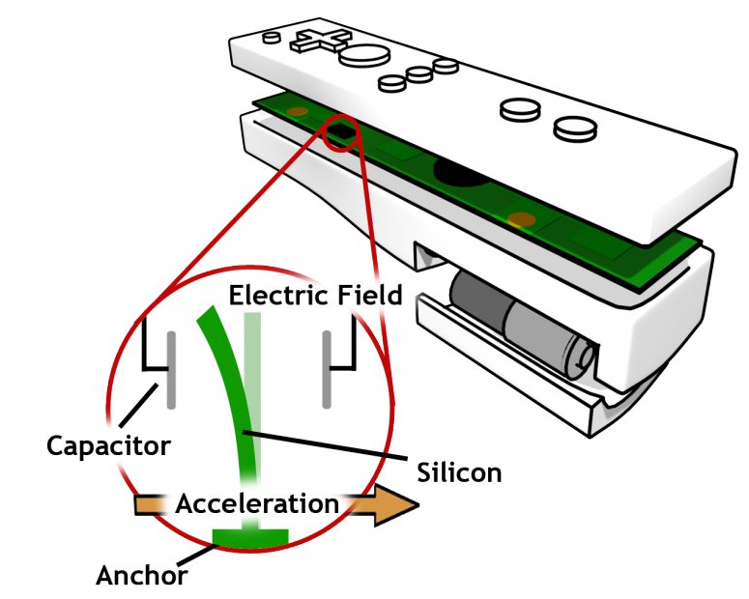
Accelerometers are Everywhere

Slide 10
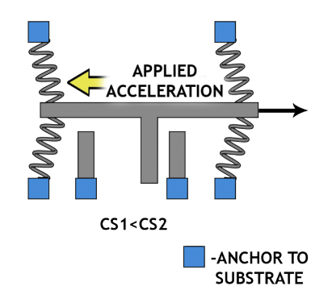
Capacitors in the iPhone
Accelerometer
Touchsensor

Slide 11
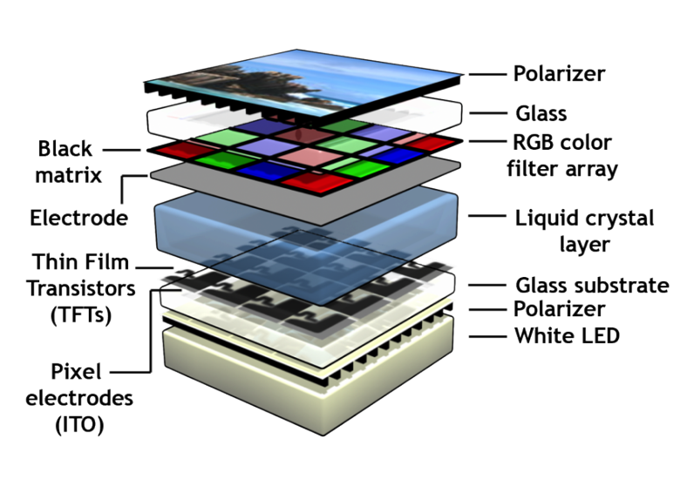


Liquid Crystal Displays
-Liquid crystals are electrically controlled light switches

Slide 12
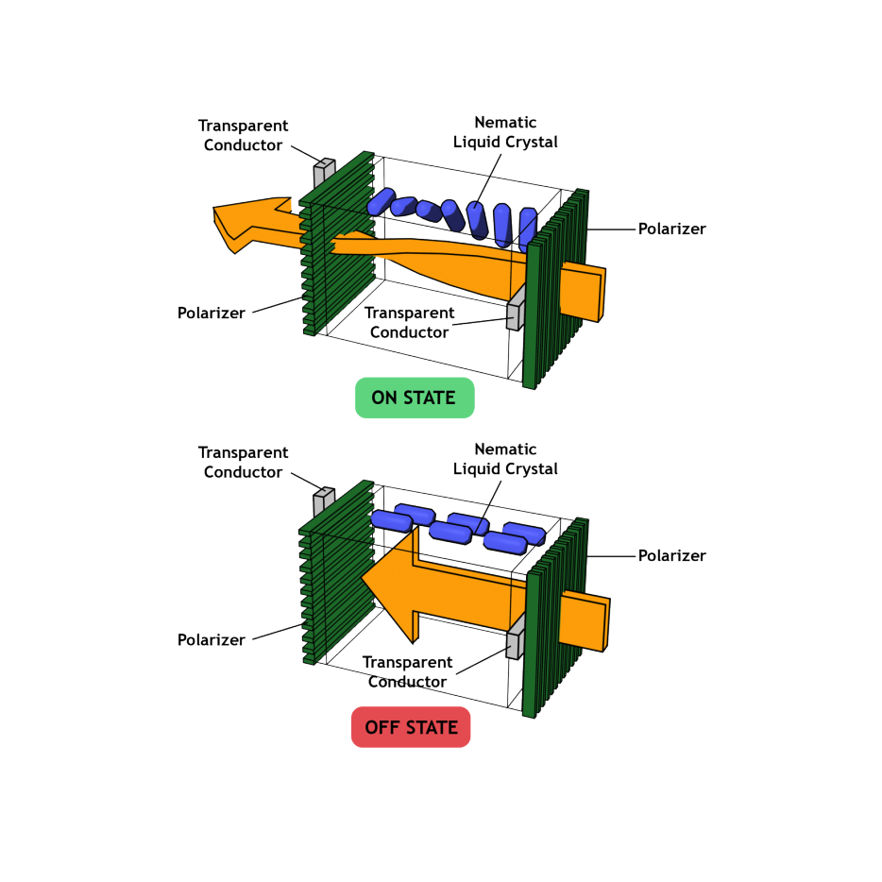
Liquid Crystal Displays
LCD Display
E
E
How can a material rotate polarization? (ANSWER IN LAB 3)

Slide 13
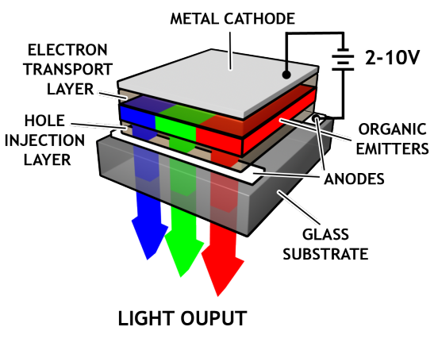
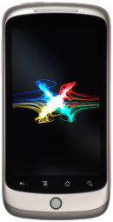
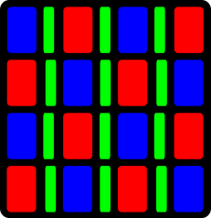
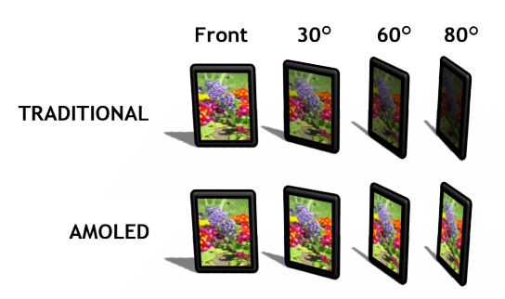
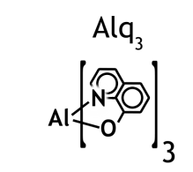
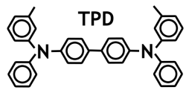
Nexus One: Organic LED Display
OLED subpixels …
OLED pixels …
Nexus One picture in public domain
Organic emitters …

Slide 14
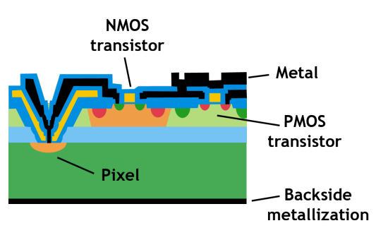
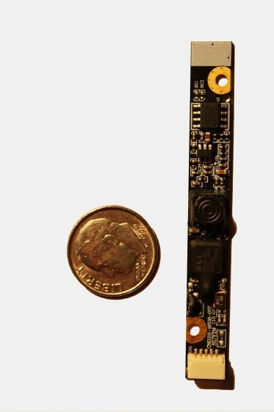
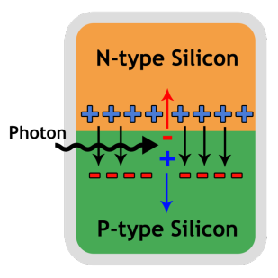
CMOS Photodiode Imagers
CMOS Imager Pixel
Photon
Charge (electron + hole)
Current (E-field pulls charge apart)

Slide 15
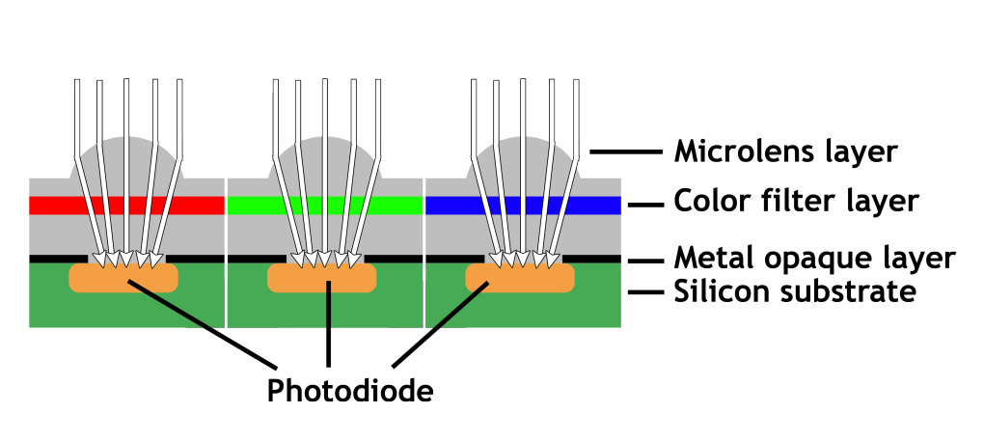
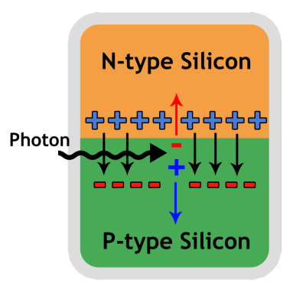
CMOS Photodiode Imagers

Slide 16

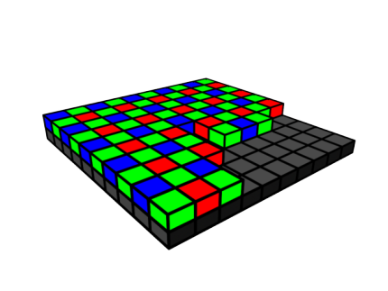
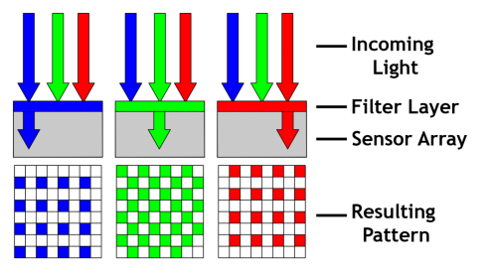
CMOS Imagers: Color Filters

Slide 17
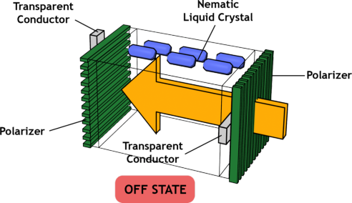
Capacitors in the iPhone
LCD Display
CMOS Photodiode Imager
-

Slide 18
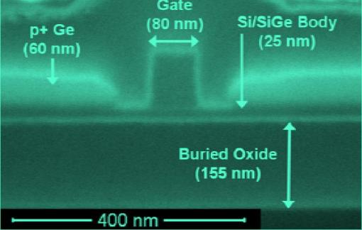

MOSFET: Transistor in a Nutshell
Conduction electron flow
Control
Gate
Source
Drain
Image courtesy of J. Hoyt Group, EECS, MIT.
Photo by L. Gomez
Control Gate
Image courtesy of J. Hoyt Group, EECS, MIT.
Photo by L. Gomez
Semiconductor
Transistor is an electrically (capacitively) controlled switch

Slide 19
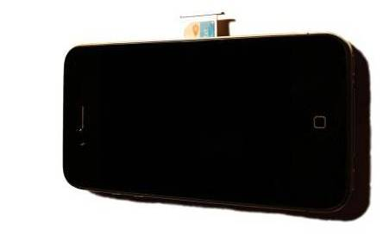
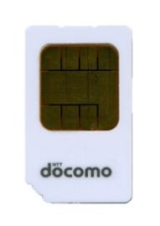
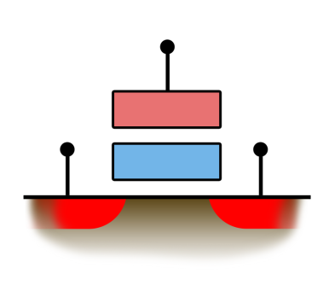
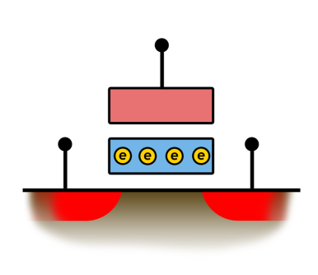
Card picture in public domain
Stored Electrons
Erased ‘1’
Programmed ‘0’
8GB iPhone employs Samsung's 65-nanometer 8-Gbyte MLC NAND flash

Slide 20

Capacitors in the iPhone
Image courtesy of Department of Electrical Engineering and
Computer Science, MIT. Photo by L. Gomez, J. Hoyt
Programmed ‘0’
CMOS Transistor
Flash Memory

Slide 21
Capacitors in the iPhone
Touchsensor
LCD Display
Accelerometer
CMOS Photodiode Imager
CMOS Transistor
Flash Memory

Slide 22
Three Big Ideas in 6.007
Accelerometer
LCD Display
MECHANICAL–TO–ELECTRICAL ENERGY CONVERSION
INTERACTION OF LIGHT AND MATERIALS
QUANTUM MECHANICAL TUNNELING
LCD Display
CMOS Photodiode Imager
CMOS Transistor
Flash Memory

Slide 23
iPhone Components | 6.007 Concepts
Touchpad | Capacitors
Display | Lights, Waveguides, Filters
Memory Card SIM | QM Tunneling Phenomena
Camera | Light Absorption, Photodetectors
Battery | Chemical Energy Conversion / Storage
Antennas | EM waves
Accelerometer, Speaker | Mechanical Energy Conversion, MEMS
LEDs | Solid State Lighting

Slide 24
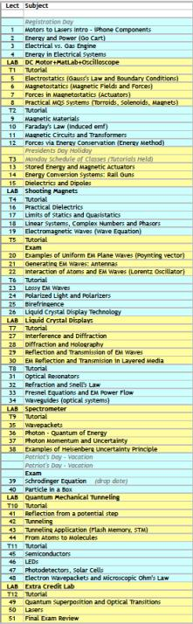
iPhone Components | 6.007 Concepts
Touchpad | Capacitors
Accelerometer, Speaker | Mechanical Energy Conversion, MEMS
Battery | Chemical Energy Conversion
Antennas | EM waves
Camera | Light Absorption, Photodetectors
Display | Lights, Waveguides, Filters, Eyes
Memory Card SIM | QM Tunneling Phenomena
LEDs | Solid State Lighting

Slide 25
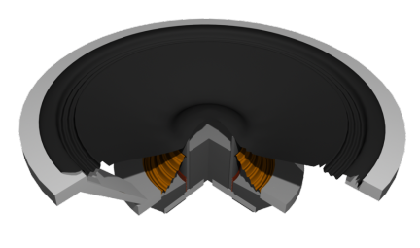
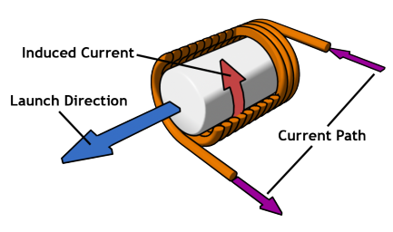
Inductors in the iPhone
not a simple inductor (not magnetostatics)

Slide 26

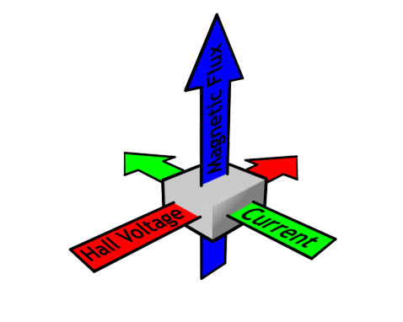
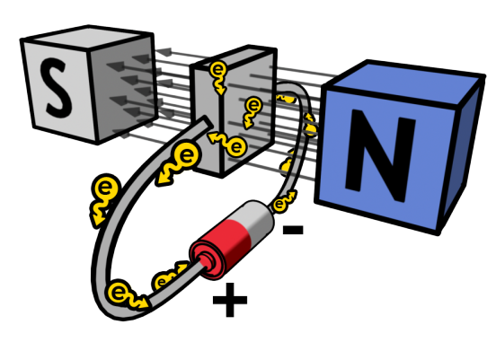
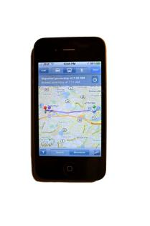

Magnetometers
Lorentz Force Law…
Hall Effect
Magnetic field deflects electrons …
… charge piles up on edges
& creates transverse potential difference
What is this doing in the iPhone 3G and Nexus One?
Nexus One picture in public domain

Slide 27

Course Details
Recommended Reading
Applied Electromagnetics
(Third edition)
L. C. Shen, J. A. Kong,
PWS publishing, 1995.
An Introduction to Quantum Physics
A.P. French, E. F. Taylor
W. W. Norton & Co, 1978.
Image is in the public domain
Grading
5 Labs 10%
10 Problem Sets 20%
2 Midterms 40%
1 Final Exam 30%

Slide 28
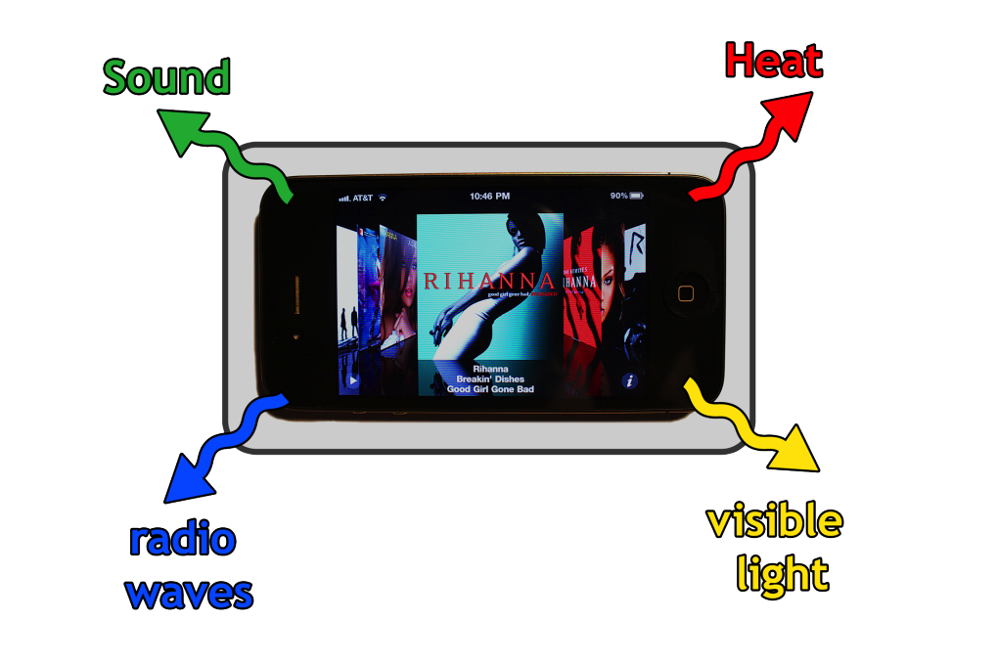
Energy Conversion in the iPhone

Slide 29
Energy Conversion in the iPhone
Heat: Charging and discharging transistors (capacitors)
Microprocessor energy consumption:
Variable speed microprocessor 620 MHz at 0.45 mW/MHz
Running 7 hours of video at ~280mW (620 MHz) = 1960 mWh
Running 8 hours of audio at <280mW (<620 MHz) < 2240 mWh
Visible Light: LED in Display:
3mW/cm² for ~40 cm² = 120 mW (40%) of processor power
7 hours of displaying = 840 mWh
Radio: Antenna radiation:
130mW of radiation (for 135g iPhone → 0.974 W/kg)
8 hours of operation = 1040 mWh
(Note: allowed FCC rating for portable appliances – 1.6 W of radiation per kg)
Total consumption over 7 hours of video (microprocessor+display) = 2800 mWh
Total consumption over 8 hours of talk (microprocessor+antenna) = 3280 mWh
Battery capacity 1400 mAh at 3.7V = 5180 mWh

Slide 30
Good Engineers …
Place ethics and morals above all else
Are team players
Follow a deterministic design process
Follow a schedule
Document their work
Never stop learning
Notes:
From “Design is a passionate process” http://design_chapter_1_pergatory.mit.edu.pdf
Consider the design engineer.
A design engineer is an engineer whose job is to produce a detailed design from a conceptual design, thereby bringing the real from the abstract.
A design engineer’s product is usually a set of drawings and specifications that should produce a working product with very little final adjustment needed. If significant rework is required in the construction, startup, or manufacturing phase, the design engineer did not do an acceptable job. This ability to foresee potential problems is a key skill for a design engineer. Flaws in the conceptual design that go uncaught by the design engineer or others will not surface until production or construction. A design engineer would usually work on a newer and less proven design than a designer, since once the engineering principles are proven to be correct in a similar design, further engineering knowledge and skill is not generally needed to produce similar designs.
Combining design and engineering into a single discipline is perhaps a lost practice due to increasing division of work and specialization. However, current (1990s and on) trends in the engineering of complex systems are largely towards re-integration of work processes. For example, the notions of Integrated Product Teams and Concurrent Engineering place design firmly within the scope of a wider engineering activity.
Design engineer From Wikipedia, the free encyclopedia, wikipedia.com, August 2006

Slide 31
MIT OpenCourseWare
http://ocw.mit.edu
6.007 Electromagnetic Energy: From Motors to Lasers
Spring 2011
For information about citing these materials or our Terms of Use, visit: http://ocw.mit.edu/terms.

