Slide 1
Electrostatics
(Free Space With Charges & Conductors)
Reading - Shen and Kong – Ch. 9
Outline
Maxwell’s Equations (In Free Space)
Gauss’ Law & Faraday’s Law
Applications of Gauss’ Law
Electrostatic Boundary Conditions
Electrostatic Energy Storage

Slide 2
Maxwell’s Equations (in Free Space with Electric Charges present)
DIFFERENTIAL FORM
INTEGRAL FORM
E-Gauss:
Faraday:
H-Gauss:
Ampere:
Static arise when , and Maxwell’s Equations split into decoupled
electrostatic and magnetostatic eqns.
Electro-quasistatic and magneto-quasitatic systems arise when one (but not both) time derivative becomes important.
Note that the Differential and Integral forms of Maxwell’s Equations are related through
Stoke’s Theorem and Gauss’ Theorem

Slide 3
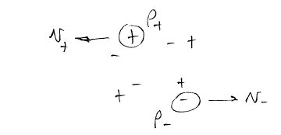
Charges and Currents
Charge conservation and KCL for ideal nodes
There can be a nonzero charge density in the absence of a current density .
There can be a nonzero current density in the absence of a charge density .

Slide 4



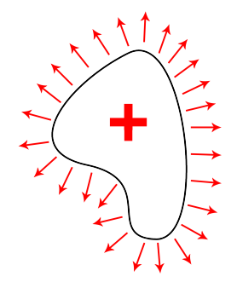
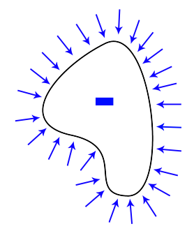


Gauss’ Law
Flux of through closed surface S = net charge inside V

Slide 5
Point Charge Example
Apply Gauss’ Law in integral form
making use of symmetry to find
Assume that the image charge is uniformly distributed at .
Why is this important ?
Symmetry

Slide 6
Gauss’ Law Tells Us …
… the electric charge can reside only on the surface of the conductor.
[If charge was present inside a conductor, we can draw a Gaussian surface around that charge and the electric field in vicinity of that charge would be non-zero !
A non-zero field implies current flow through the conductor, which will transport the charge to the surface.]
… there is no charge at all on the inner surface of a hollow conductor.
… that, if a charge carrying body has a sharp point, then the electric field at that point is much stronger than the electric field over the smoother part of the body.
Lets show this by considering
two spheres of different size, connected by a long, thin wire …

Slide 7







SPHERE B
Because the two spheres are far apart, we can assume that charges are uniformly distributed across the surfaces of the two spheres,
with charge q_{a} on the surface of sphere A
and q_{b} on the surface of sphere B
SPHERE A
b
WIRE
a
… and the E-field on the surface of the spheres is:
Note that E_{a} >> E_{b} if b >> a
from Shen and Kong

Slide 8
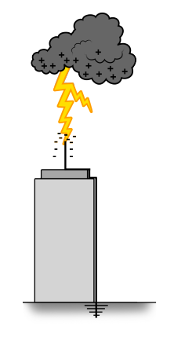

Image by http://www.flickr.com/photos/
zokuga/5817408342/ on flickr
Lightning Rod
When a conductive body contains sharp points,
the electric field on these points is much stronger than that on the smooth part of the conducting body.
Lighting Rods are connected to the ground. When a cloud carrying electric charges approaches, the rod attracts opposite charges from the ground. The Electric field at the tip of the rod is much stronger than anywhere else. When the E-field exceeds the
air breakdown strength (of 33 kV/cm), charges start to travel to ground.

Slide 9
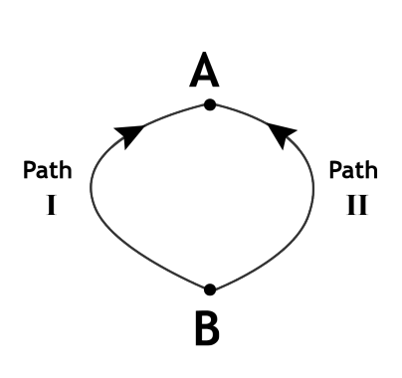
Faraday’s Law
Dynamic form:
Static form:
and
Path I
Path II
Path I
Path II
A unique path-independent potential
may be defined if and only if

Slide 10
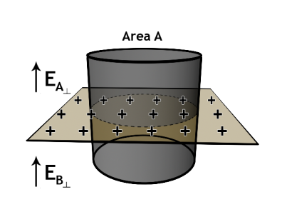
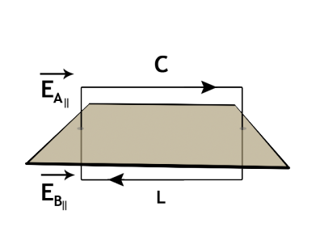
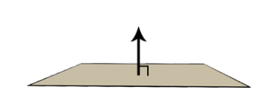
Boundary Conditions
Normal is discontinuous at a surface charge.
Tangential is continuous at a surface.
A static field terminates
perpendicularly on a conductor

Slide 11
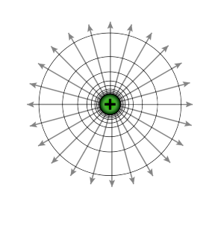

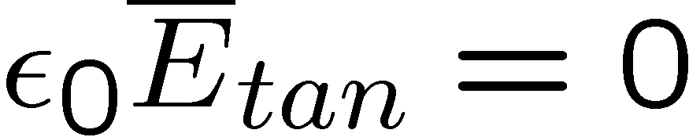


Point Charges Near Perfect Conductors
Time t = 0
+ + + + + + +
+ + + + + + +
+ + + + + + +
-
-
-
-
-
-
-
-
-
-
-
-
-
-
-
-
-
-
-
-
-
-
-
Time t >> 0
+ + + + + + +
+ + + + + + +
+ + + + + + +
-
-
-
-
-
-
-
-
-
-
-
-
-
-
-
-
-
-
-
-
-
-
-

Slide 12
Point Charges Near Perfect Conductors
+
-
-
-
-
-
-
-
-
-
+
+
+
+
-
-
-
-
-
+
+
+
+
-
-
+
+
+
+
+
+
+
+
+
+
+
+
Negative charge on top surface of conductor
Positive charge on top and bottom surface of conductor

Slide 13

Uniqueness and Equivalent Image Charges
-
-
-
-
-
-
-
-
-
+
+
+
+
-
-
-
-
-
+
+
+
+
-
-
Equivalent Image Charge

Slide 14

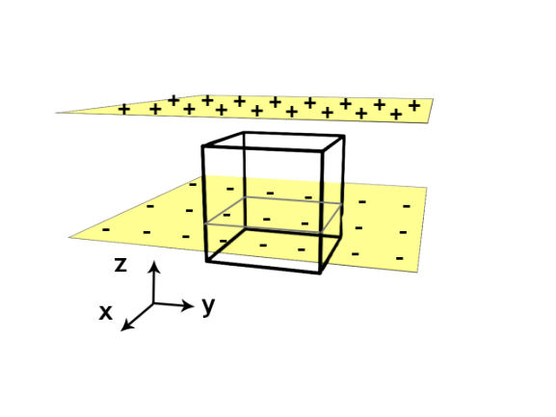
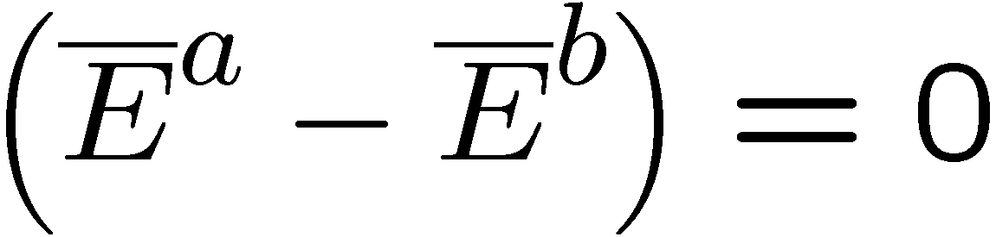


Electrostatic Boundary Conditions
        There is a jump in the normal electric field as one passes through a surface charge
Tangential field is continuous

Slide 15
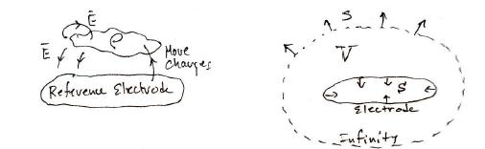
Energy Stored in
Electric Fields
Begin with a neutral reference conductor, the charge reservoir. Its potential is zero, by definition.
Move charges from the reference conductor into free space, thereby creating an electric field and doing work in the process. The work is stored as potential energy in the electric fields.
Account for all the work done, and thereby derive the energy stored in the electric fields.
The argument directly extends to systems with multiple conductors
(and dielectrics).
The work done by moving charge to a location with potential is . More generally, the work done to make an incremental charge change to a charge density is
Gauss’ Law
ZERO ! WHY ?
ENERGY DENSITY [J/m³]

Slide 16
Energy Stored in Electric Fields
The energy stored in an electric field is ½ ε₀ E².
The maximum achievable field strength is
typically limited by electric breakdown
Note: Dielectric constant is

Slide 17

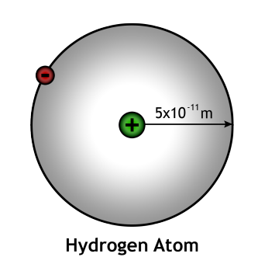
1.54 Å
1.16 Å
Modeling Atoms and Molecules
as Capacitors that Store Energy
H H
H - C – C – H
H H
0.96 Å
O
H H
- -
- -
-
-
O = C = O
1.10 Å
These product molecules have shorter bond lengths than the initial reactant molecule, hence the charge in them
sits closer together. This can be
modeled as a higher capacitance.
Since voltage V = Q/C = E • d is reduced,
stored energy W/Volume = ½ ε_{o}E²
is reduced in these molecules
Burn this molecule by reacting it
with oxygen
ENERGY OF AN ELECTRON IN AN ALKANE MOLECULE IN GASOLINE
Energy [eV]
ENERGY OF AN ELECTRON IN H₂O or CO₂
0 V
Hydrogen ground state energy is -13.6 eV
If the hydrogen radius was twice as long, what would be the ground state energy ?
_
ENERGY GIVEN OFF AS HEAT IN THE PROCESS OF GASOLINE COMBUSTION
+
_
Remember this
unit of energy:
1 eV = 1.6 x 10⁻¹⁹ J
+

Slide 18

Leyden Jar

Slide 19
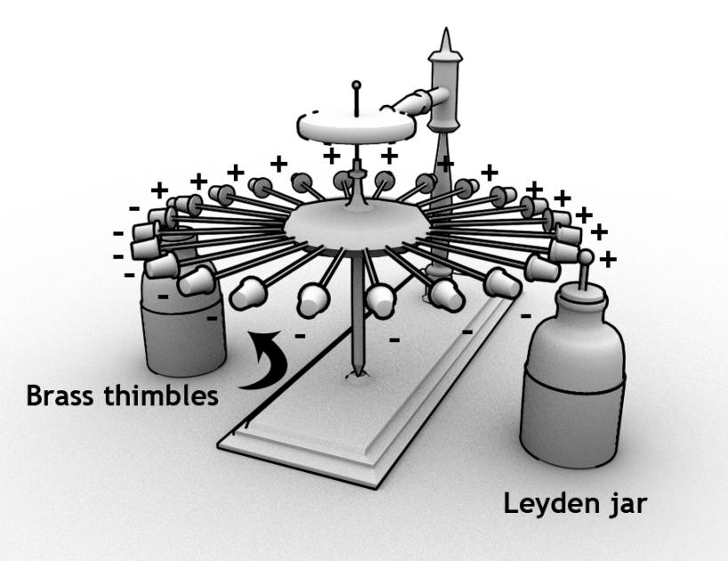
Franklin’s motor (1748)

Slide 20
KEY TAKEAWAYS
Maxwell’s Equations (in Free Space with Electric Charges present):
DIFFERENTIAL FORM
INTEGRAL FORM
E-Gauss:
Faraday:
H-Gauss:
Ampere:
Boundary conditions for E-field:
  . Normal E-field – discontinuous
  . Tangential E-Field - continuous
GOOD FACTS TO REMEMBER:
AIR BREAKDOWN STRENGTH
is 33 kV/cm
NEW UNIT OF ENERGY:
Energy stored in the
electric field per unit volume is:
Energy released when fuel molecules are oxidized since the charges in the products
are positioned closer together than in reactants (hence in a lower energy state)
Dielectric constant in free space is

Slide 21
MIT OpenCourseWare
http://ocw.mit.edu
6.007 Electromagnetic Energy: From Motors to Lasers
Spring 2011
For information about citing these materials or our Terms of Use, visit: http://ocw.mit.edu/terms.

