Slide 1
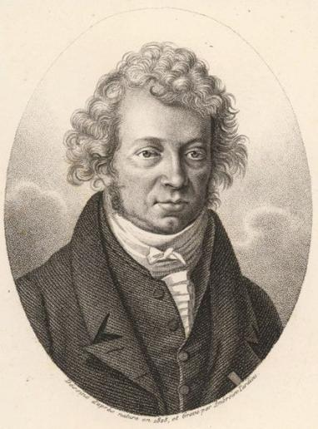
Magnetostatics
(Free Space With Currents & Conductors)
Suggested Reading - Shen and Kong – Ch. 13
Outline
Review of Last Time: Gauss’s Law
Ampere’s Law
Applications of Ampere’s Law
Magnetostatic Boundary Conditions
Stored Energy
André-Marie Ampère, 1775-1836
portrait is in the Public Domain

Slide 2







Electric Fields
Magnetic Fields

Slide 3
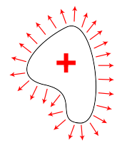
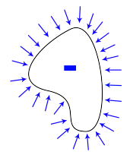



1st Observation: Coulomb’s Law
Fields fall-off as 1/r² from point charge…
Gauss’s Law:
Gauss’s Law encompasses all observations related to Coulomb’s Law…

Slide 4
2nd Observation: Force and Potential Energy
From 8.01:
From 8.02:
Where is this in Maxwell’s Equations?
Integral form:
For closed loops (where a=b):
Faraday’s Law (static) accounts for the E-field being a conservative force…

Slide 5
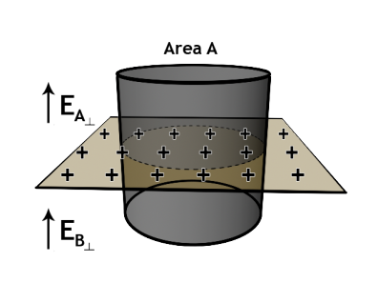
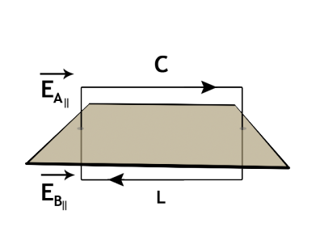
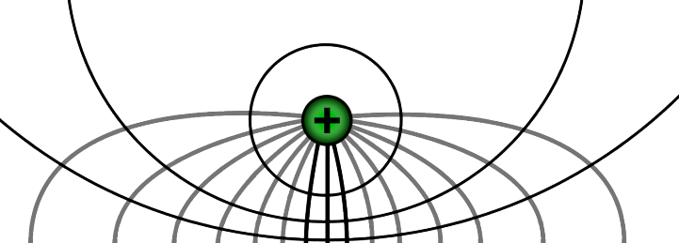
Boundary Conditions from Maxwell’s Laws
Normal is discontinuous at a surface charge.
Tangential is continuous at a surface.
A static field terminates
perpendicularly on a conductor

Slide 6
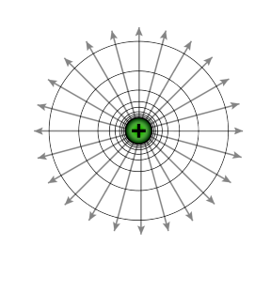
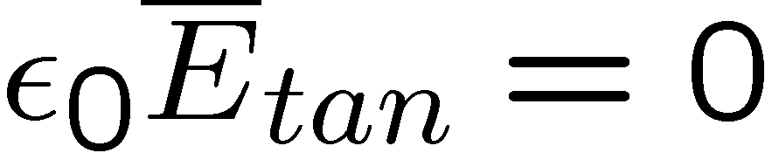


Point Charges Near Perfect Conductors
Time t = 0
+ + + + + + +
+ + + + + + +
+ + + + + + +
-
-
-
-
-
-
-
-
-
-
-
-
-
-
-
-
-
-
-
-
-
-
-
Time t >> 0
+ + + + + + +
+ + + + + + +
+ + + + + + +
-
-
-
-
-
-
-
-
-
-
-
-
-
-
-
-
-
-
-
-
-
-
-

Slide 7
Point Charges Near Perfect Conductors
+
-
-
-
-
-
-
-
-
-
+
+
+
+
-
-
-
-
-
+
+
+
+
-
-
+
+
+
+
+
+
+
+
+
+
+
+
Negative charge on top surface of conductor
Positive charge on top and bottom surface of conductor

Slide 8
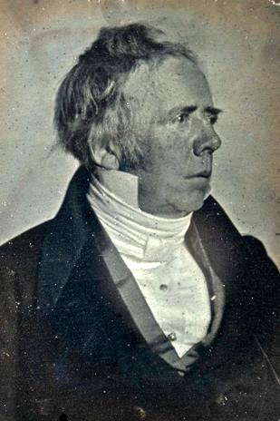
In 1820, which Ørsted described as the happiest year of his life, Ørsted considered a lecture for his students focusing on electricity and magnetism that would involve a new electric battery. During a classroom demonstration, Ørsted saw that a compass needle deflected from magnetic north when the electric current from the battery was switched on or off. This deflection interestred Ørsted convincing him that magnetic fields might radiate from all sides of a live wire just as light and heat do. However, the initial reaction was so slight that Ørsted put off further research for three months until he began more intensive investigations. Shortly afterwards, Ørsted's findings were published, proving that an electric current produces a magnetic field as it flows through a wire. This discovery revealed the fundamental connection between electricity and magnetism, which most scientists thought to be completely unrelated phenomena.
His findings resulted in intensive research throughout the scientific community in electrodynamics. The findings influenced French physicist André-Marie Ampère’s developments of a single mathematical form to represent the magnetic forces between current-carrying conductors. Ørsted's discovery also represented a major step toward a unified concept of energy.
Hans Christian Ørsted
Picture in Public Domain
http://www.bookrags.com/biography/hans-christian-orsted-wop/
http://en.wikipedia.org/wiki/Hans_Christian_Oersted

Slide 9
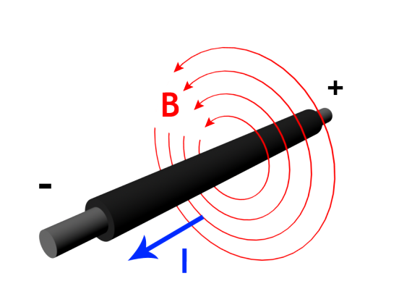
3rd Observation: Magnetic Fields from Wires
Ampere observe that:
1) the H-field is rotationally symmetric around wire
2) the H-field falls off as 1/r
3) the H-field is proportional to the current in the wire
Andre-Marie Ampere, Memoir on the Mathematical Theory of
Electrodynamic Phenomena, Uniquely Deduced from Experience (1826)

Slide 10
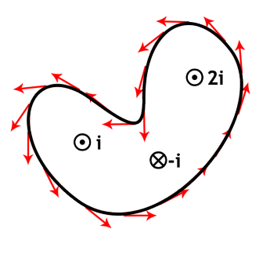


Ampere’s Law for Magnetostatics
portrait is in the Public Domain
Andre-Marie Ampere, Memoir on the Mathematical Theory of
Electrodynamic Phenomena, Uniquely Deduced from Experience (1826)

Slide 11
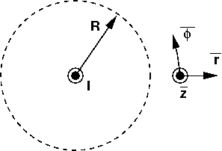


Magnetic Field
Around a Very Long Wire
Carrying Current
in the z-Direction
Ampere observe that:
1) the H-field is rotationally symmetric around wire
2) the H-field falls off as 1/r
3) the H-field is proportional to the current in the wire

Slide 12
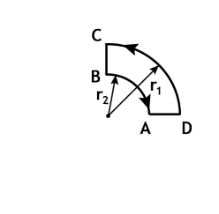
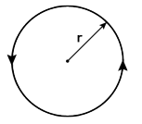
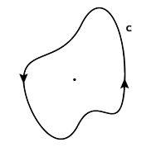
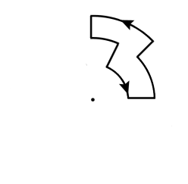
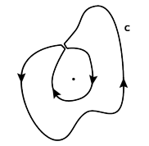
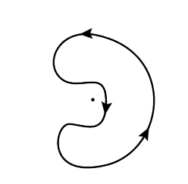
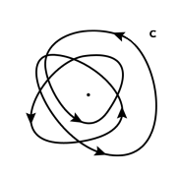
Ampere’s Law Examples
(d) Circular path
enclosing wire
Path lying in plane
perpendicular to wire
(e) Crooked path
enclosing wire
(b) Path constructed of
Radial segments and arcs
(f) Circular and
crooked path NOT
enclosing wire
(c) Path which does not
Enclose the wire
(g) Loop of N turns
enclosing wire

Slide 13
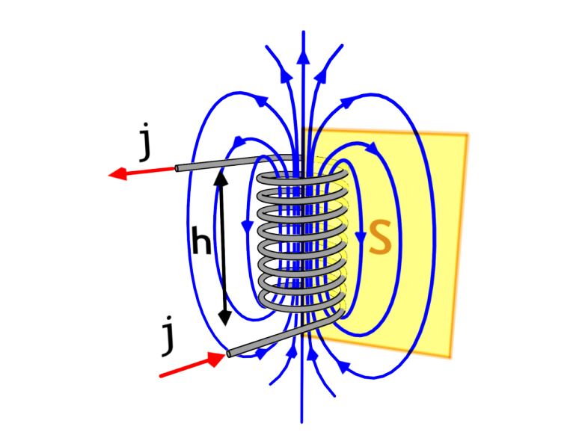

Fields from a Solenoid
N I
h

Slide 14
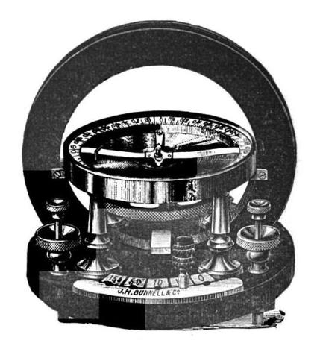
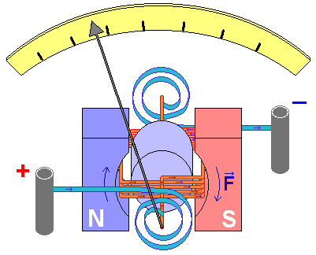
A galvanometer is a type of an electric current meter. It is an analog electromechanical transducer that produces a rotary deflection of some type of pointer in response to electric current flowing through its coil.
Ampere invented the galvanometer.
Schweigger used a coil (1821).
Nobili improved on it in 1825 with
two opposite magnets, one of which is in the coil.
Picture is In the Public Domain
© Fred the Oyster. CC BY-SA. This content is excluded from our Creative Commons license. For more information, see http://ocw.mit.edu/fairuse.

Slide 15
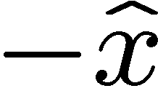
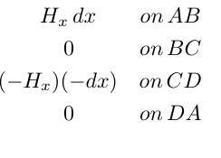

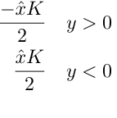
Magnetic Field Above/Below a Sheet of Current
… flowing in the direction with current density
uniform DC surface current
As seen “end on”, the current sheet may be thought of as a combination of parallel wires, each of which produces its own field. These fields combine, so that the total field above and below the current sheet is directed in and direction, respectively.
In between the wires
the fields cancel

Slide 16
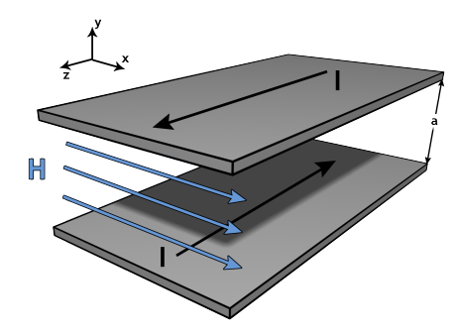
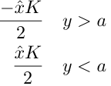

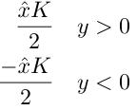



What happens if we place near by each other …
Two Parallel-Plate Conductors
… with currents flowing in opposite directions
Solve by using SUPERPOSITION
All the magnetic field is confined between the two current plates !

Slide 17
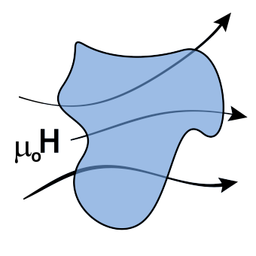
4th Observation: No Magnetic Monopoles
and
Gauss’ Law for Magnetic Fields
No net magnetic flux enters of exits a closed surface.
What goes in must come out.
Lines of magnetic flux ( ) never terminate.
Rather, they are solenoidal and close on themselves in loops.

Slide 18
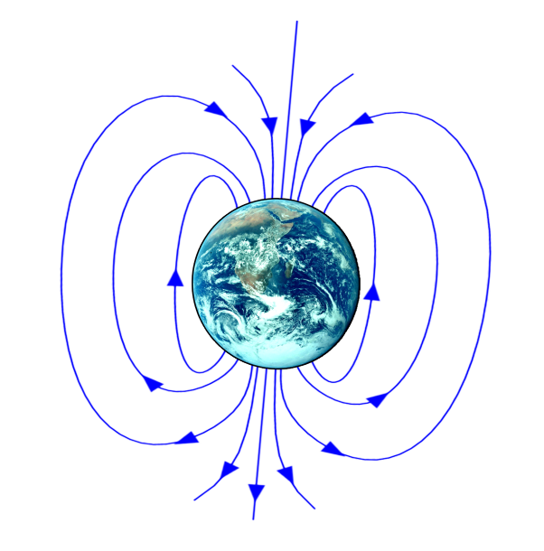
Earths Magnetic Field

Slide 19
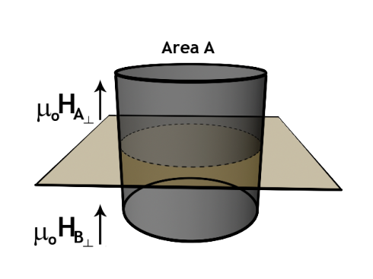
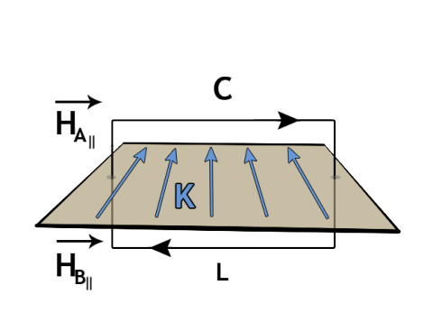
Magnetostatic Boundary Conditions
GAUSS’LAW:
Normal is continuous at a surface.
AMPERE’S LAW
Tangential is discontinuous at
a surface current .

Slide 20
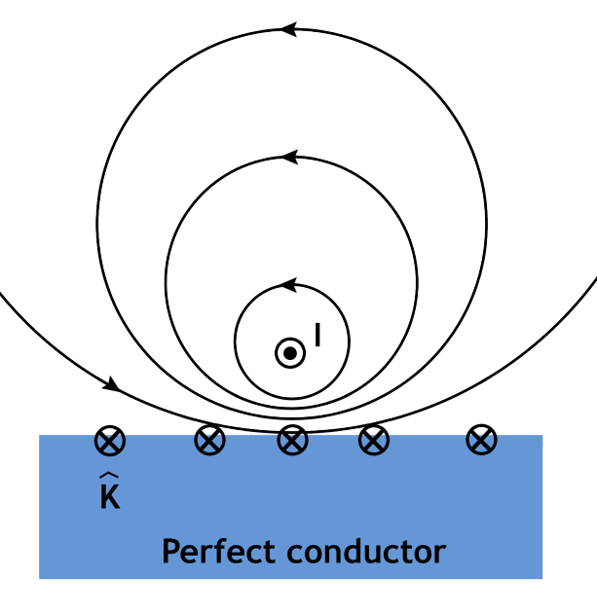
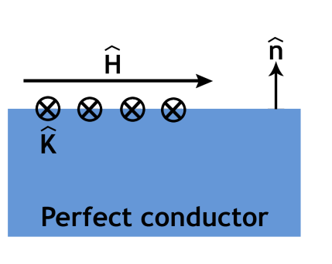
Magnetic Fields at Perfect Conductors
Perfect conductors exclude magnetic fields. Since normal is continuous across a surface, there can be no normal at the surface of a perfect conductor. Thus, only tangential magnetic fields can be present at the surface. They are terminated with surface currents.

Slide 21
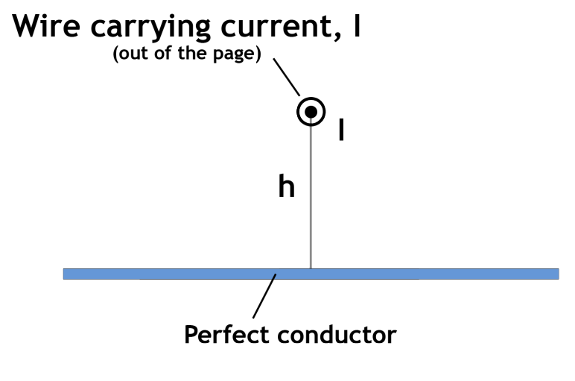
Boundary Condition Example:
Magnetic Field at a ‘perfect conductor’
There can be no fields (E or H) inside such perfect conductors,
so any H field just at the surface must be parallel to the surface.

Slide 22
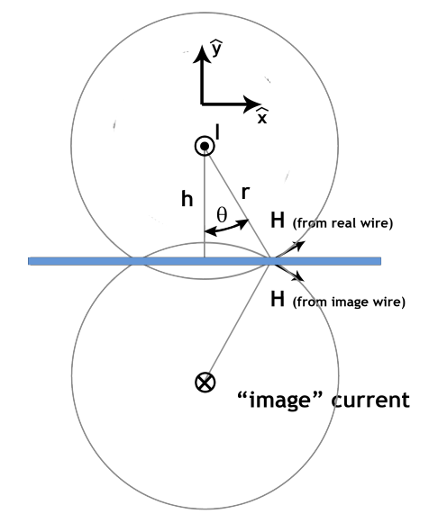
Solution uses the ‘Method of Images’:
A negative ‘image’ of the real current is situated below the surface, the same distance as the actual current, ensuring that the magnetic field at the surface is tangential.
A calculation of the x-directed (horizontal field at the surface of the ‘perfect’ conductor employs superposition of fields from the two (real and image) sources. At y=0:

Slide 23
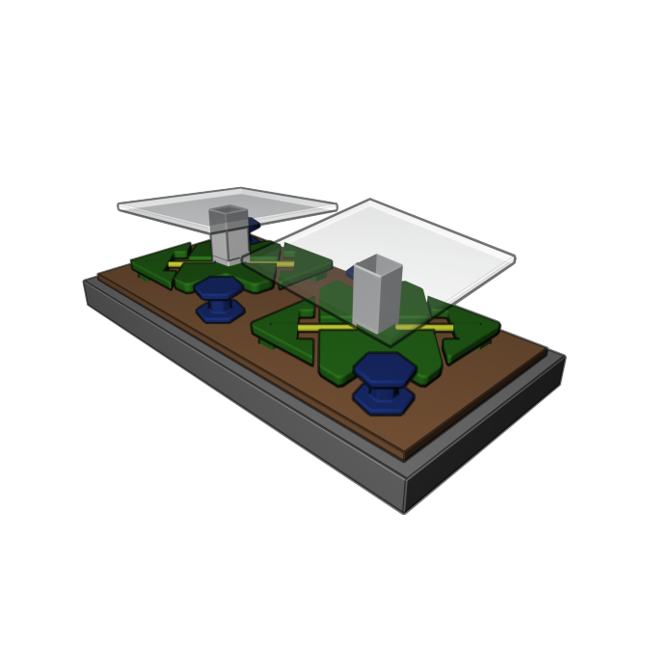

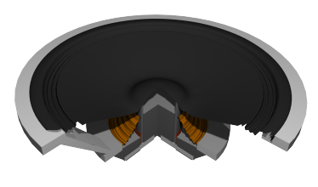
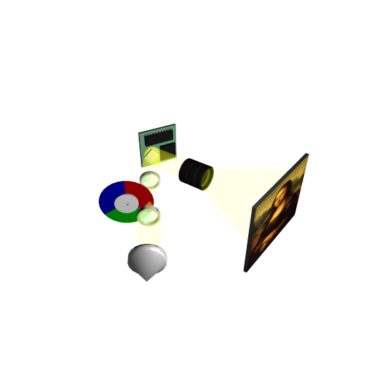
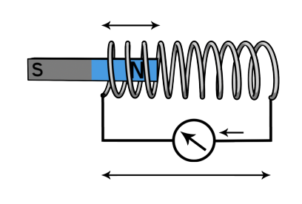
Actuators
Now that we know how to calculate
charges & E-fields, currents and H-fields
we are ready to calculate the forces that make things move

Slide 24
KEY TAKEAWAYS
Maxwell’s Equations (in Free Space with Electric Charges present):
DIFFERENTIAL FORM
INTEGRAL FORM
E-Gauss:
Faraday:
H-Gauss:
Ampere:
Boundary conditions for E-field:
  . Normal E-field – discontinuous
  . Tangential E-field - continuous
Boundary conditions for H-field:
  . Normal H-field – continuous
  . Tangential H-field - discontinuous

Slide 25
MIT OpenCourseWare
http://ocw.mit.edu
6.007 Electromagnetic Energy: From Motors to Lasers
Spring 2011
For information about citing these materials or our Terms of Use, visit: http://ocw.mit.edu/terms.

