Slide 1
Actuators in Electro- and Magnetostatics
Outline
Lorentz Force Law
MEMs Devices
Homopolar Motor
Speakers
Homopolar Generator

Slide 2
TRUE or FALSE?
Tangential electric field is always continuous at a surface.
Tangential magnetic field is always continuous at a surface.
An electric generator, or dynamo, is created by running a motor is reverse, i.e. hooking up the power source with the opposite polarity.

Slide 3
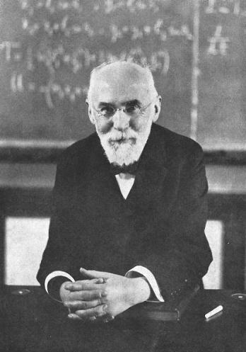

Lorentz Force Law (1892)
Replaced Ampere’s force law, widely used in the 1800s
v x B term had been known earlier; was published by Maxwell in 1861
Hendrik Lorentz
Note that this law does not explain forces on dielectrics or magnetically permeable materials. Most common actuators employ these forces.
Portrait in United States Public Domain

Slide 4
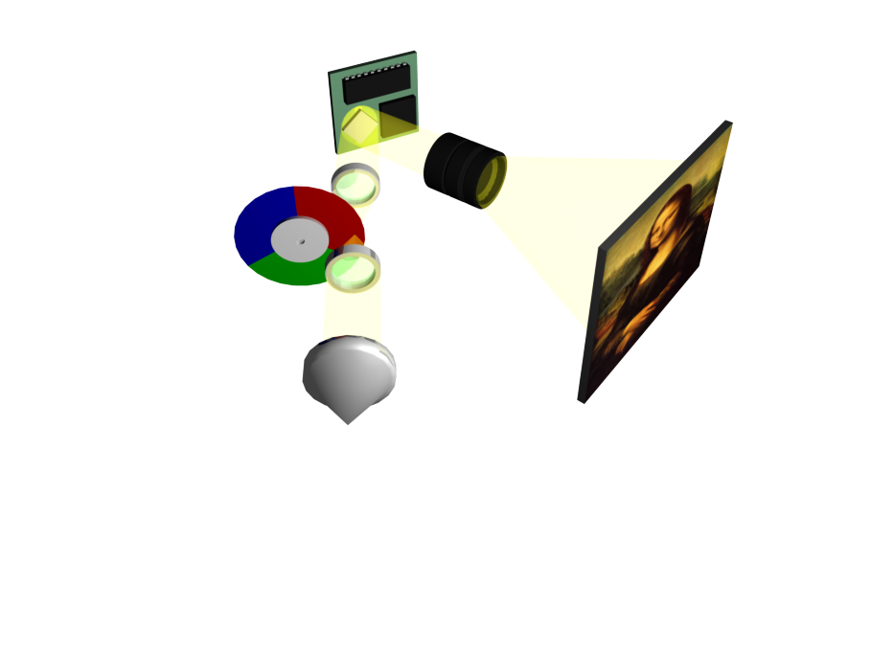
Digital Light Processing

Slide 5
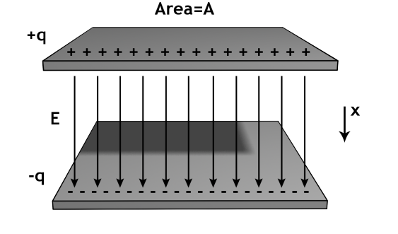
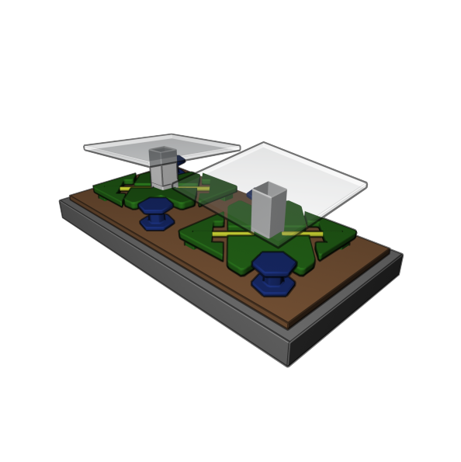
Normal Force between Two Charged Plates
Gauss’s Law:
^
q
E =
x
ε_{o}A
  In electric field systems, force tends to increase capacitance
  In magnetic field systems, force tends to increase inductance

Slide 6
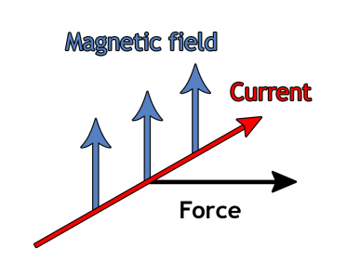
Force on a current carrying wire
Note this follows the ‘right-hand’ rule
Section of wire in a magnetic field: force per unit length is:
Check units: A X H/m X A/m = J/m^2 = N/m

Slide 7
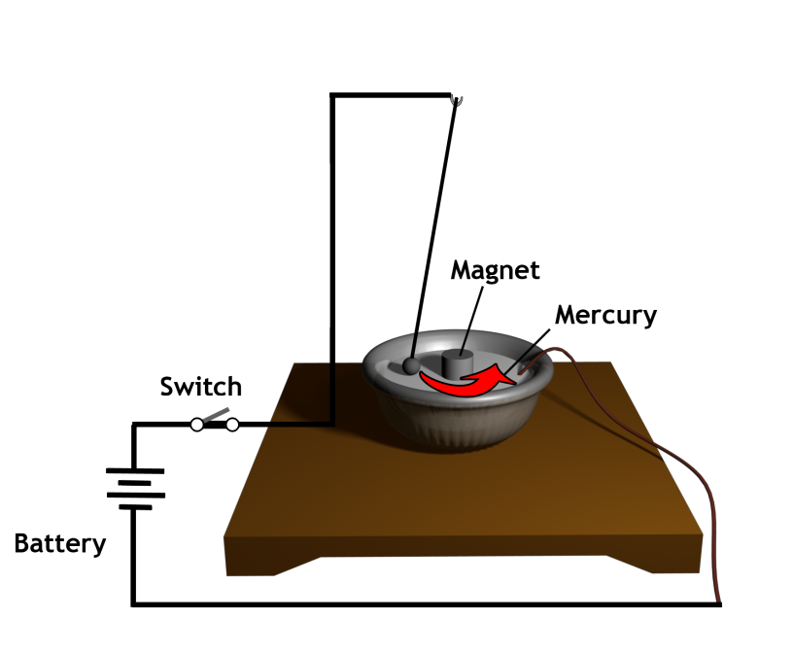
First magnetic motor as created by Michael Faraday in 1821
http://www.engineering-timelines.com/how/electricity/rotations.asp.

Slide 8
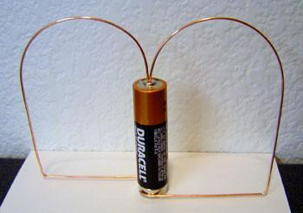
Homopolar Motor
Magnet

Slide 9
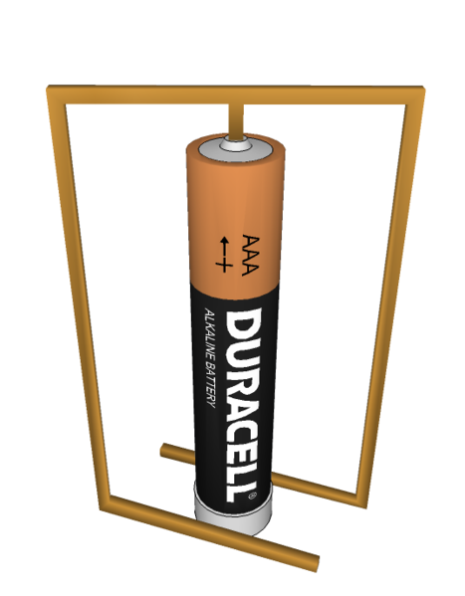
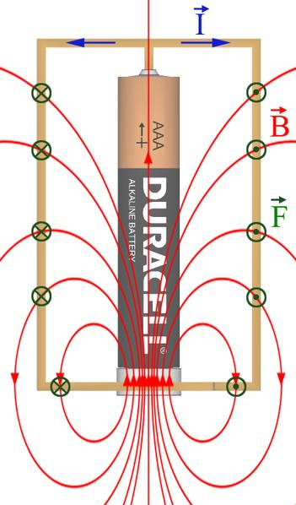
Homopolar Motor
Magnet

Slide 10
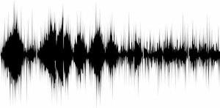
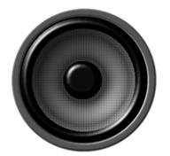
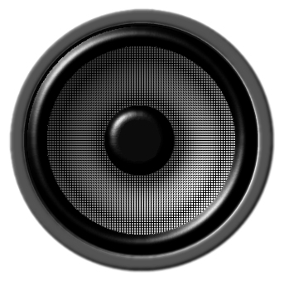
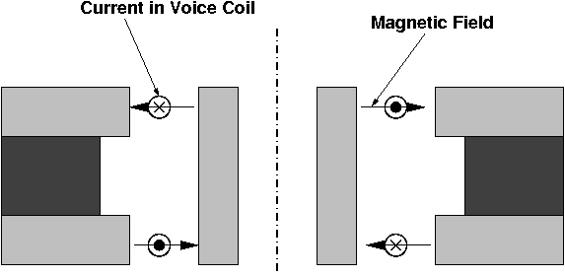
Speakers
Pressure waves
“Music! I feel happy, yay!”
Current (I) waveform

Slide 11
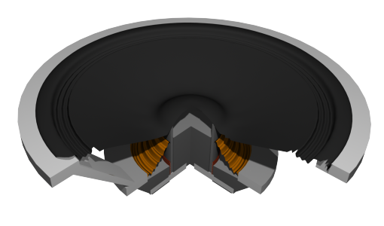
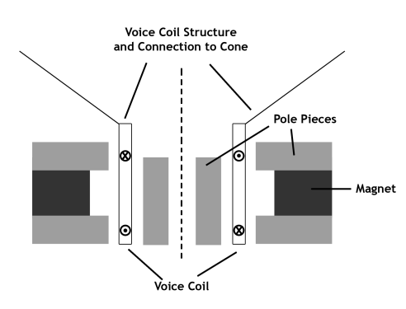
Loudspeaker
The loudspeaker is just a coil that makes a force applied to the paper cone. It has a low force spring to keep things centered (not shown below)
We will get to how the magnetic field is made later
http://static.howstuffworks.com/flash/speaker-working.swf

Slide 12
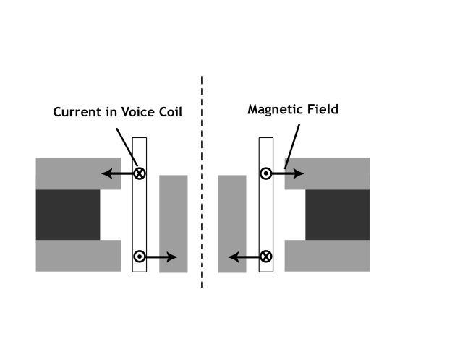
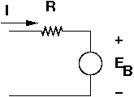
Force exerted on the voice coil: (up)
And here is the electrical equivalent circuit
Suppose the voice coil is light and produces a force:
So now you know what they mean when they talk of an 8 ohm speaker.

Slide 13

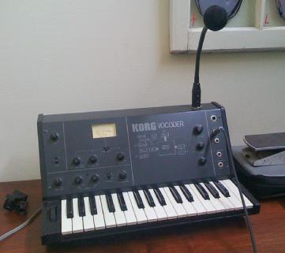
Today’s Culture Moment
Vocoders
A vocoder is an audio processor that captures the characteristic elements of an audio signal and then uses this characteristic signal to affect other audio signals. The technology behind the vocoder effect was initially used in attempts to synthesize speech. The effect called vocoding can be recognized on records as a "talking synthesizer", made popular by artists such as Stevie Wonder.
Image by snackfight on flickr http://www.flickr.com/photos/snackfight/3486304280/
Black Eyed Peas

Slide 14
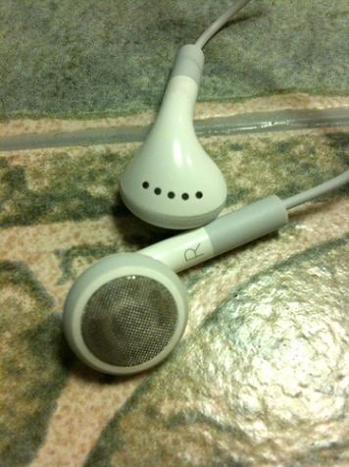
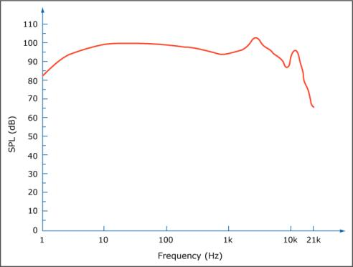
Speakers
Image by MIT OpenCourseWare.
Photograph by davidking on Flickr.
Why is it hard for earbuds to have good bass?

Slide 15
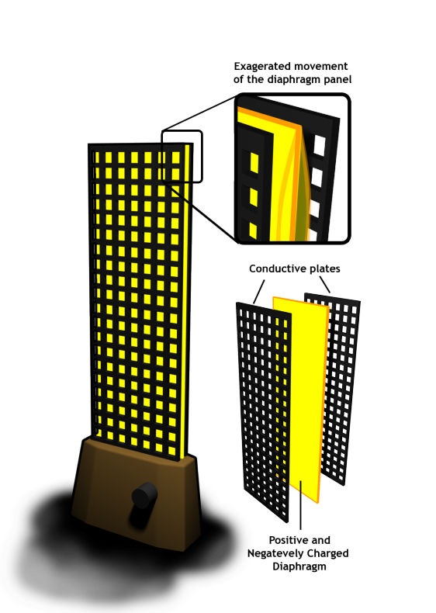
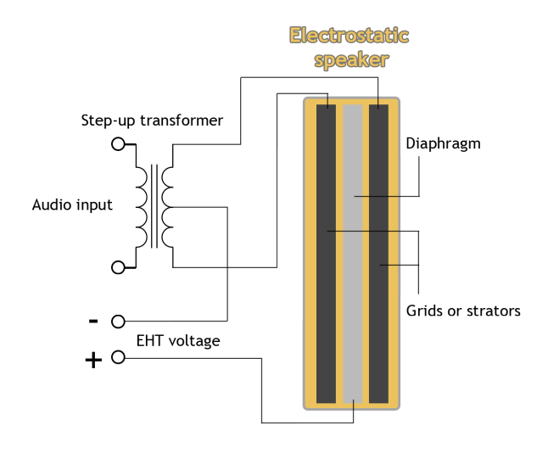
Electrostatic Speakers
Lower distortion
Extremely light weight diaphragm
Exemplary frequency response (both in amplitude and phase)
Lack of good bass response

Slide 16
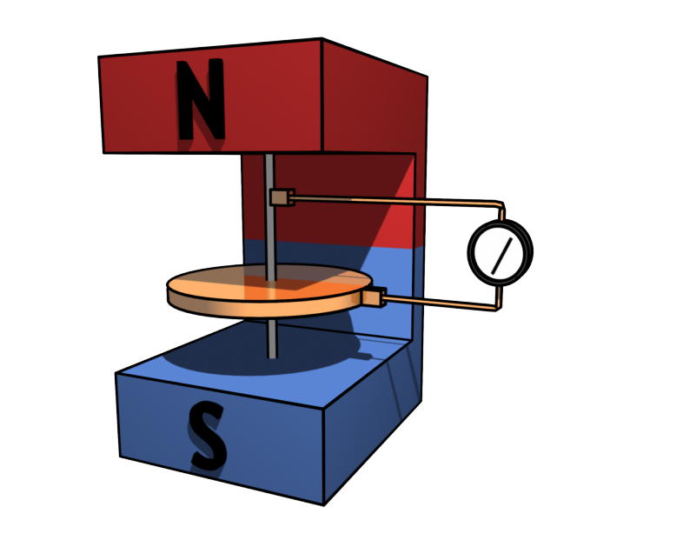
Homopolar Generator

Slide 17
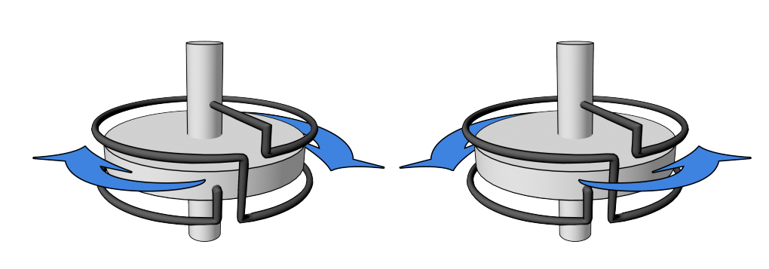
Dynamo Brain Teaser
Dynamo A
(b) Dynamo B
Only one of these devices can be a dynamo

Slide 18
Summary
Lorentz force law
MEMs actuators (such as DLP arrays) rely on electrostatic attraction
A commutator periodically reverses the current direction between the rotor
Speakers (vibrating diaphragm) can utilize magnetostatic or electrostatic forces
Induced current is always in such a direction as to oppose the motion or change causing it

Slide 19
MIT openCourseWare
http://ocw.mit.edu
6.007 Electromagnetic Energy: From Motors to Lasers
Spring 2011
For information about citing these materials or our Terms of Use, visit: http://ocw.mit.edu/terms.

