Slide 1
“Solenoids” In Magnetostatics
Outline
Solenoids
Solenoidal Inductors
Toroids & Applications
Permanent Magnets

Slide 2
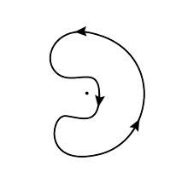
TRUE or FALSE?
The normal electric field is always continuous at a surface.
The normal magnetic field is always continuous at a surface.
3. There is a current-carrying wire coming out of the board. If we integrate along the path, we will find that the magnetic field is zero along the path.

Slide 3

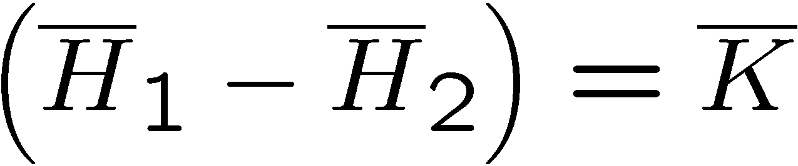

Electrostatics
Magnetostatics
+
Superposition …
Superposition …
+
+
+
+
+
+
+
+
+
The normal electric field is discontinuous across a surface charge.
The tangential magnetic field is discontinous across a surface current.

Slide 4







Electric Fields
Magnetic Fields

Slide 5


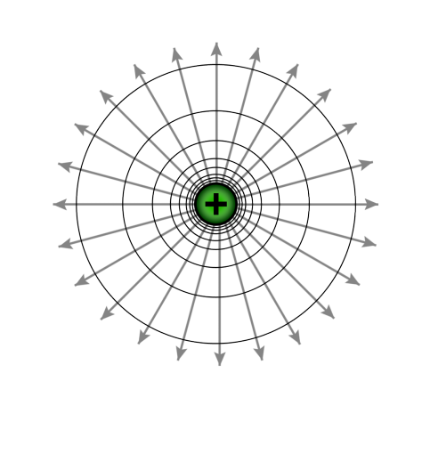
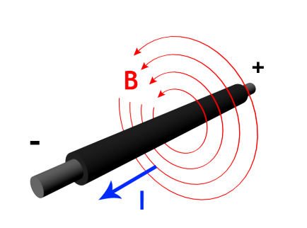
Electrostatics
Magnetostatics

Slide 6
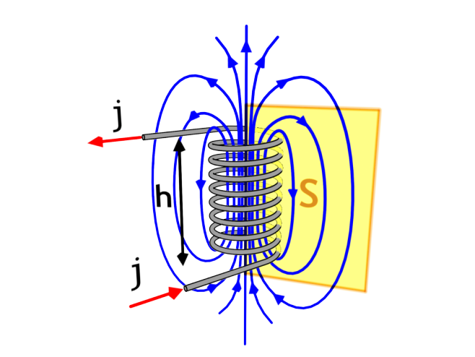

Fields from a Solenoid
NI
h
path C
The same result can be obtained using the boundary condition from Ampere’s Law with K = Ni/h

Slide 7
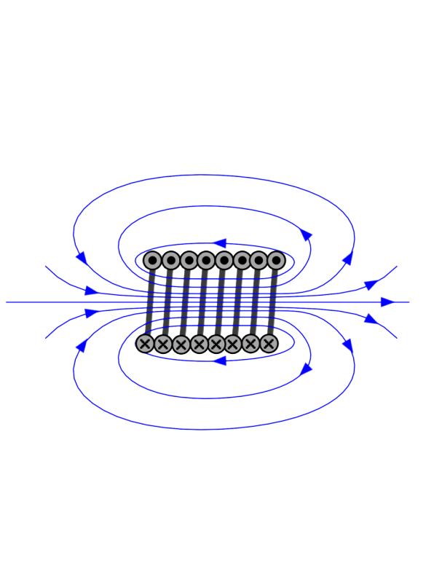
Magnetic Flux Lines
A magnetic pole sets up a magnetic field in the space around it that exerts a force on magnetic materials. The field can be visualized in terms of magnetic flux lines (similar to the lines of force of an electric field). These imaginary lines indicate the direction of the field in a given region. By convention they originate at the north pole of a magnet and form loops that end at the south pole either of the same magnet or of some other nearby magnet. The flux lines are spaced so that the number per unit area is proportional to the field strength in a given area. Thus, the lines converge near the poles, where the field is strong, and spread out as their distance from the poles increases.
A picture of these lines of induction can be made by sprinkling iron filings on a piece of paper placed over a magnet. The individual pieces of iron become magnetized by entering a magnetic field, i.e., they act like tiny magnets, lining themselves up along the lines of induction.

Slide 8
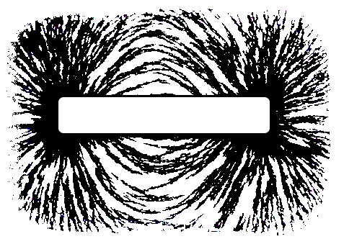
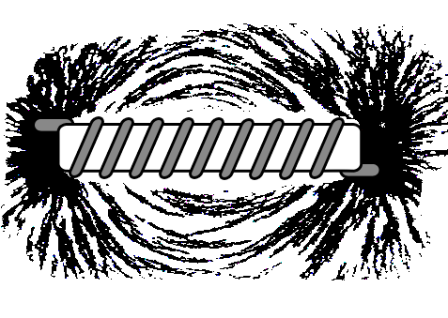
MAGNETIC FIELD OF A BAR MAGNET
Flux lines close together indicate high
magnetic flux density, B, near the poles
MAGNETIC FIELD OF A SOLENOID
We calculated the field of a long solenoid using Ampere’s law
For long solenoid:
© Source unknown. All rights reserved. This content is excluded from our Creative Commons license. For more information, see http://ocw.mit.edu/fairuse.

Slide 9
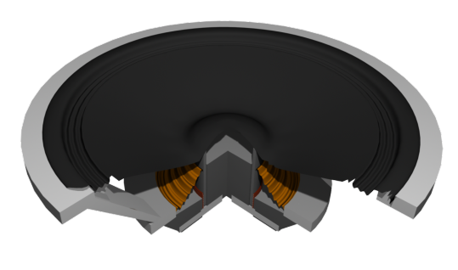
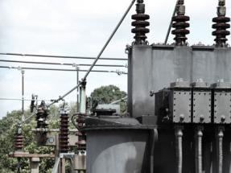
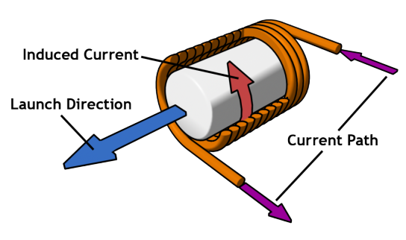
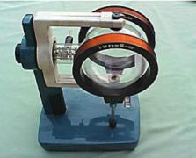
Uses of Solenoids
TRANSFORMER
SPEAKER
TUBULAR INDUCTION LAUNCHER
HELMHOLTZ COIL
Images are in the public domain

Slide 10
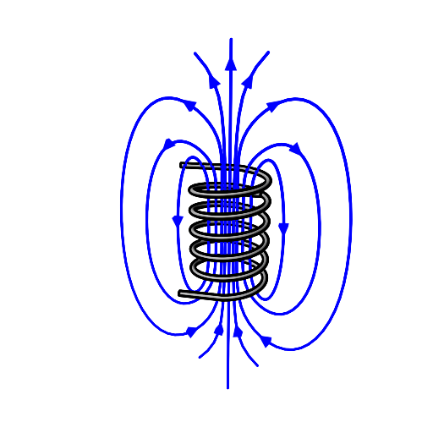
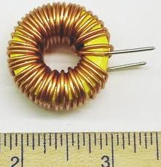
A Preview of Inductance
INDUCTOR
Cross-sectional area A →
λ = NA µ₀ Ni/h →
L = µ₀ N² A / h

Slide 11
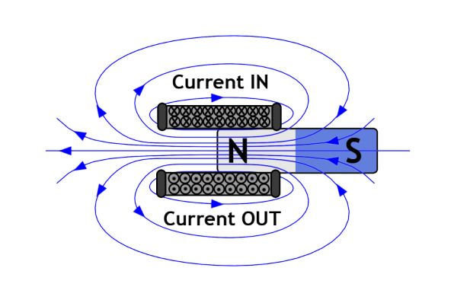
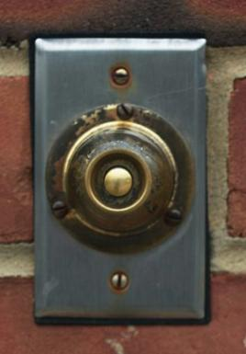
Ding Dong!
Image by takomabibelot http://www.flickr.com/photos/takomabibelo
t/3917734943/ on flickr
A 1920 explanation of a commercial solenoid used as an electromechanical actuator. Source: Wikipedia

Slide 12

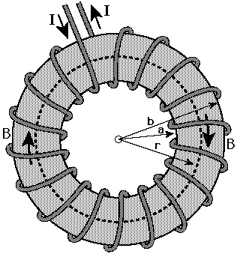
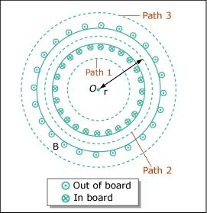

Fields from a Toroid
Image by MIT OpenCourseWare.
Path 1
Path 2
Path 3

Slide 13
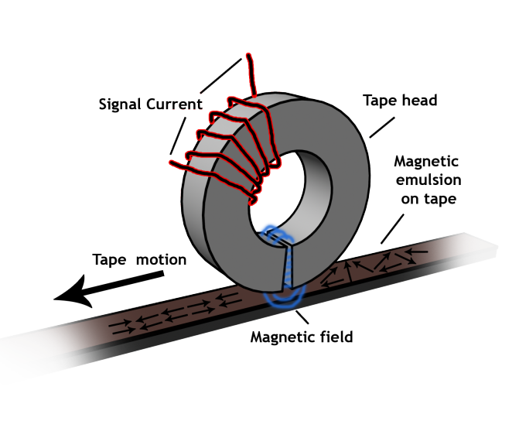
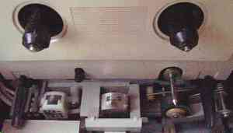
Toroids in the Living Room
© Source unknown. All rights reserved. This content is excluded from our Creative Commons license. For more information, see http://ocw.mit.edu/fairuse.

Slide 14
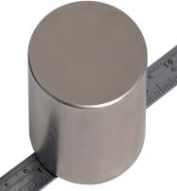

Permanent Magnets
Neodymium-Boron-Iron, Niobium–Iron–Cobalt and Samarium-Cobalt permanent magnets all produce very large magnetic fields.

Slide 15
Microscopic & Macroscopic Magnets
The current within an atom due to electron orbit creates a magnetic moment and field.
The current within an atom due to electron spin creates a magnetic moment and field.
-
-
+
-
-
-
-
-
-
+
+
+
+
+
+
Permanent magnet …
Some materials have organized/permanent magnetic moments while others do not.
-
-
-
-
-
-
+
+
+
+
+
+
-
-
-
-
-
-
+
+
+
+
+
+

Slide 16
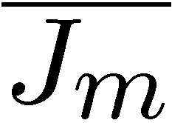

Generating Strong Magnetic Fields
Superposition with current loops…

Slide 17
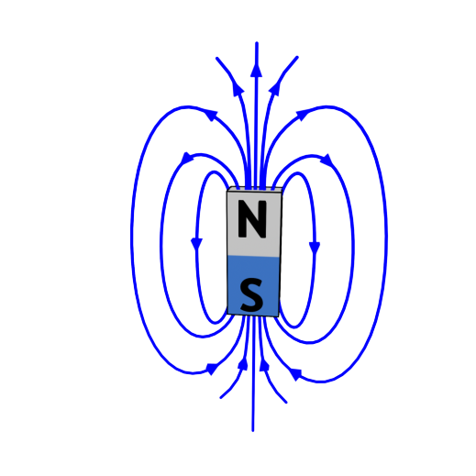
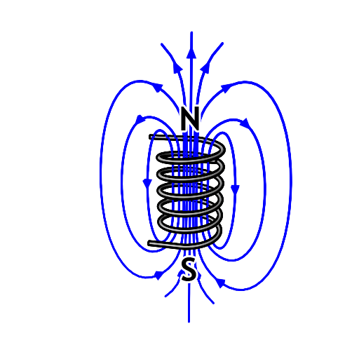
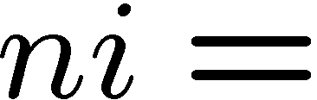
Generating Strong Magnetic Fields
Will it be “easier” to generate a 0.5-T magnetic flux density with a permanent magnet or an electromagnet ?
Why ?
B = 0.5 T = µ_{o}H
= 0.5 T = µ_{o}ni/h
7600 A

Slide 18

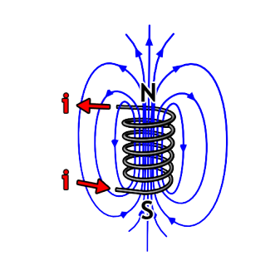
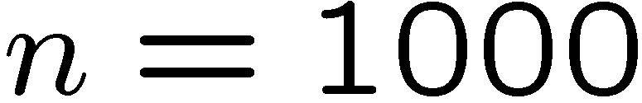
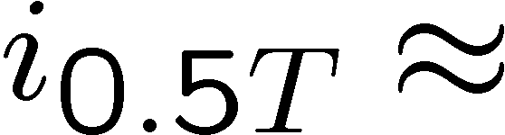
0.5 T Electromagnets
0.5 Tesla with current loop…
0.5 Tesla with 1000 turn solenoid…
7600 Amps
7.6 Amps
...but the wires are microscopic !

Slide 19
Generating Strong Magnetic Fields
Will it be “easier” to generate a 0.5-T magnetic flux density with a permanent magnet or an electromagnet ?
-
-
-
-
-
-
+
+
+
+
+
+
-
-
-
-
-
-
+
+
+
+
+
+
-
-
-
-
-
-
+
+
+
+
+
+
~3 Å
m_{atom} ≈ 10⁻²³ A·m²/atom and a_{atom} ≈ 9 Å² ≈ 10⁻¹⁹ m² so i_{atom} ≈ 10⁻⁴ A and K_{atom} ≈ 3000 A/cm !

Slide 20
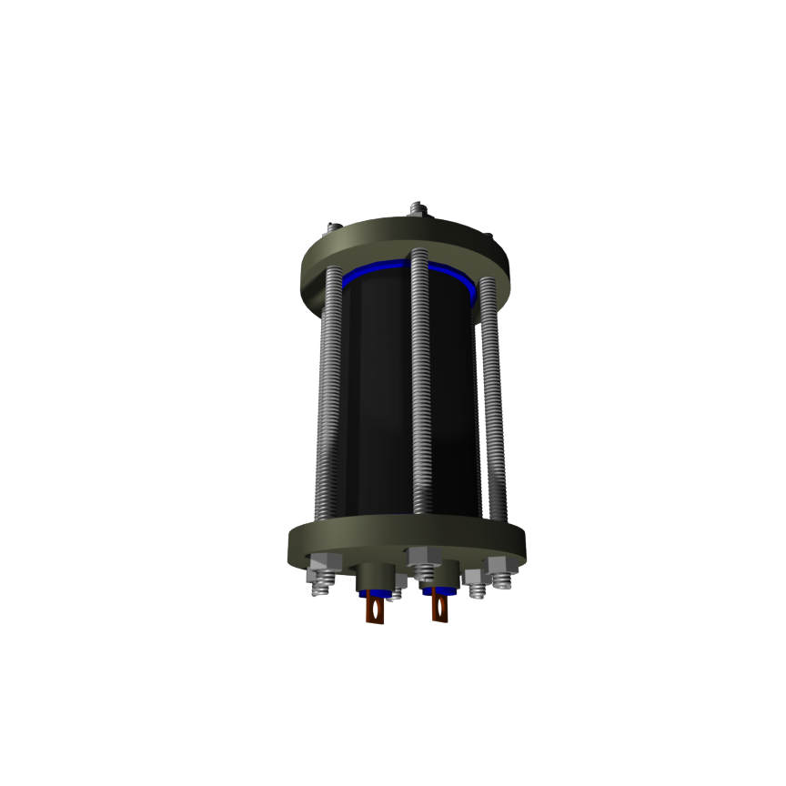
Record Breaking (Pulsed) Electromagnets
Coil consists of few turns to keep the coil inductance low
Magnet cooled to 77 K prior to pulsing increases conductivity

Slide 21
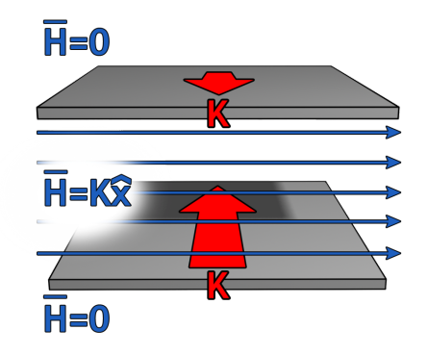
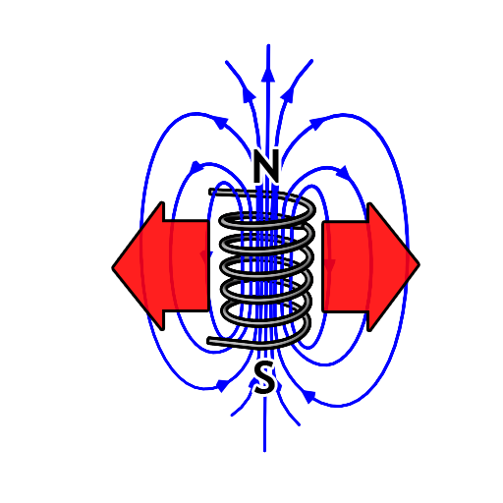
Force on Current Sheet
The force acts to
SEPARATE the plates.
Note that the direction of the force tends to increase the volume that the field is stored in.
What about forces on a solenoid ?

Slide 22
What Sets the Limit ?
1 atmosphere = 14.7 pounds per square inch
Pressure Under Water
1000 m Submarine 1000 psi
4000 m Ocean Floor Submersible 6000 psi
80-T Pulsed Magnet 200,000 psi
… exceeds the practical strength of most materials …
Strong Electromagnets Generate
HUGE Forces- this can be disastrous if not controlled!

Slide 23






Summary
Maxwell’s Equations (in Free Space with Electric Charges present):
DIFFERENTIAL FORM
INTEGRAL FORM
E-Gauss:
Faraday:
H-Gauss:
Ampere:

Slide 24
MIT OpenCourseWare
http://ocw.mit.edu
6.007 Electromagnetic Energy: From Motors to Lasers
Spring 2011
For information about citing these materials or our Terms of Use, visit: http://ocw.mit.edu/terms.

