Slide 1
Faraday’s Law (Induced emf)
Reading - Shen and Kong – Ch. 16
Outline
Magnetic Flux and Flux Linkage
Inductance
Stored Energy in the Magnetic Fields of an Inductor
Faraday’s Law and Induced Electromotive Force (emf)
Examples of Faraday’s Law

Slide 2
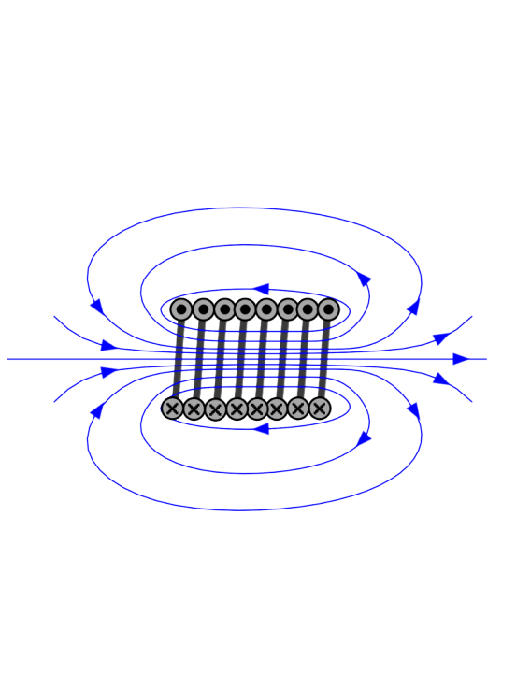
Magnetic Flux Φ [Wb] (Webers)
Magnetic Flux Density B [Wb/m²] = T (Teslas)
Magnetic Field Intensity H [Amp-turn/m]
due to macroscopic
& microscopic
due to macroscopic
currents

Slide 3
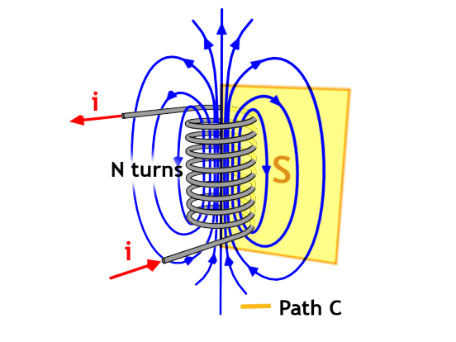
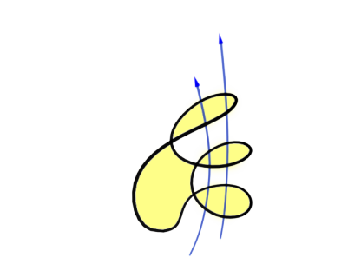
Flux Linkage of a Solenoids
FOR A SUFFICIENTLY LONG SOLENOID…
B
B = Magnetic flux density inside solenoid
A = Solenoid cross sectional area
N = Number of turns around solenoid
… flux linked by solenoid
S
In the solenoid the individual flux lines pass through the integrating surface S more than once

Slide 4
Inductors
… is a passive electrical component that stores energy in a magnetic field created by the electric current passing through it. (This is in equivalence to the energy stored in the electric field of capacitors.)
IN GENERAL:
FOR A LINEAR COIL:
The magnetic permeability of the vacuum: [henry per meter]
An inductor's ability to store magnetic energy is measured by its inductance, in units of henries. The henry (symbol: H) is named after Joseph Henry (1797–1878), the American scientist who discovered electromagnetic induction independently of and at about the same time as Michael Faraday (1791–1867) in England.
EQUIVALENCE OF UNITS:

Slide 5



Stored Energy in an Inductor
FROM 8.02:
← voltage over an inductor
If L is not a function of time …
… where E is energy stored in the field of the inductor any instant in time
FOR A LINEAR COIL:

Slide 6
Calculation of energy stored in the inductor

Slide 7


General: Stored Energy in the Coil
FROM 8.02:
← voltage over an inductor
Since then
→ Change in the magnetic flux within the inductor generates voltage
… where W_{s} is energy stored in the field of the inductor any instant in time

Slide 8
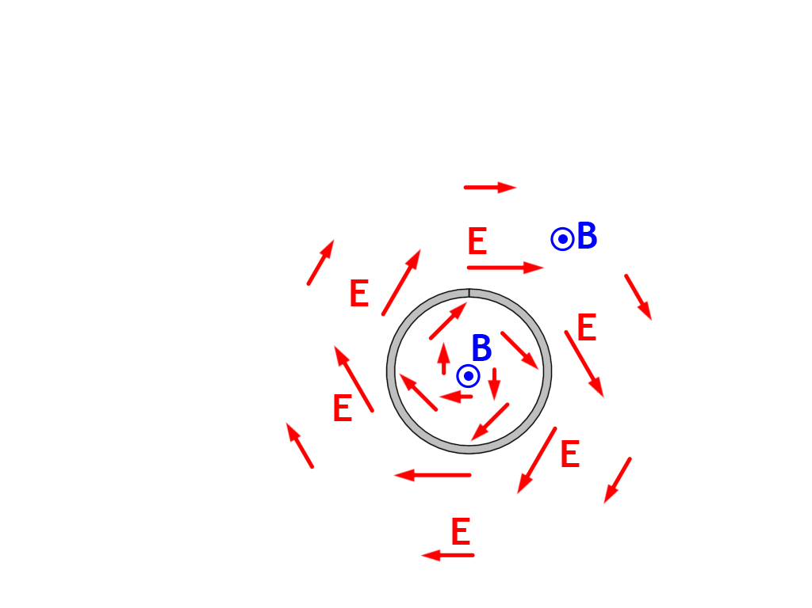
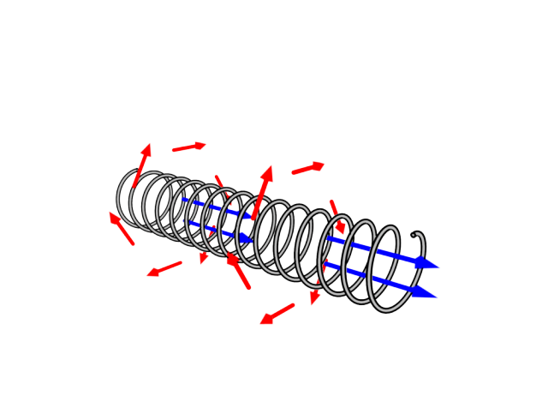
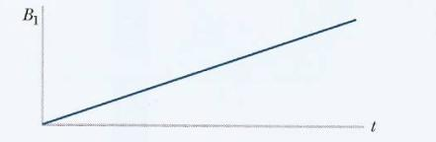
Induced electromotive force (emf)
Michael Faraday in 1831 noticed that
time-varying magnetic field produces an emf in a solenoid
from Chabay and Sherwood, Ch 22

Slide 9
THEREFORE, THERE ARE
TWO WAYS TO PRODUCE ELECTRIC FIELD
(1) Coulomb electric field is produced by electric charges according
to Coulomb’s law:
(2) Non-Coulomb electric field E_{NC}
is associated with time-varying
magnetic flux density dB/dt
For a solenoid, E_{NC}
- curls around a solenoid
- is proportional to -dB/dt through the solenoid
- decreases with 1/r, where r is the
radial distance from the solenoid axis
=0

Slide 10
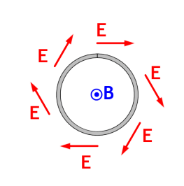
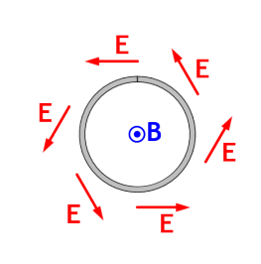
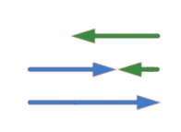
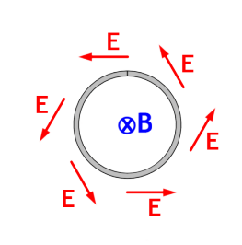
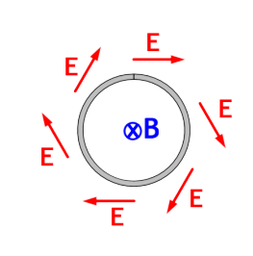
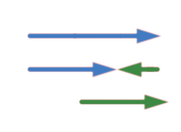
What is the Direction of Magnetically Induced
(non-Coulomb) Field, E_{NC} ?
Find the change in the magnetic flux density as a basis for determining the direction of
B out, increasing
B out, decreasing
into page
out of page
Lenz’s Rule
The induced electric field would drive the current in the direction to make the magnetic field that attempts to keep the flux constant
B in, increasing
B in, decreasing
out of page
into page

Slide 11
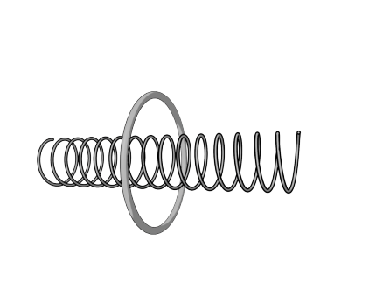
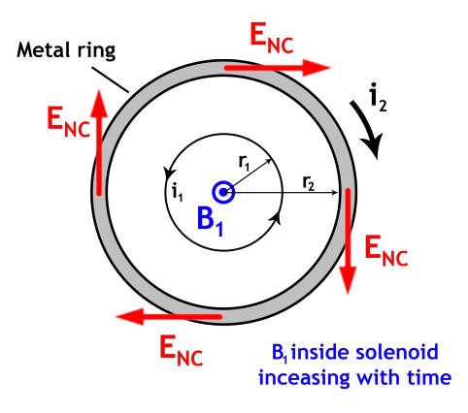
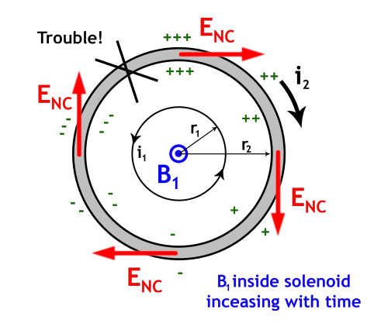
Magnetically Induced
(non-Coulomb) E_{NC}
Drives Current in a Loop Surrounding the Solenoid
METAL RING IS PLACED AROUND A SOLENOID
END VIEW: The non-Coulomb electric field drives a current I₂ in the ring
This pattern of surface charge is impossible, because it would imply
a huge E at the marked location,
and in the wrong direction !

Slide 12
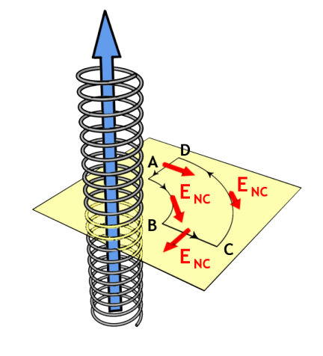
B inside solenoid increasing with time
where R is the ring resistance
Integral of E_{NC} along a path that does not encircle the solenoid is zero since E_{NC} ~ 1/r
What if we double the value of r₂ ? → Still get the same emf around the loop
emf in a ring encircling the solenoid is the same for any radius

Slide 13
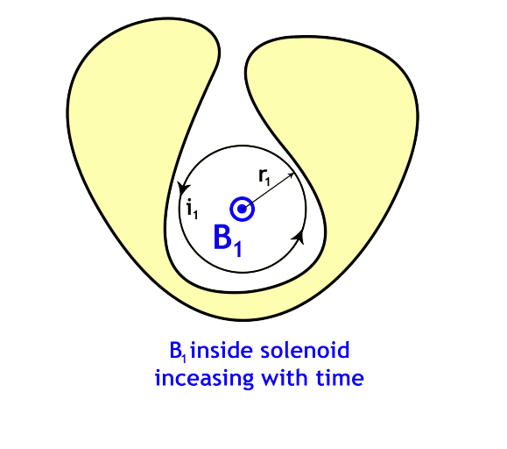
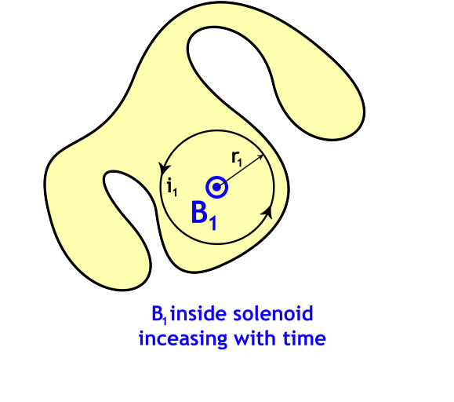
Will Current Run in these Wires ?
Wire

Slide 14
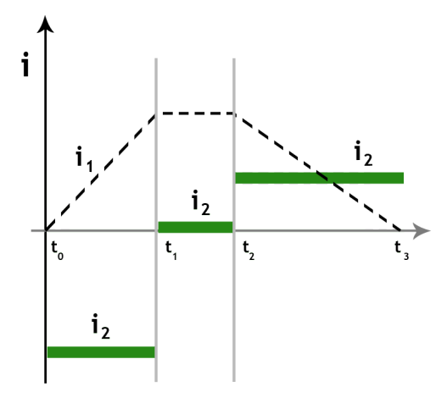
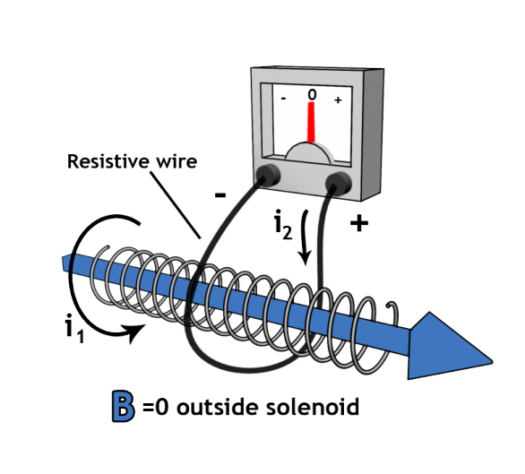
Example
An ammeter measures current in a loop surrounding the solenoid. Initially
I₁ is constant, so B₁ is constant, and
no current runs through the ammeter.
Vary the solenoid current I₁ and observe the current I₂ that runs in the outer wire, through the ammeter
from Chabay and Sherwood, Ch 22

Slide 15
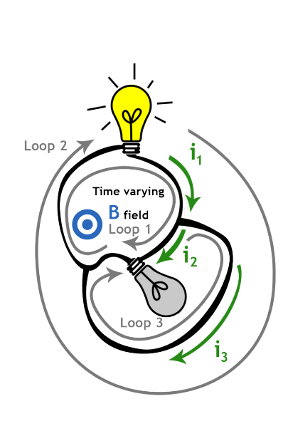
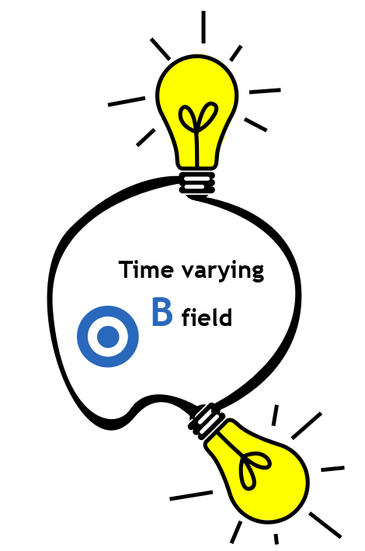
Peculiar Circuit – Two Bulbs Near a Solenoid
… Add a thick copper wire.
Loop 1: emf - R₁I₁ – R₂I₂ = 0
Loop 2: emf - R₁I₁ = 0
Loop 3: R₂I₂ = 0 (no flux enclosed)
Two light bulbs connected around a long solenoid with varying B.

Slide 16

Question:
If we use a solenoid with twice the cross-sectional area, but the same magnetic flux density (same magnitude of I₁), what is the magnitude of I₂ ?
We can build the solenoid with the larger cross-sectional area, 2*A, out of two solenoids with the initial cross-sectional area, A. Each of the smaller solenoids would induce current I₂,
so by superposition, for the twice-as-big solenoid the current would be
twice-as-big !

Slide 17




Faraday’s Law
The induced emf along a round-trIp path is equal to the rate of change of the magnetic flux on the area encircled by the path.

Slide 18
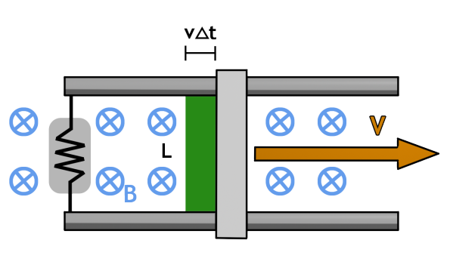
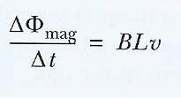
Faraday’s Law and Motional emf
What is the emf over the resistor ?
In a short time Δt the bar moves a distance Δx = v*Δt, and the flux increases by ΔФ_{mag} = B (L v*Δt)
There is an increase in flux through the circuit as the bar of length L moves to the right (orthogonal to magnetic field H) at velocity, v.

Slide 19
Terminal Voltages & Inductance
Assume:
Perfectly conducting wire
Stationary contour C
Negligible magnetic flux at the terminals
emf = dλ/dt
If the current i created the
magnetic flux density B, then
the flux linkage is given by λ = Li.
In this case, emf = L di/dt.
L is the self inductance of the coil.

Slide 20
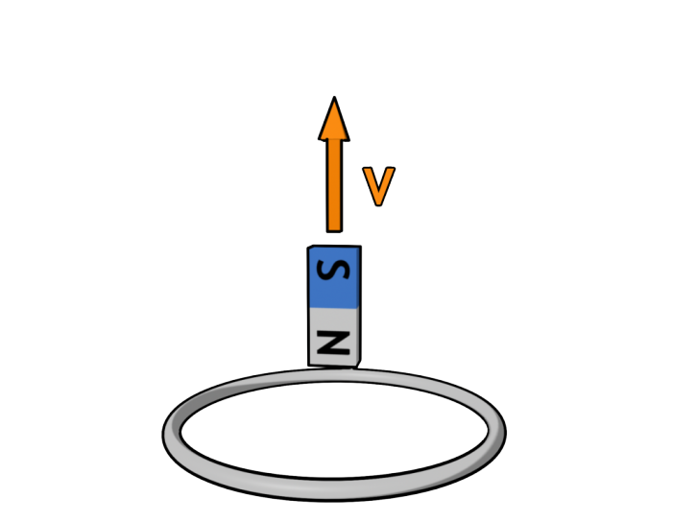

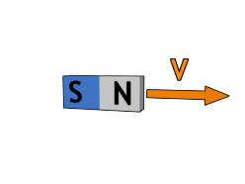
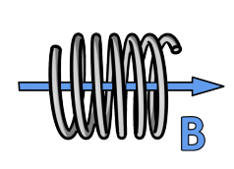
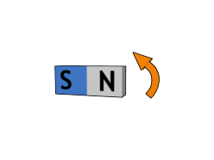
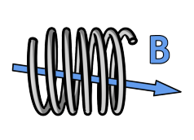
Faraday’s Law for a Coil
The induced emf in a coil of N turns is equal to
N times the rate of change of the magnetic flux on one loop of the coil.
Moving a magnet towards a coil produces a time-varying magnetic field inside the coil
Rotating a bar of magnet (or the coil) produces a time-varying magnetic field inside the coil
Will the current run
CLOCKWISE or ANTICLOCKWISE ?

Slide 21
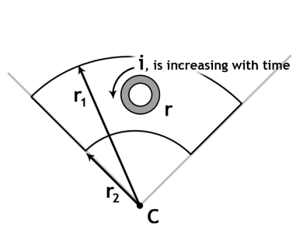
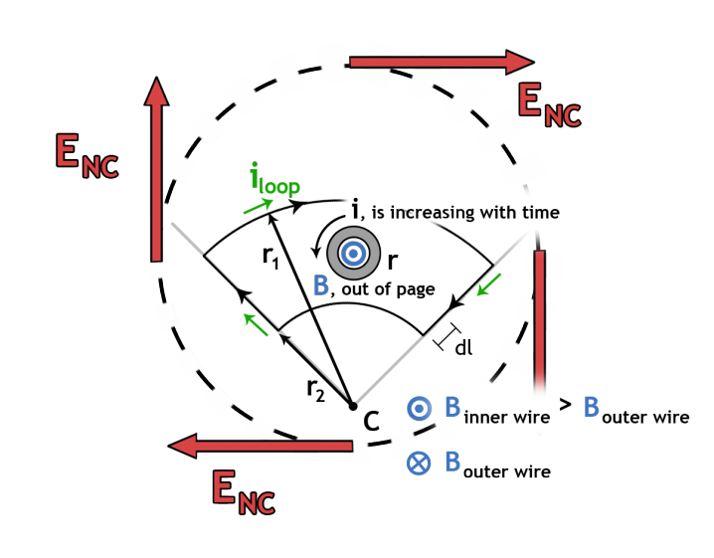
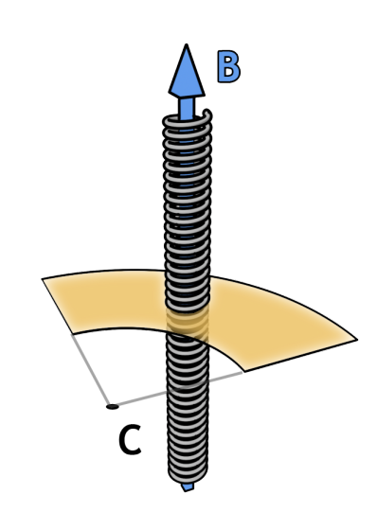
A long solenoid passes through a loop of wire…

Slide 22








Electric Fields
Magnetic Fields
GAUSS
GAUSS
FARADAY
AMPERE

Slide 23
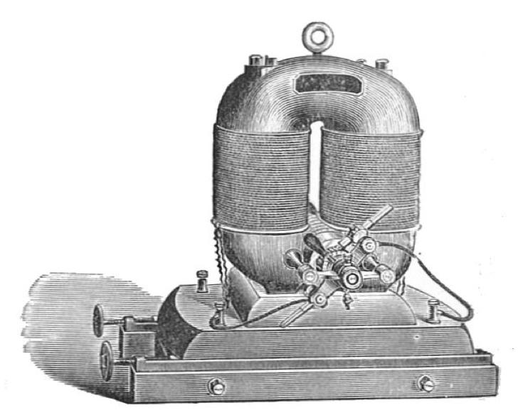
Next …
MAGNETIC MATERIALS
MAGNETIC CIRCUITS
Image is in the public domain

Slide 24
KEY TAKEAWAYS
FOR A SUFFICIENTLY LONG SOLENOID…
INDUCTANCE:
UNITS of INDUCTANCE:
ENERGY STORED in an INDUCTOR:
THERE ARE TWO WAYS TO PRODUCE ELECTRIC FIELD
Coulomb electric field is produced by electric charges according to Coulomb’s law
Non-Coulomb electric field E_{NC} is due to time-varying magnetic flux density dB/dt
Faraday’s Law: The induced emf along a round-trIp path is equal to the rate of change of the magnetic flux on the area encircled by the path.
Lenz’s Rule:
The induced electric field would drive the current in the direction to make the magnetic field that attempts to keep the flux constant

Slide 25
MIT OpenCourseWare
http://ocw.mit.edu
6.007 Electromagnetic Energy: From Motors to Lasers
Spring 2011
For information about citing these materials or our Terms of Use, visit: http://ocw.mit.edu/terms.

