Slide 1
Actuators & the Coil Gun
Outline
Review of Electrostatic Actuators
-Energy method for Electrostatics
Rail Gun
-Energy method for Magnetostatics
Coil Gun

Slide 2
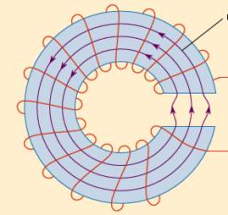
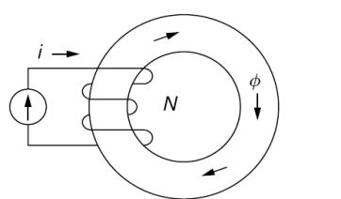
TRUE or FALSE?
Since W = ½ CV², the force always acts to decrease capacitance to go to lower energy.
If the gap is decreased, the magnetic flux will increase.
3. The energy stored in the electric field is ½ ε_{o}E² and has units of Joules.

Slide 3
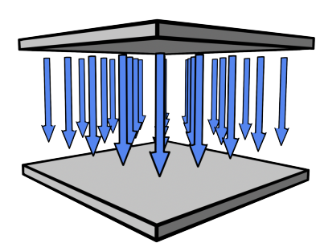
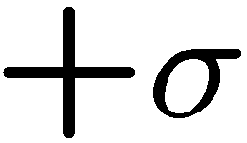





Attractive Force Between Parallel Plates
+
+
+
+
+
+
+
+
+
+
+
+
+
+
-
-
-
-
-
-
-
-
-
-
-
-
-
-
-
-
-
-
CAPACITOR PLATES ARE PULLED
TOWARDS EACH OTHER
(FORCE ACTS TO INCREASE C)

Slide 4
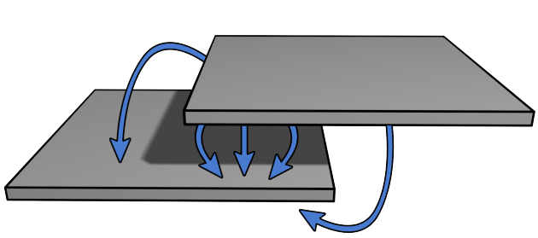




Linear Electrostatic Actuator
+
+
+
+
+
+
+
+
+
+
+
+
+
+
+
+
-
-
-
+
+
+
+
+
+
+
+
-
-
-
-
-
-
-
-
-
-
-
-
-
-
-
-
-
-
-
-
-
-
-
CONSTANT FORCE ALONG DIRECTION OF MOTION
(FORCE ACTS TO INCREASE C)

Slide 5



Gap Closing Electrostatic Actuators
Moderate force
Weak force

Slide 6
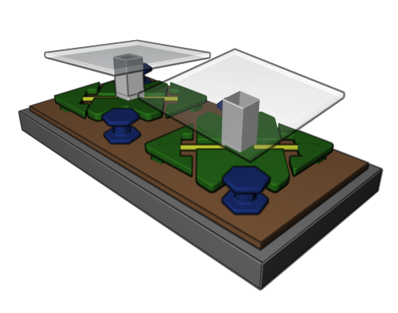
MEMS Actuator Mirror
Hinges
Yoke
Landing Tip

Slide 7
Rail Gun Force … Using Energy Conservation
Perfectly conducting plates and slider
Depth
… one-turn solenoid

Slide 8
Rail Gun Force -Energy Conservation Again
Perfectly conducting plates and slider
Depth
(Recall that )
… (Keep constant)

Slide 9
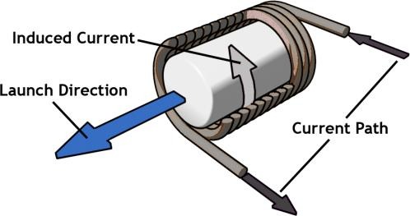
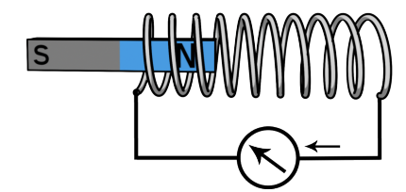
Coil Gun
How can we use a solenoid to propel a “bullet” if the force is always into the solenoid?
Our Plan: Two magnets repel
(or attract). We should be able to get a coil to repel a magnet !

Slide 10
Consider this energy model:
  ‘Back voltage’ v is due to motion
+
-
Then, force is simply:
Some caution here: this is the force due to the interaction with the coil -- It doesn’t mean there may not be other forces!
To find back voltage: run the system open circuited
This will give the right back voltage; If you know how fast the magnet is going, you get flux change
+
+
-
-

Slide 11
Coil with Permanent Magnet
Instantaneous force on the magnet…

Slide 12

Key Takeaways
Energy method for calculating Forces
calculated at constant flux linkage
Coil Gun
Force acts to increase Capacitance
Moderate force
Weak force

Slide 13
MIT OpenCourseWare
http://ocw.mit.edu
6.007 Electromagnetic Energy: From Motors to Lasers
Spring 2011
For information about citing these materials or our Terms of Use, visit: http://ocw.mit.edu/terms.

