Slide 1
Tunneling Applications
Outline
Barrier Reflection and Penetration
Electron Conduction
Scanning Tunneling Microscopy
Flash Memory

Slide 2






Reflection of EM Waves and QM Waves
Then for optical material when μ=μ₀:
= probability of a particular
photon being reflected
= probability of a particular
electron being reflected

Slide 3
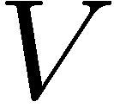
Quantum Tunneling Through a Thin Potential Barrier
Total Reflection at Boundary
Frustrated Total Reflection (Tunneling)
2a = L

Slide 4

A Rectangular
Potential Step
CASE II : E_{o} < V
Region 1
Region 2
Region 3
In Regions 1 and 3:
In Region 2:
for E_{o} < V :

Slide 5


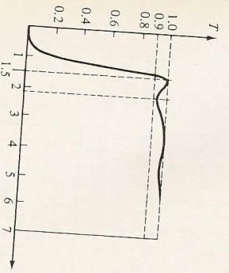
A Rectangular
Potential Step
2a = L
Real part of Ψ for E_{o} < V, shows hyperbolic (exponential) decay in the barrier domain and decrease in amplitude of the transmitted wave.
x=0
x=L
for E_{o} < V :
Transmission Coefficient versus E_{o}/V
for barrier with
Tunneling Applet: http://www.colorado.edu/physics/phet/dev/quantum-tunneling/1.07.00/

Slide 6
Imagine the Roller Coaster ...
Normally, the car can only get as far as B,
before it falls back again
But a fluctuation in energy could get it over the barrier to E!
A particle ‘borrows’ an energy ΔE to get over a barrier
Does not violate the uncertainty principle,
provided this energy is repaid within a certain time Δt
Start position with zero speed
B
A

Slide 7
Example: Barrier Tunneling
Let’s consider a tunneling problem:
  An electron with a total energy of E_{o}= 6 eV approaches a potential barrier with a height of
  V₀ = 12 eV. If the width of the barrier is
  L = 0.18 nm, what is the probability that the electron will tunnel through the barrier?
V₀
E_{o}
metal
metal
0
L
air
gap
x
Question: What will T be if we double the width of the gap?
Notes:
7
Answer: With twice the thickness, the exponential factor comes in twice. Therefore, T = 4(0.011)^2 =0.05%

Slide 8
Multiple Choice Questions
Consider a particle tunneling through a barrier:
1. Which of the following will increase the
likelihood of tunneling?
a. decrease the height of the barrier
b. decrease the width of the barrier
c. decrease the mass of the particle
2. What is the energy of the particles that have successfully “escaped”?
a. < initial energy
b. = initial energy
c. > initial energy
V
E_{o}
0
L
x
Although the amplitude of the wave is smaller after the barrier, no energy is lost in the tunneling process

Slide 9
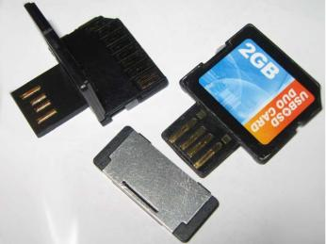
Flash Memory
Stored Electrons
Erased
“1”
Programmed
“0”
Image is in the public domain
CONTROL GATE
Insulating Dielectric
Floating Gate
Tunnel Oxide
FLOATING GATE
SOURCE
DRAIN
CHANNEL
Channel
Substrate
Electrons tunnel preferentially when a voltage is applied

Slide 10
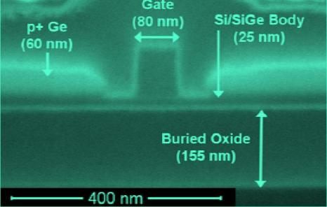
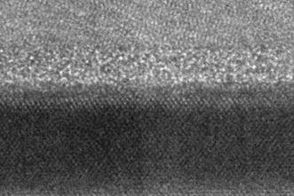
MOSFET: Transistor in a Nutshell
Conduction electron flow
Control Gate
Conducting Channel
Semiconductor
Image courtesy of J. Hoyt Group, EECS, MIT.
Photo by L. Gomez
Image courtesy of J. Hoyt Group, EECS, MIT.
Photo by L. Gomez
Tunneling causes thin insulating layers to become leaky !
Image is in the public domain

Slide 11
Reading Flash Memory
UNPROGRAMMED
PROGRAMMED
CONTROL GATE
CONTROL GATE
FLOATING GATE
FLOATING GATE
SILICON
To obtain the same channel charge, the programmed gate needs a higher control-gate voltage than the unprogrammed gate
How do we WRITE Flash Memory ?

Slide 12
Reading Flash Memory
Reading a bit means:
1. Apply V_{read} on the control gate
2. Measure drain current I_{d} of the floating-gate transistors

Slide 13
Erasing Flash Memory
Fowler-Nordheim tunneling
Direct tunneling
Effective thickness decreases with voltage…

Slide 14
Flash Memory
Holding Information
Erasing Information
V₀
E_{o}
E_{o}
channel
channel
floating gate
floating gate
oxide
barrier
oxide
barrier
0
L
x
x
Retention = the ability to hold on to the charge
Effective thickness
of the tunneling barrier
decreases, as the applied voltage
bends the potential energy levels
Tunnel oxide thickness | Time for 20% charge loss
4.5 nm | 4.4 minutes
5 nm | 1 day
6 nm | ½ - 6 years
7-8 nm oxide thickness is the bare minimum, so that the flash memory chip
can retain charge in the floating gates for at least 20 years

Slide 15
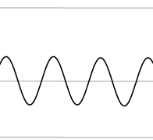

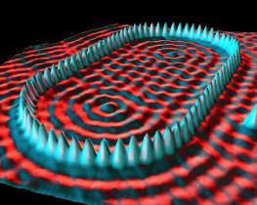
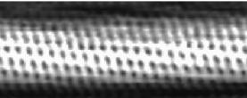
Application of Tunneling:
Scanning Tunneling Microscopy (STM)
Due to the quantum effect of “barrier penetration,” the electron density of a material extends beyond its surface:
One can exploit this to measure the electron density on a material’s surface:
material
STM tip
~ 1 nm
material
STM tip
Sodium atoms
on metal:
E₀
V
Single walled
carbon nanotube:
STM images
Image originally created
by IBM Corporation
© IBM Corporation. All rights reserved. This content is excluded from our Creative Commons license. For more information, see http://ocw.mit.edu/fairuse.
Image is in the public domain
Notes:
15
http://www.quantum-physics.polytechnique.fr/en/ -- wave mechanics – scanning tunneling microscope

Slide 16
Leaky Particles
Due to “barrier penetration”, the electron density of a metal
actually extends outside the surface of the metal !
E_{VACUUM}
Work
function Φ
E_{FERMI}
Occupied levels
x
x
x = 0
x = 0
  Assume that the work function (i.e., the energy difference between the most energetic conduction electrons and the potential barrier at the surface) of a certain metal is Φ = 5 eV. Estimate the distance x outside the surface of the metal at which the electron probability density drops to 1/1000 of that just inside the metal.
(Note: in previous slides the thickness of the potential barrier was defined as x = 2a)
using

Slide 17
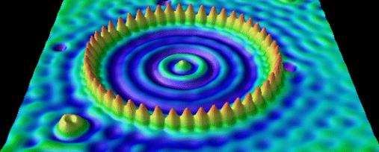
Application: Scanning Tunneling Microscopy
Metal
Metal
Vacuum
Vacuum
Second Metal
Piezoelectric Tube
With Electrodes
Tunneling
Current Amplifier
Tip
Sample
Tunneling
Voltage
Image originally created by IBM Corporation.
© IBM Corporation. All rights reserved. This content is excluded from our Creative Commons license. For more information, see http://ocw.mit.edu/fairuse.
Notes:
http://www.quantum-physics.polytechnique.fr/en/ -- wave mechanics – scanning tunneling microscope

Slide 18
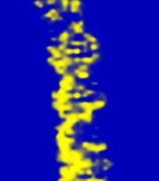
Application of Tunneling:
Scanning Tunneling Microscopy (STM)
Due to the quantum effect of “barrier penetration,” the electron density of a material extends beyond its surface:
One can exploit this to measure the electron density on a material’s surface:
material
STM tip
~ 1 nm
material
STM tip
Sodium atoms
on metal:
DNA Double Helix:
E₀
V
STM images
Image originally created
by IBM Corporation.
Image by Wolfgang Schonert
of GSI Biophysics Research Group
© IBM Corporation. All rights reserved. This content is excluded from our Creative Commons license. For more information, see http://ocw.mit.edu/fairuse.
Courtesy of Wolfgang Schonert,
GSI. Used with permission.
Notes:
18
http://www.quantum-physics.polytechnique.fr/en/ -- wave mechanics – scanning tunneling microscope

Slide 19
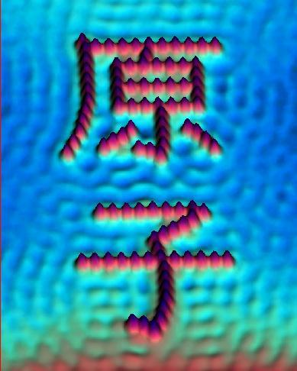
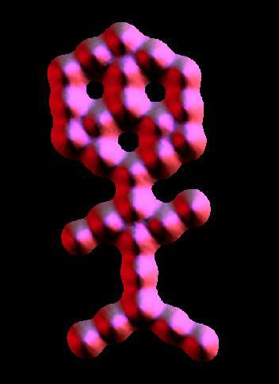
“PRIMITIVE
or PLAIN”
“CHILD”
= “ATOM”
Images originally created by IBM Corporation.
© IBM Corporation. All rights reserved. This content is excluded from our Creative Commons license. For more information, see http://ocw.mit.edu/fairuse.

Slide 20
Example: Al wire contacts
E(x)
V₀
“Everyday” problem:
  You’re putting the electrical wiring in your new house, and you’re considering using Aluminum wiring, which is cheap and a good conductor. However, you also know that aluminum tends to form an oxide surface layer (Al₂O₃) which can be as much as several nanometers thick.
10 eV
E_{o}
outlet
contact
Al wire
0
L
x
This oxide layer could cause a problem in making electrical contacts with outlets, for example, since it presents a barrier of roughly 10 eV to the flow of electrons in and out of the Al wire.
  Your requirement is that your transmission coefficient across any contact must be T > 10⁻¹⁰, or else the resistance will be too high for the high currents you’re using, causing a fire risk.
  Should you use aluminum wiring or not?
Compute L:
Oxide is thicker than this, so go with Cu wiring! (Al wiring in houses is illegal for this reason)

Slide 21
Tunneling and Electrical Conduction
Squeezing a material can reduce the width of the tunneling barrier and turn an ‘insulator’ into a ‘metal’
4
Si
Ge
2
V₀
E_{o}
metal
metal
log(resistivity)
0
L
Polymer
gap
x
0
-2
0
200
400
Pressure (kbar)

Slide 22
Key Takeaways
FOR EXAMPLE:
V₀
E_{o}
metal
metal
0
L
x
air
gap

Slide 23
MIT OpenCourseWare
http://ocw.mit.edu
6.007 Electromagnetic Energy: From Motors to Lasers
Spring 2011
For information about citing these materials or our Terms of Use, visit: http://ocw.mit.edu/terms.

